Slide 1
welcome screen

Slide 2
gathering device settings

Slide 3
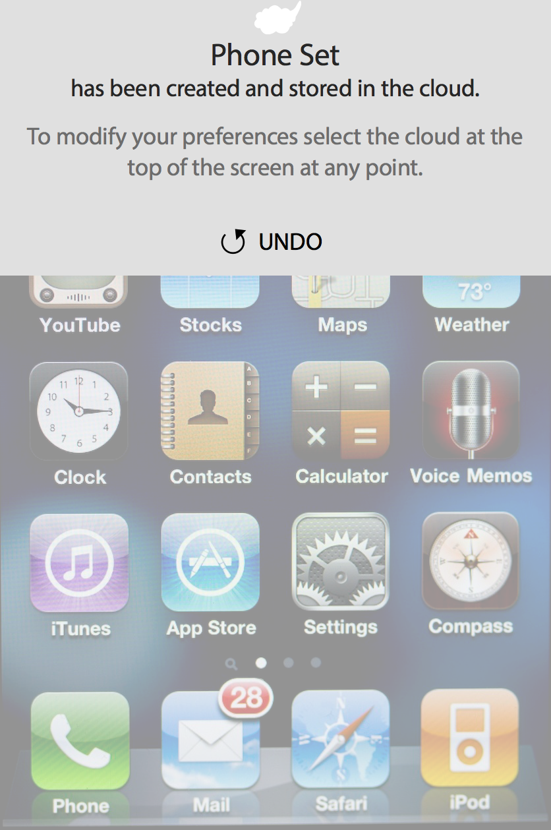
Touch anywhere on the device screen to exit PCP

Slide 4
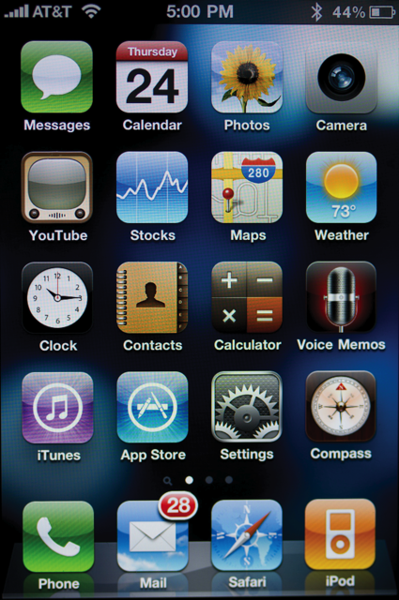
device content (phone set)
Touch the cloud to edit preferences

Slide 5
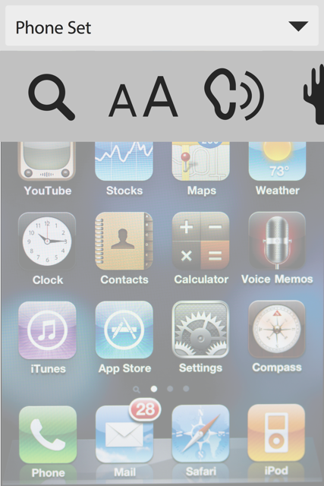
PCP is opened
Phone Set is active and indicated in upper left
Select drop-down to open Preference Set menu.

Slide 6
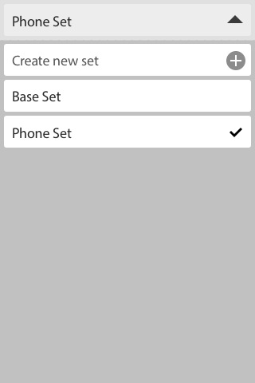
Settings list
Preference Set menu shows list of available preference sets
Select Base Set

Slide 7
applying base set

Slide 8
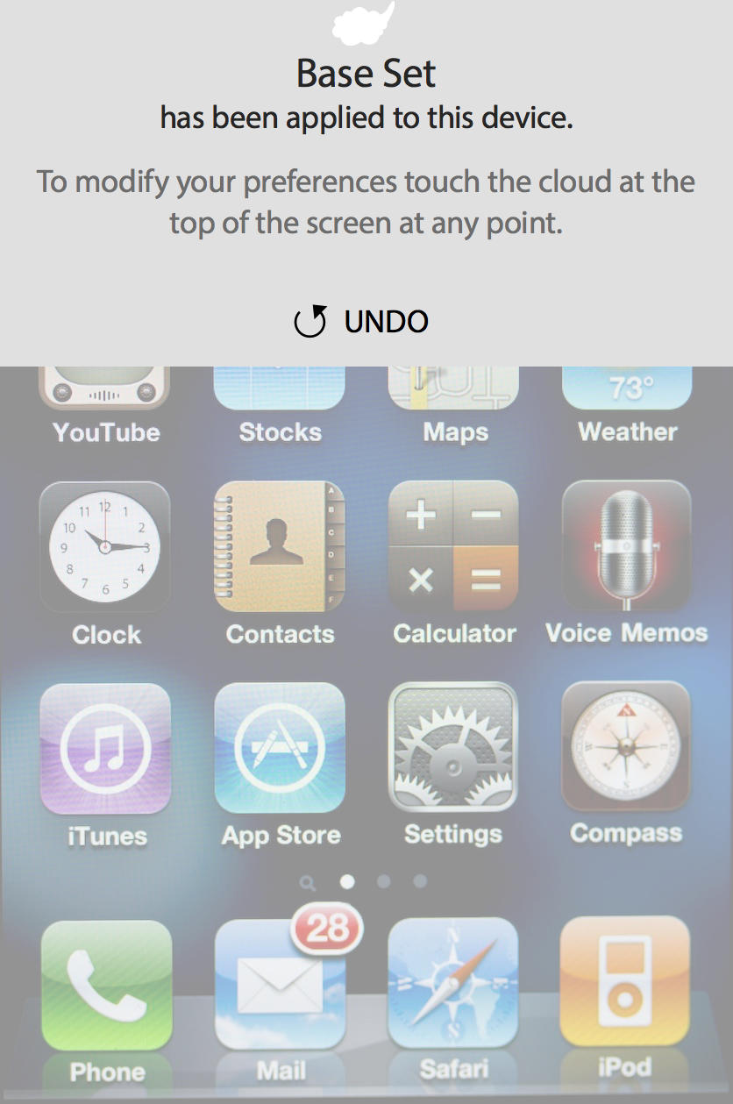
base set created
Touch anywhere on the device screen to exit PCP

Slide 9
device content (phone set)
RETURN TO WELCOME SCREEN

