Slide 1
welcome screen

Slide 2
gathering device settings

Slide 3
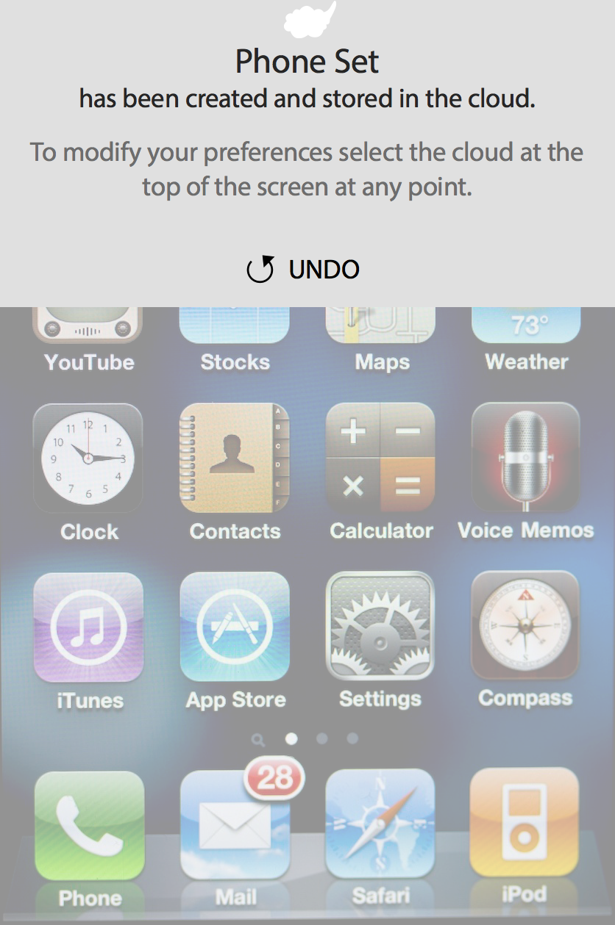
phone set created
Touch anywhere on the device screen to exit PCP

Slide 4
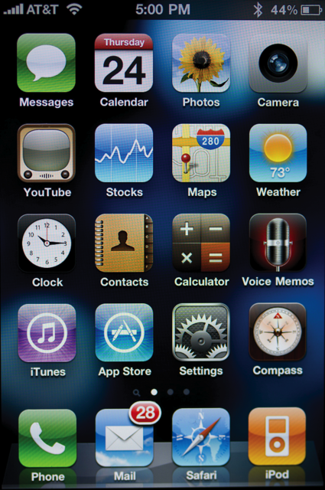
device content (phone set)
Touch the cloud to edit preferences

Slide 5
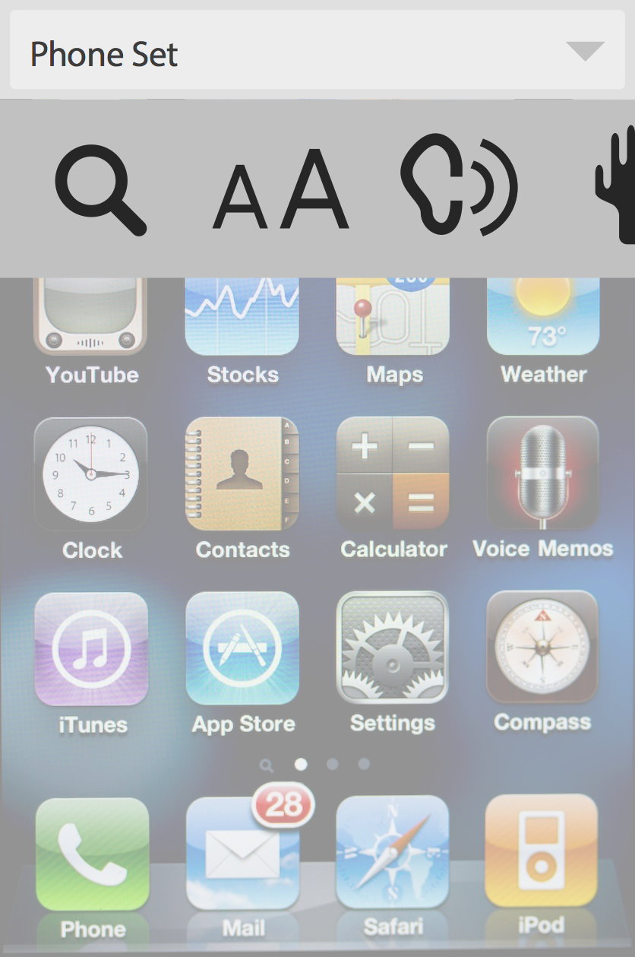
text size adjusted (Phone Set)
Select the icon to search for a setting

Slide 6
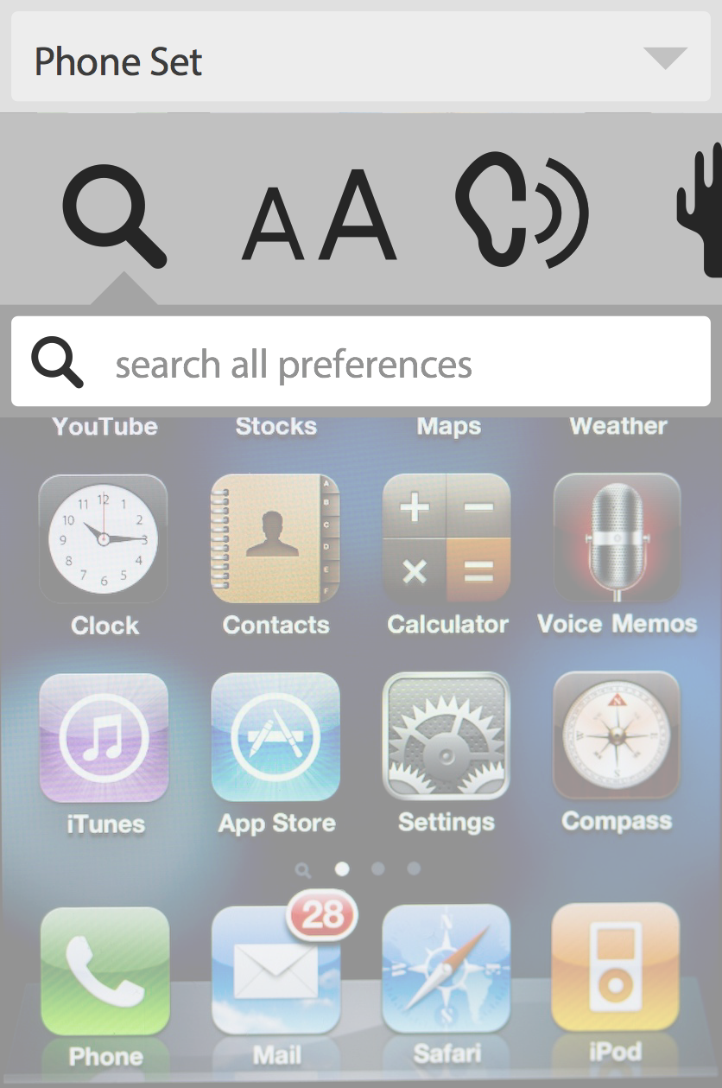
text size adjusted (Phone Set)

Slide 7
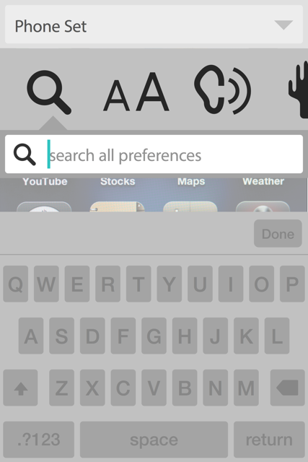
Keypad Search
(Phone Set)
Enter search term

Slide 8
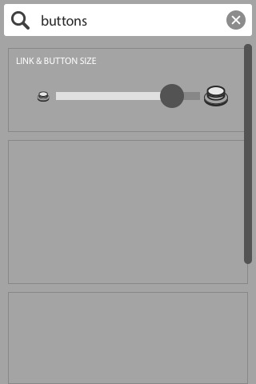
Keypad Search
(Phone Set)
RETURN TO BEGINNING OF DEMO

