Slide 1
welcome screen

Slide 2
applying base set

Slide 3
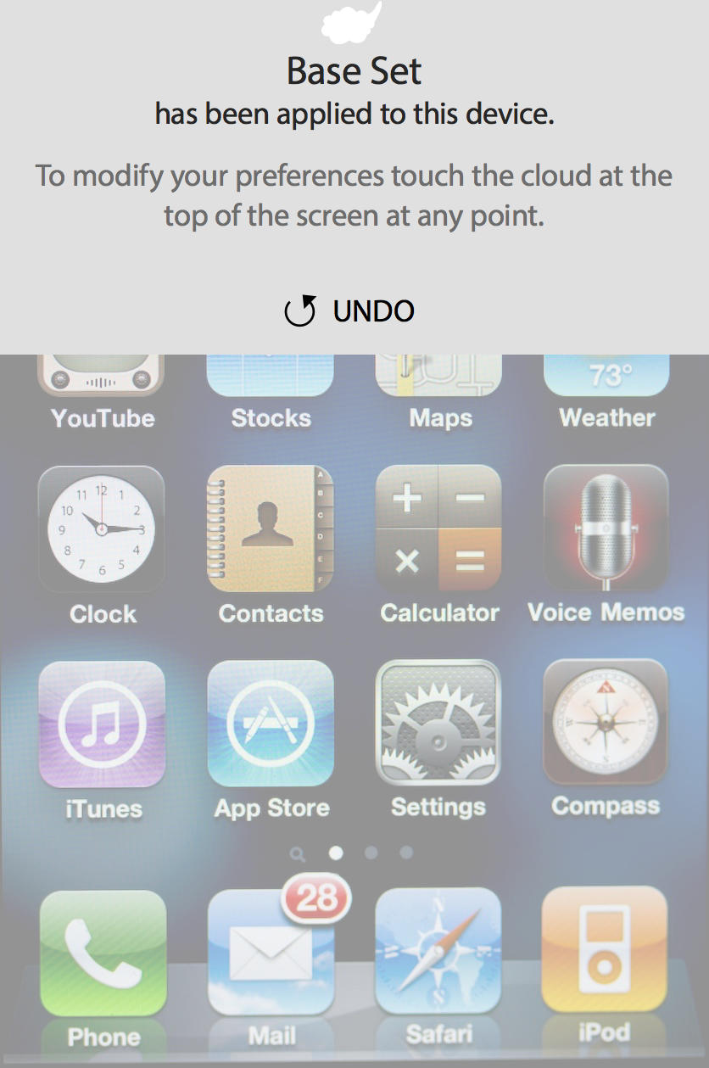
base set created
Touch anywhere on the device screen to exit PCP

Slide 4
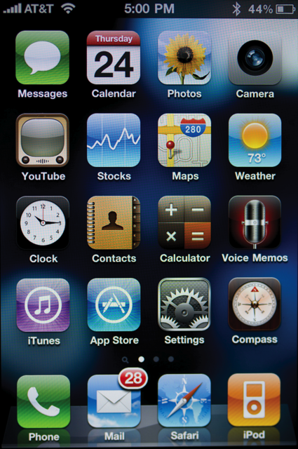
device content (phone set)
Touch the cloud to edit preferences

Slide 5
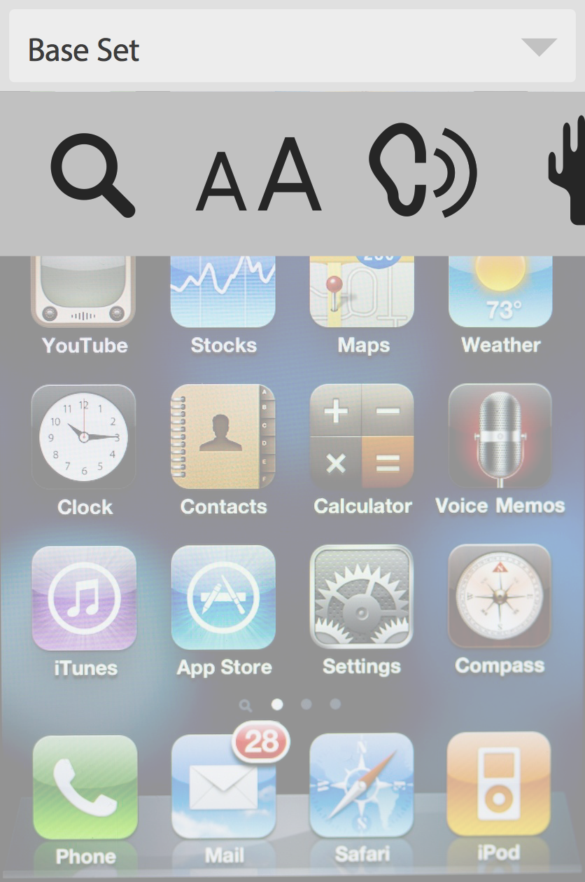
PCP opened (Phone Set)
Active set is indicated at top left.
Select icon to increase size of content

Slide 6
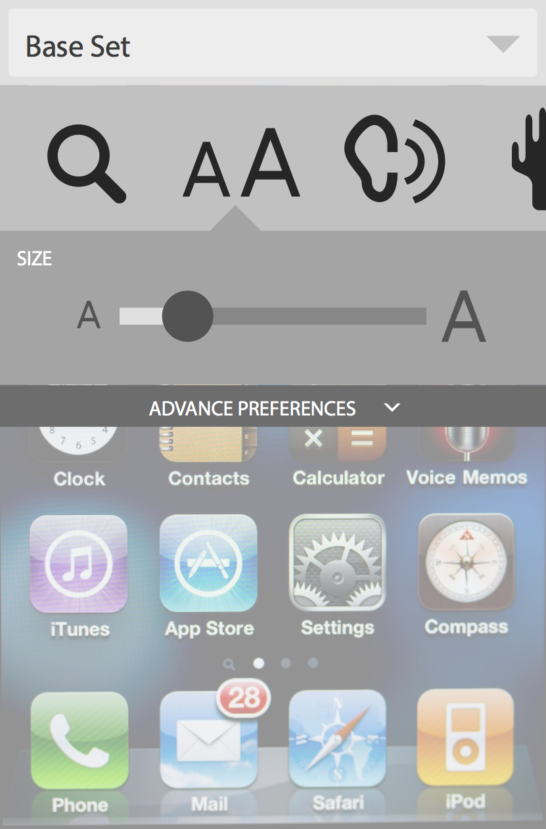
adjust text size (Phone Set)
Adjust slider to increase content size

Slide 7
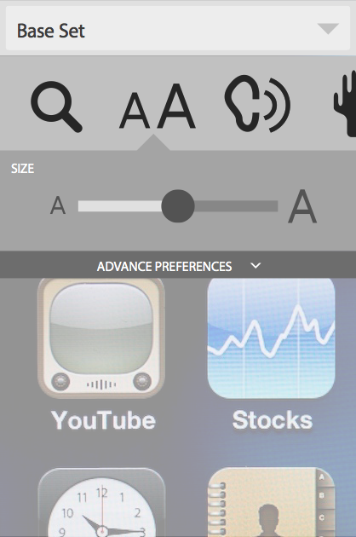
text size adjusted (Phone Set)
Explore advanced preferences related to size

Slide 8
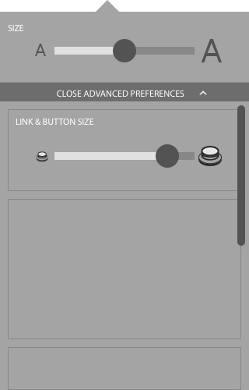
open advance prefs – button size
Decide not to make any changes, close advanced preferences

Slide 9
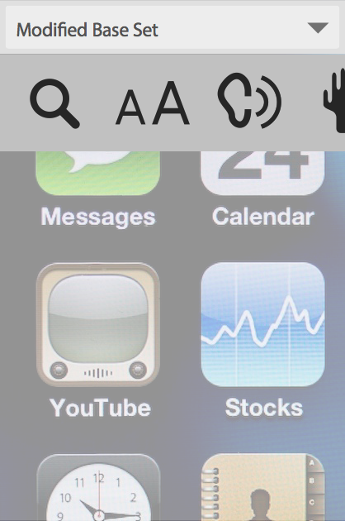
text size adjusted (Phone Set)
Modified Base Set is now indicated in upper left
Select device screen to exit PCP

Slide 10
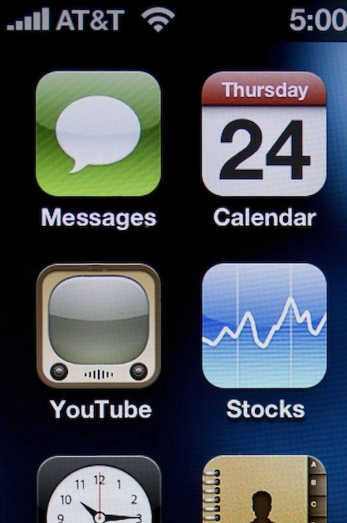
device content (phone set)
Touch the cloud to edit preferences

Slide 11
text size adjusted (Phone Set)
Modified Base Set remains active and is indicated in upper left
Select drop-down to open Preference Set menu

Slide 12
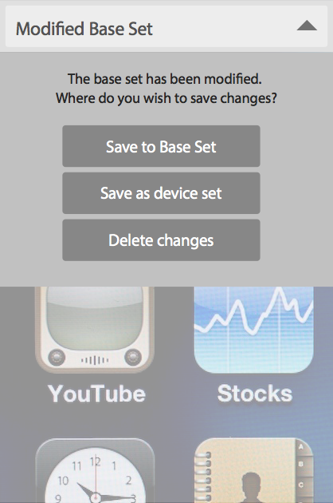
text size adjusted (Phone Set)
Because the Base Set has been modified, the user is prompted to save before they can access the Preference Set menu.
RETURN TO BEGINNING OF DEMO

