Slide 1
The Question Concerning Style
A response to Basman and Tchernavskij’s “Escaping the Prison of Style”
Colin Clark
Associate Director, Inclusive Design Research Centre
OCAD University

Slide 2
What is style?

Slide 3
“Omit needless words.” - Strunk & White
Notes:
Style as elementary rules, principles, and matters of form

Slide 4
“Use variable names that mean something.” – Kernighan & Plauger
Notes:
Style as elementary rules, principles, and matters of form

Slide 5
“Programming style is what results from writing programs under a set of constraints” – Lopes, Exercises in Programming Style
Notes:
Style as elementary rules, principles, and matters of form

Slide 6
“”
– Basman and Tchernavskij, “Escaping the Prison of Style”
Notes:
Style as elementary rules, principles, and matters of form

Slide 7
The Style Culture Industry
Notes:
Adorno’s idea of the industrialization of art and music—the culture industry—points out how as artworks become commodified, styles become standardized and exchangeable. That is to say that styles become uncoupled from their histories, contexts, and indeed for the opportunity to genuinely change—an endless parade of the same old presented as new.

Slide 8
– Lopes, presentation about Exercises in Programming Style

Slide 9
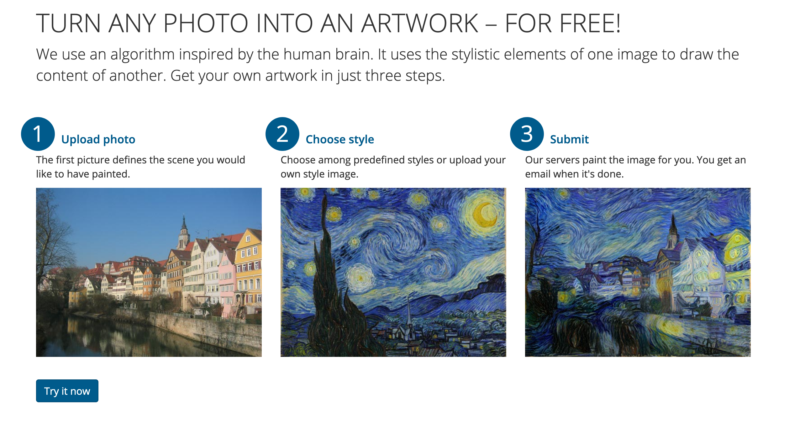
deepart.io
Notes:
The instrumentalization of style

Slide 10
“Raymond Queneau wrote a jewel of a book with the title Exercises in Style, featuring 99 renditions of the exact same story, each written in a different style. The book is a masterpiece of writing technique, as it illustrates the many different ways a story can be told. The story being fairly trivial and always the same, the book shines the spotlight on form, rather than on content.” – Crista Lopes, Exercises in Programming Style
Notes:
Lopes proceeds to link this to her own design to teach undergraduate programmers about different styles of programming.

Slide 11
“Variations, proliferated almost to infinity.” – Queneau himself
Notes:
Inspired by Bach’s Art of Fugue, writing in context of Italo Calvino and Harry Matthews and others…

Slide 12
Queneau’s book is a work of art in which his explicit foregrounding of style embodies a critique of the form/content dichotomy. It’s a work full of reference and relation, created in the experimental artistic context of ‘60s France, connected with communities of collaborating artists—Oulipo, Dada, and Fluxus. It’s not simply a pedagogical text or a catalogue of forms.

Slide 13
“Independent of their origin, constraints are the seeds of style… we can write a variety of programs that are virtually identical in terms of what they do, but that are radically different in terms of how they do it. – Crista Lopes, Elements of Programming Style

Slide 14
Style, here, has been conceptualized as a purely technical quality. Like so much in computation, it has been instrumentalized.

Slide 15
Instrumentalization fails to recognize two essential qualities of style: 1. stylistic form is entangled with content 2. styles have histories and places

Slide 16
“The expression expresses something, but this something does not exist without its expression.” – Gilles Deleuze, What is Grounding?

Slide 17
Abstract, generalized, higher order, universal—this is the ideology of computation.
Notes:
Marcel yesterday referred to a paradigm as “that which we don’t think about,” and I think this is right

Slide 18
To think without history, without place, is do a kind of violence.

Slide 19
Styles can’t simply be treated as exchangeable commodities.

Slide 20
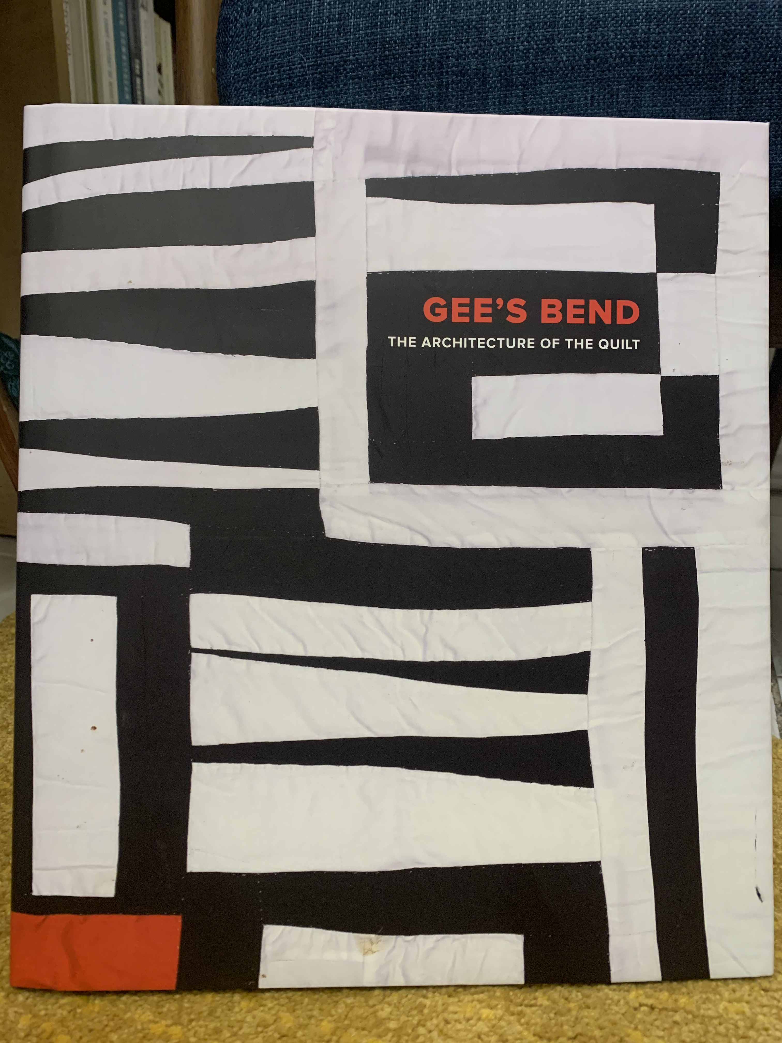

Slide 22
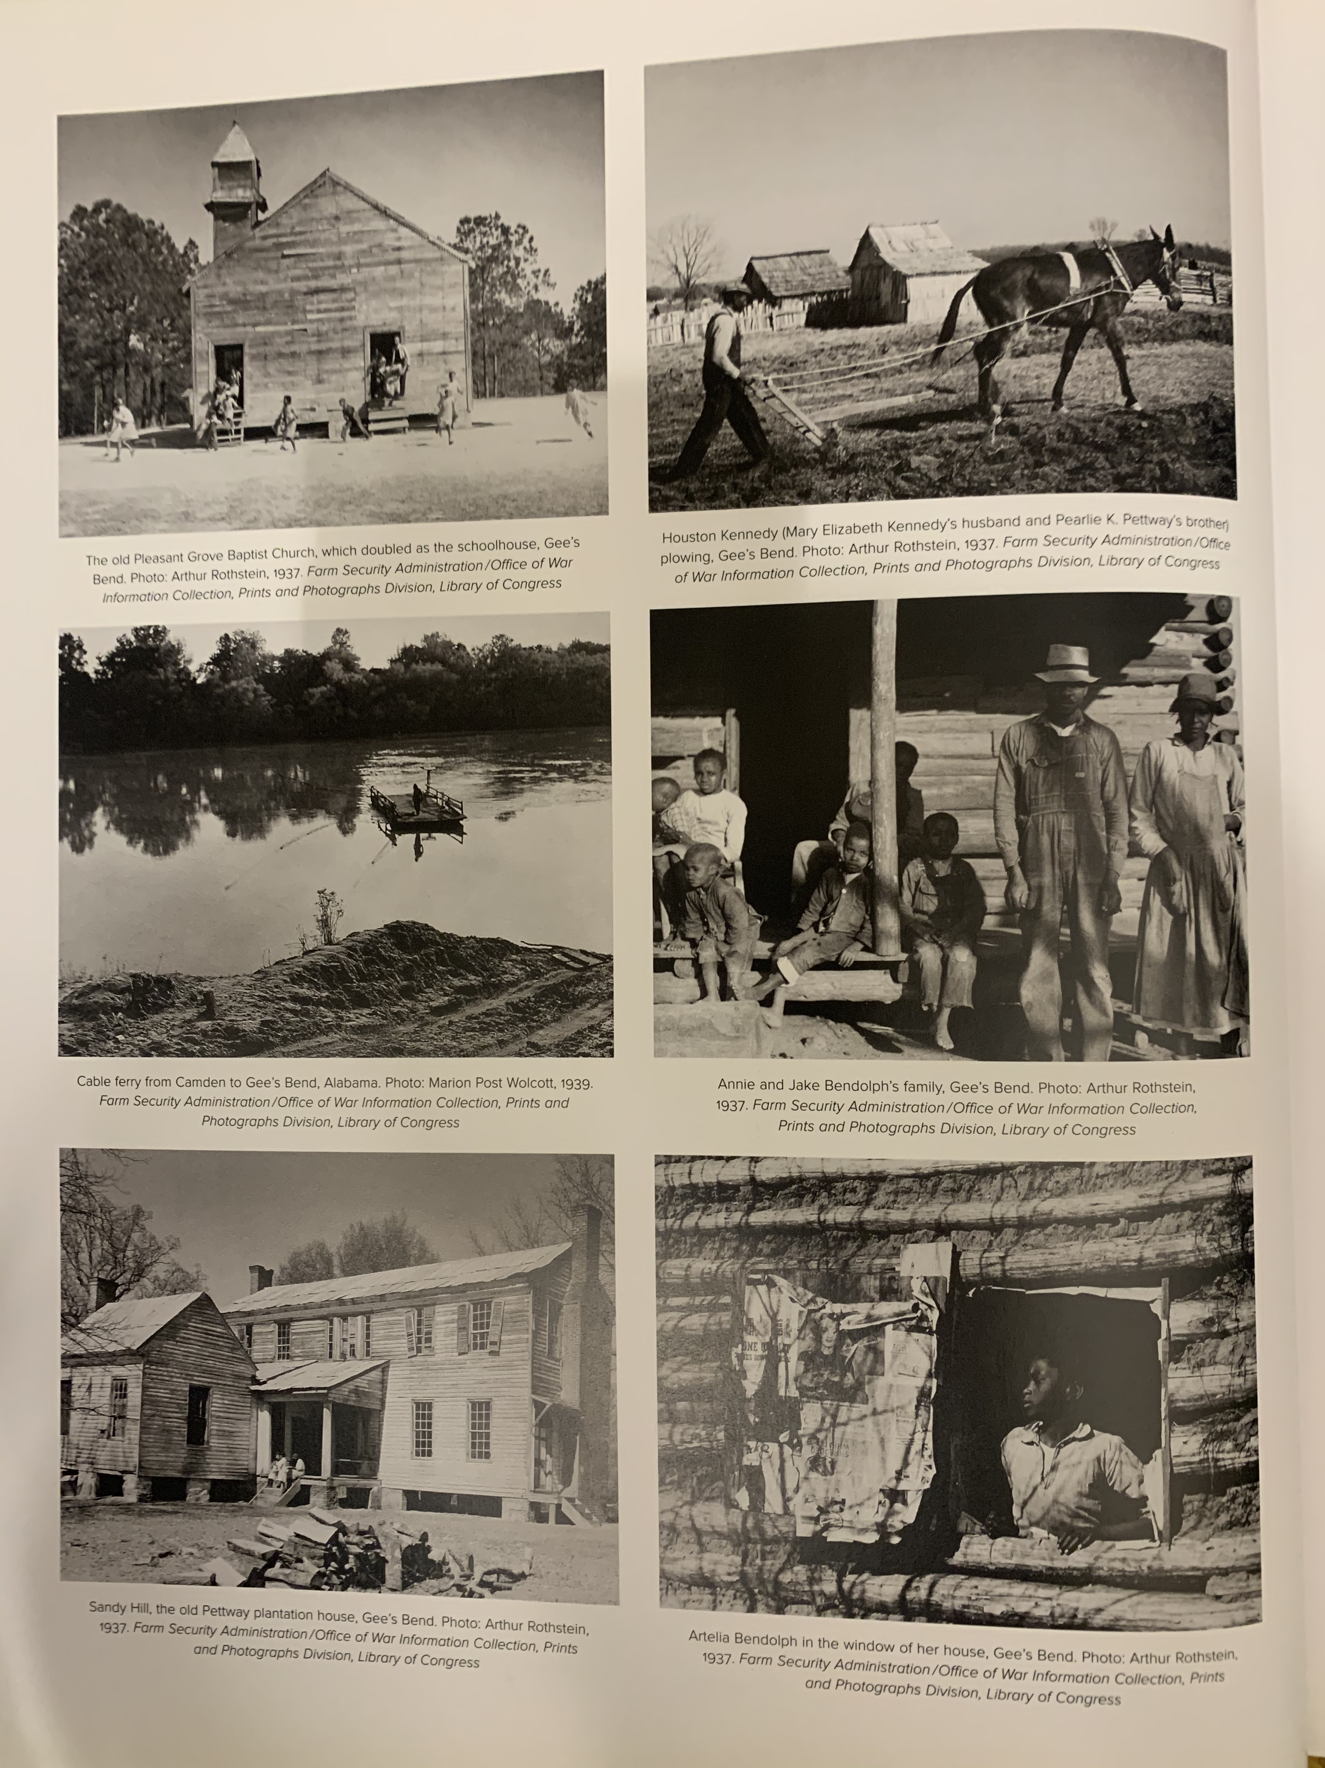

Slide 23
Style is a materialization of the deep networks of culture and history within which a creative practice is embedded.
Notes:
How can we express this c

Slide 24
In Exercises in Programming Styles, Lopes takes the time to elaborate a marvelously detailed catalog of technical practices—where they’re came from, and why they’re used…
Notes:
How can we express this c

Slide 25
Yet in their critique, Basman and Tchernavskij do not provide us with a similar effort to ground their arguments in the lives of real communities. They continue to see the issue primarily through the lens of technique.
Notes:
How can we express this c

Slide 26
How can we imagine a different kind of future for computation, while still grounding our systems, our languages, our abstractions, within the history, place, and practices of specific communities? How do we acknowledge the importance of technique, without losing grasp of what’s surplus to it?

Slide 27
Metaphor and Power

Slide 28
“Computational expressions are imprisoned as a result of the structure of languages, tools and idioms underlying today’s software construction, and are unable to participate in an open ecology of function where communities have the power to effectively and economically own their software.” - Basman and Tchernavskij

Slide 29
Community

Slide 30
Prisons, too, have a material history and context—especially for those of us in North America. They do real physical violence to the First Nations and Black communities against which they are predominantly deployed.

Slide 31
Metaphors have the power to do real violence, too. Yet we seem to be asked here to treat the prison metaphor stylistically—as a rhetorical technique only.

Slide 32
Who, specifically, is imprisoned by programming styles? Who holds the social power to put them there? How do we break down the walls?

Slide 33
‘Good, this is real,’ Camille said. ‘I am kneeling on the floor, you are trying to get me on my feet. Not metaphorically, but actually. Look,’ he said, hurling himself out of his friend’s grasp, ‘now I have fallen straight over on my face. This is action,’ Camille said to the carpet. ‘Now, can you distinguish what has just happened from what happens when somebody says “the country is on its knees? ‘Of course I can. Please get up.’ Camille stood up and brushed himself down a little. 'You terrify me,’ Robespierre said. He turned away and sat down at the table where he had been writing the letter. He took off his spectacles, rested his elbows on the table and covered his closed eyes with his fingertips. 'Metaphors are good,’ he said. 'I like metaphors. Metaphors don’t kill people.’ - Hilary Mantel, A Greater Place of Safety

