Slide 1

What is Inclusive Design?
Dana Ayotte
Inclusive Design Research Centre
OCAD University, Toronto ON
Notes:
You may have more questions than answers by the end of this presentation – that’s a good thing
Please interrupt me – a discussion, not a lecture

Slide 2
The Inclusive Design Research Centre (IDRC)
An international community of open source developers, designers, researchers, advocates, and volunteers working together to ensure that emerging information technology and practices are designed inclusively.

Slide 3
History
Began as the Adaptive Technology Resource Centre at the University of Toronto in 1994
Moved to OCAD University and became the Inclusive Design Research Centre in 2010
A non-profit research centre funded by grants from foundations, government

Slide 4
Principles of Inclusive Design

Slide 5
Disability as Mismatch
Tools
Individual Needs
Education
Services
Environment
Notes:
A grounding principle
Mismatch between individual needs and Design Solutions
As a way to put the responsibility onto the design and the designer to meet the needs of the user
As a way to frame disability (the mismatch) as “design solvable”
As a way to expand our thinking beyond the medical model of disability as a personal trait (permanent, limiting)
As a way to consider a broader beneficial impact - not designing for someone “out there”
Not an all-encompassing definition of disability
Consider the mismatch to be conditional, solvable through design, and the result of many factors, including:

Slide 6
Disability as Mismatch
Tools
Individual Needs
Education
Services
?
Environment
?
?
Notes:
A grounding principle
Mismatch between individual needs and Design Solutions
As a way to put the responsibility onto the design and the designer to meet the needs of the user
As a way to frame disability (the mismatch) as “design solvable”
As a way to expand our thinking beyond the medical model of disability as a personal trait (permanent, limiting)
As a way to consider a broader beneficial impact - not designing for someone “out there”
Not an all-encompassing definition of disability
Consider the mismatch to be conditional, solvable through design, and the result of many factors, including:

Slide 7
Accessibility = Adaptability
Tools
Individual Needs
Service
Education
Environment
Notes:
Accessibility/Inclusion, then, is the adaptability of the system to the needs of each individual.
PERSONALISATION – tools can be personalised to meet the needs of the user
Our research, development, education and service are all grounded in this principle.

Slide 8
Learning to Learn
PULL
Tools
Individual Needs
Service
Education
Environment
Notes:
Getting to know what works for you
Medical model - PUSH
Autonomous User/Learner
One Size Fits One – user decides
Individual determines their own needs, through experimentation, trial and error

Slide 9
Open
Open Access
Collaborative
Transparent
Open Source
Co-design
Diverse Participation
Notes:
Accessibility/Inclusion, then, is the adaptability of the system to the needs of each individual.
Our research, development, education and service are all grounded in this principle.

Slide 10
GPII
Global Public Inclusive Infrastructure
http://gpii.net/
Cloud4All
Prosperity4All
Preferences for Global Access
Notes:
Auto-personalisation of digital interfaces
Portable preferences
C4A Developing key parts of the Global Public Inclusive Infrastructure (GPII)
P4A a multi-sided platform to allow for ubiquitous auto-personalization of interfaces and materials
PGA Developing tools and technologies to support users in specifying their individual needs and preferences in several application settings.

Slide 11
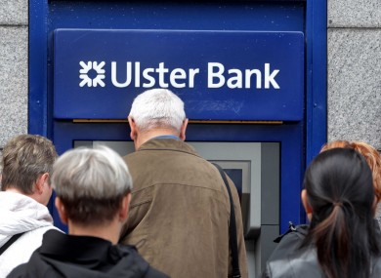
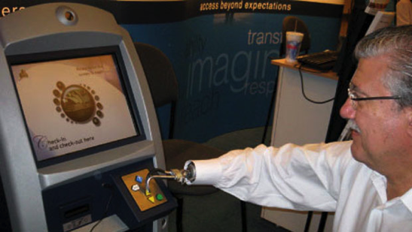
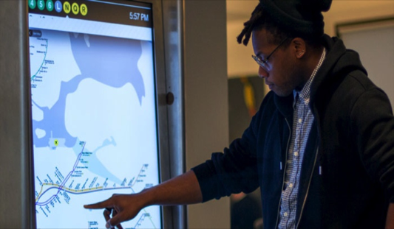
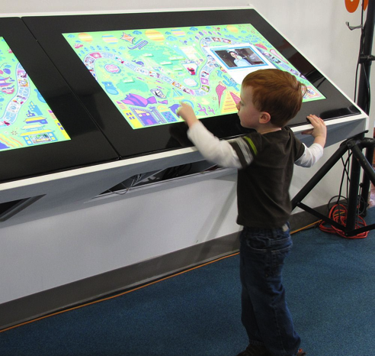
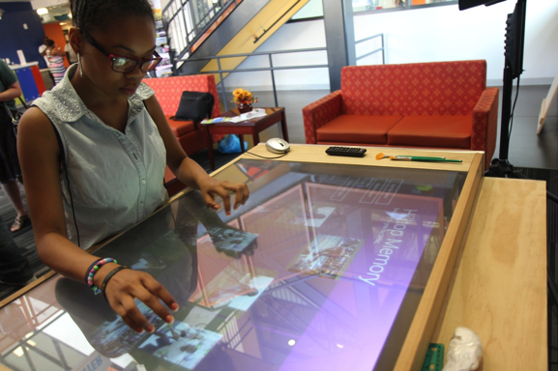
Why Personalized Interfaces?
Notes:
An increasingly digital world.
In the digital world it is much easier to make things customizable!
Eliminate barriers to access to
the web
museum kiosks, ticket machines, ATMs
public computer terminals (e.g. library, school)
Users and settings are unique
IBM EZ access keypad

Slide 12
A digital mismatch can be the result of many factors:
context (e.g. upon awakening in the morning)
environment (e.g. a dark room)
hardware and software variations (e.g. smartphone vs. desktop)
unique personal needs and learning styles (e.g. I prefer to listen rather than read)
Notes:
A mismatch between user needs and digital interfaces
Our needs are affected by a number of different factors, which can change in the short-term and long-term

Slide 13
GPII
Digital mismatch is design solvable through auto-personalization
In other words…

Slide 14
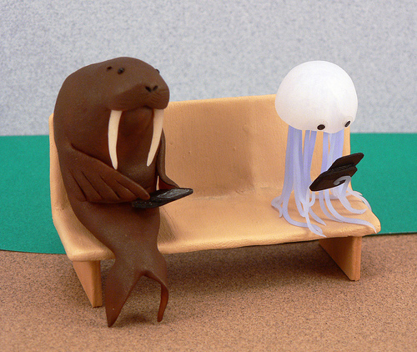
One-size-fits-one
Notes:
we can’t take a one-size-fits-all approach to creating interfaces, and yet this is the current state of most digital interactions
Content that can be delivered in a form that people can understand and use
User interfaces that can adapt to the needs, preferences and tastes of individual users
FLEXIBLE (levels of complexity)
ACCESSIBLE ((get in the door)
MEET USERS WHERE THEY ARE ((comfort level, environment, context)
By using the rich tools and techniques afforded by the web, combined with the inherent mutability of the digital, we can design tools that allow users to customize their digital interaction to fit their specific contexts, needs and preferences.

Slide 15
Preference Discovery Tools for Personalisation
Learner Options Demo
Learner Options Wordpress plugin:
https://github.com/fluid-project/uio-wordpress-plugin/
First Discovery Tool
Notes:
PORTABLE PREFERENCES
15 minutes

Slide 16
FLOE – Flexible Learning for Open Education
Through the Open Education Resources community, FLOE makes tools available that transform, augment, and personalize the learning experience.
Metadata
Learning Toolkit
Notes:
Time dependent demo
SELF-DIRECTED

Slide 17
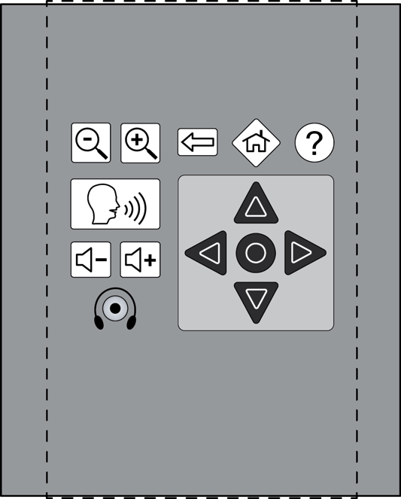
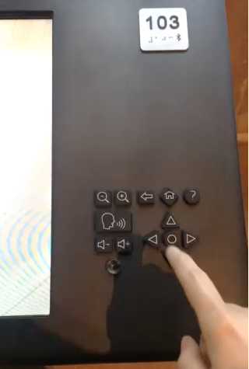
Canadian Museum of Human Rights

Slide 18
Why Inclusive Design?

Slide 19
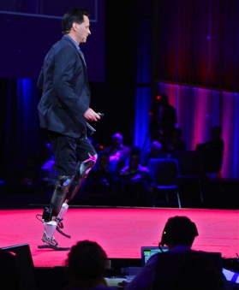
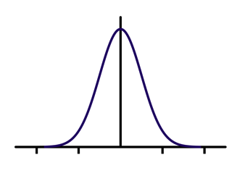
Status Quo
2 Extremes
Design for the majority
Design for the average
Design for the 80%
Highly specialized, custom solutions
Unaffordable
“It’s too expensive to design for the margins / the 20%”
“There’s no market for this”
Notes:
Hugh Herr – MIT engineering professor, rock climber, film FIXED

Slide 20
Inclusive Design
Design solutions that are:
Flexible
Adaptable
Personalizable
Customizable
User-continued
Normal?
Design for the majority
Design for the average
Design for the 80%
Highly specialized, custom solutions
Unaffordable
“It’s too expensive NOT to design for the margins / the 20%”
“There’s a market for this!”
Notes:
Each ONE can make their own match

Slide 21
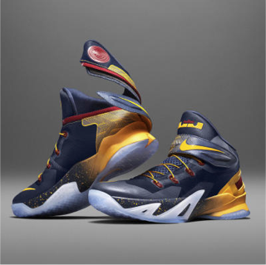
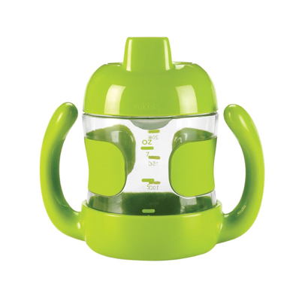
If we design for the margins, everyone benefits
Nike Flyease
OXO sippy cup
“If we understand what the extremes are, the middle will take care of itself.” Dan Formosa (Smart Design)
Notes:
Flyease inspired by a letter to Nike by a basketball loving teenager with Cerebral Palsy — what resulted is a cool looking shoe with an innovative entry that is usable and attractive to everyone.
OXO sippy cup for wee ones – also useful in meeting mobility/dexterity needs – e.g. shaking hands
IT”S JUST BETTER DESIGN
Objectified

Slide 22
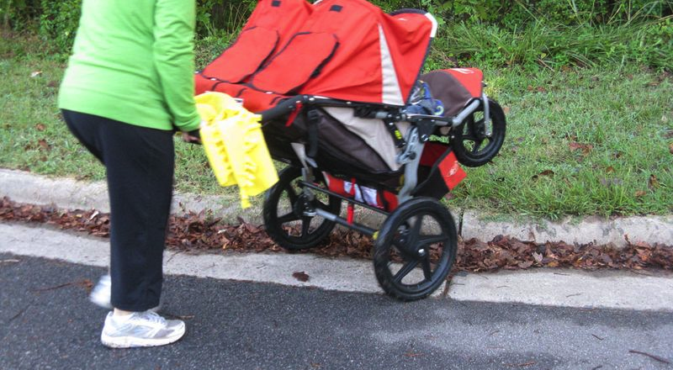
But who is “on the margin”?
Extreme user?
Notes:
Do you consider yourself to be “on the margin”? An “extreme user”? An outlier?
Not designing for users “out there” somewhere

Slide 23
Broader Beneficial Impact
Leverage the “curb-cut effect”
Consider digital curb cuts
E.g. voice over / text-to-speech – meets the needs of someone who cannot see, as well as someone learning a new language, and someone with a unique learning need

Slide 24
Activity (5 min)
Pair up with someone
Think of a time that you adapted something to make it work better for you
Describe this adaptation to your partner –what need or preference of yours was not being met?
Consider how this adaptation might be beneficial to someone with different needs
Notes:
Could be as simple as rearranging your desk
I have a clock set to Toronto time, every time my nephew comes over and uses my computer, he sets it to local time
I prefer to set my scrolling to “natural”, others hate this
Smartphone icon arrangement, desktop arrangement

Slide 25
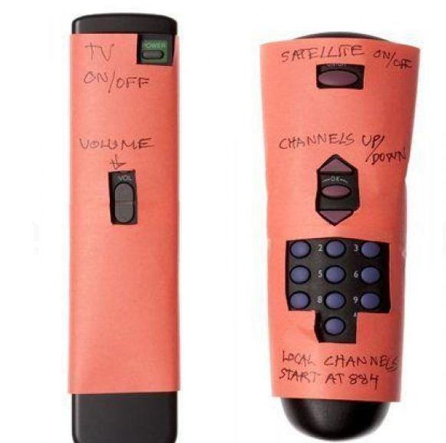
Adaptation
Notes:
Useful for someone who finds the number and layout of buttons overwhelming
Useful for someone who has dexterity needs – shaking hands or large fingers
Useful for someone with memory loss

Slide 26
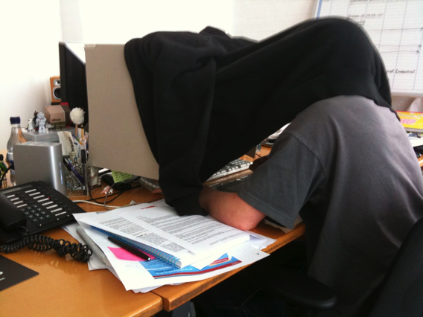
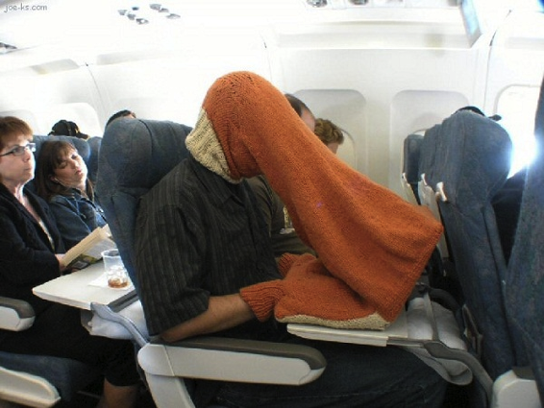
User-continued Design
Notes:
User-continued design – both from UI configurations as well as from a technical perspective with Infusion

Slide 27
Three Dimensions of Inclusive Design
Recognize Diversity and Uniqueness
  Self-knowledge/autonomy
  One-size-fits-one
Inclusive Processes and Tools
  Accessible tools
  Diverse perspective/participation
Broader Beneficial Impact
  Leverage curb-cut effect
  Virtuous cycles of inclusion
Notes:
SUMMARY
The more people that can be included, increased prosperity, greater participation – cycle continues

Slide 28
Additional Resources

Slide 29
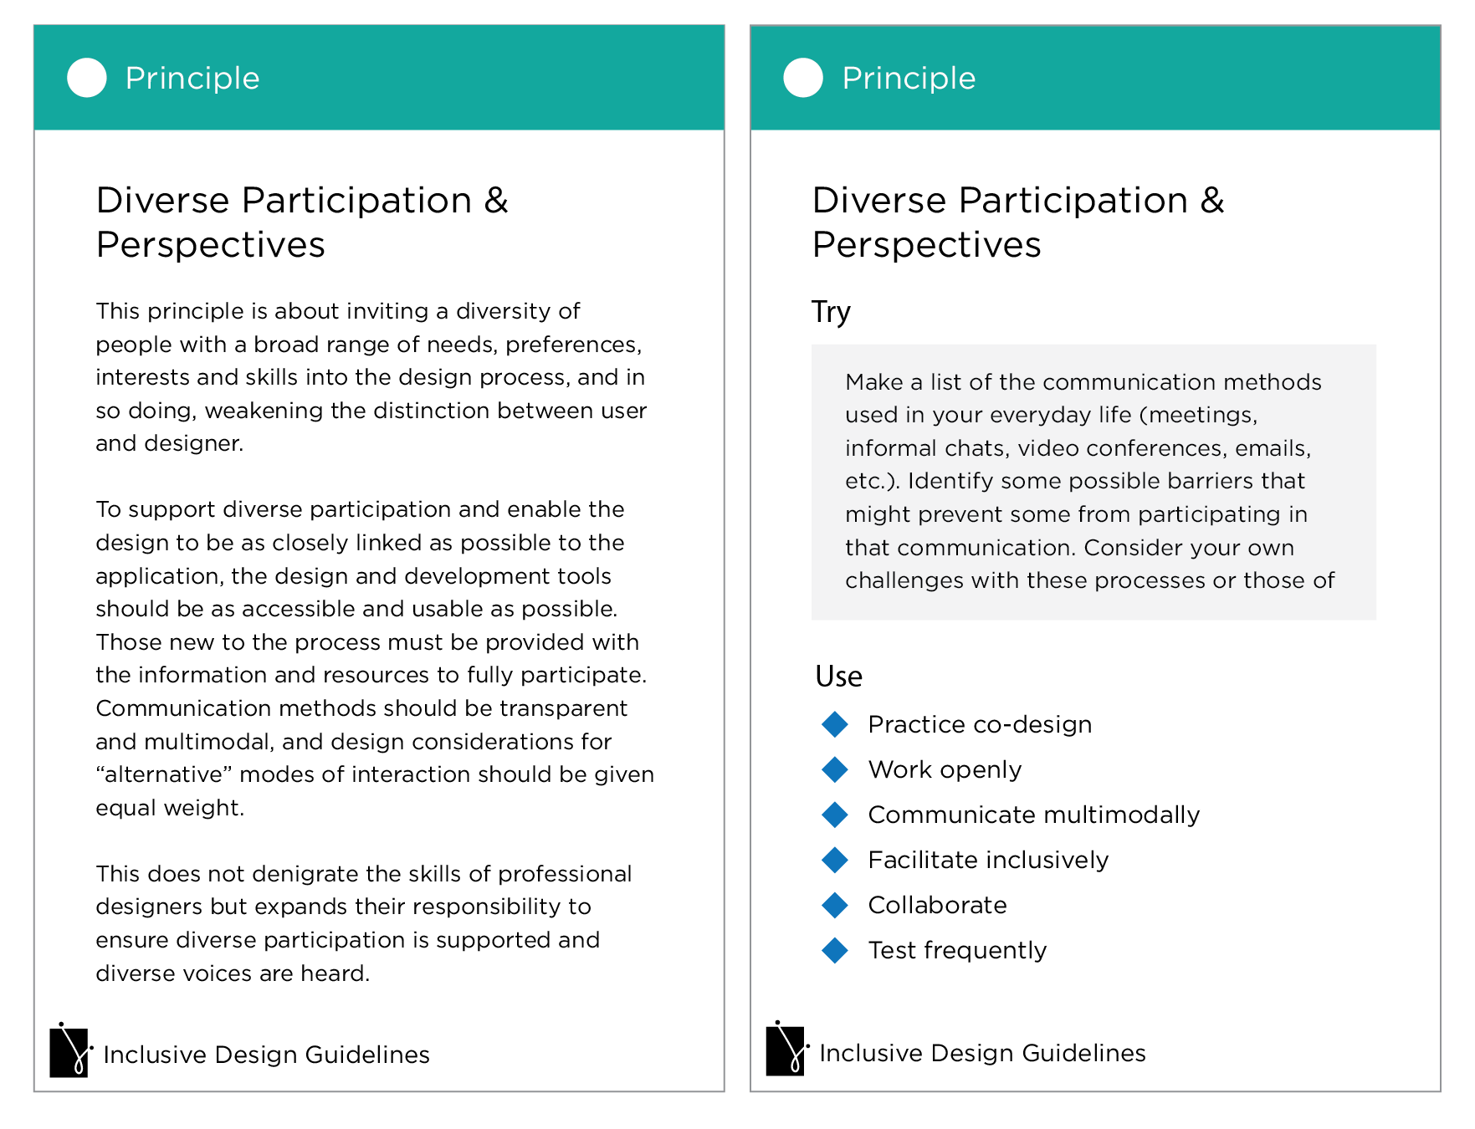
Inclusive Design Guidelines

Slide 30
Learning Web Accessibility
http://courses.idrc.ocadu.ca/
http://webaim.org/
Notes:
Haven’t talked about web accessibility specifically – very important aspect of inclusive design
Lots of other resources out there
Joanna Briggs has given a couple of presentations, more to come I’m sure

Slide 31
Infusion
a code framework and growing collection of user interface components for building personalizable and adaptive applications using JavaScript and other web technologies.
built on top of jQuery, Infusion makes it easier to build user interfaces by mixing, matching and customizing accessible components
https://github.com/fluid-project/infusion
http://docs.fluidproject.org/infusion/development
http://build.fluidproject.org/infusion/demos/

Slide 32
Inclusive Design - Definition
Design that considers the full range of human diversity with respect to ability, language, culture, gender, age and other forms of human difference.

Slide 33
Join Us!
IRC Channel
  Hostname: irc.freenode.net
  #fluid-work, #fluid-tech, #fluid-design
Wiki.fluidproject.org
Community Meetings – Wednesdays 2:30 ET
Design Crits – Mondays 1:00 ET
Volunteer
Notes:
Links to Vidyo room on the wiki

Slide 34
Thanks!
Dana Ayotte
@artyyotty
@idrc_ocadu
dayotte@ocadu.ca

Slide 35
Image Credits
Nike Flyease: http://cnet2.cbsistatic.com/hub/i/r/2015/07/15/dc055c68-bb4b-47a6-9472-6cf1475a6703/resize/
Oxo: http://images.bloomingdales.com/is/image/BLM/products/7/optimized/8017617_fpx.tif?
Walrus and Jelly fish: Justina Kochansky/articulatematter.com
Bell curve: https://upload.wikimedia.org/wikipedia/commons/thumb/f/f6/Gaussian_Filter.svg/2000px-Gaussian_Filter.svg.png
Hugh Herr: https://upload.wikimedia.org/wikipedia/commons/a/ab/Hugh_Herr,_TED_2014.jpg
IBM EZ Access Keypad: http://www-03.ibm.com
Ulster Auto Bank Teller: http://www.thejournal.ie
Digital Subway Map: http://inhabitat.com/
Child at digital map: http://dc.about.com/od
Woman at tabletop digital kiosk: http:/insideupmc.blogspot.ca
Stroller and curb: http://www.bullcityrising.com/2010/10/walk-to-school-day-highlights.html
Curb cut: http://zomigi.com/downloads/Web-Accessibility_Charlotte-UX_111114.pdf
Sweater over head: http://blog.nzime.com
Knitted computer sock: http://cocreatingourreality.com
Adapted remote control: http://www.flipperremote.com/wp-content/uploads/2013/05/grandma-stop-calling-remote.jpg

