Slide 1
Inclusive Design: A Change in Perspective
Jess Mitchell
Inclusive Design Research Centre
OCAD University, Toronto
Accessibility Advisory Committee Forum
York Regional Municipality May, 2017

Slide 2
What is Inclusive Design

Slide 3
3 Principles of Inclusive Design
Recognize diversity and uniqueness
Use an inclusive process & inclusive tools
Have a broader beneficial impact

Slide 4
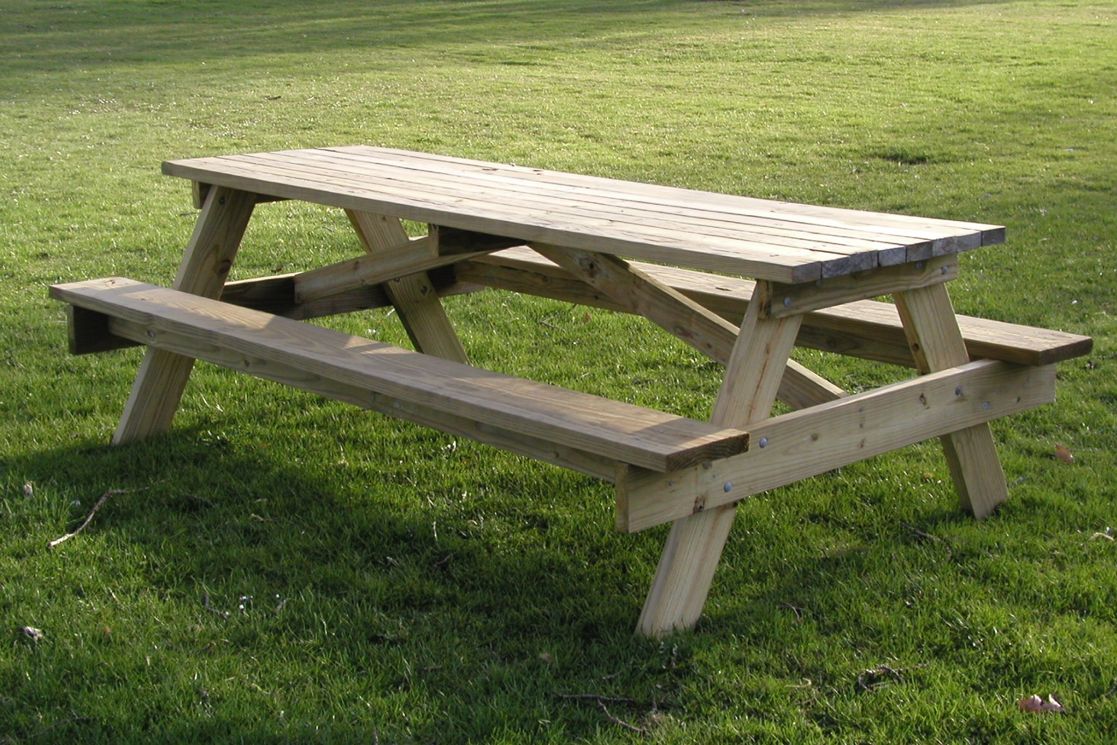
Sitting at the Table

Slide 5
About this Table…
Who isn’t here?
Is the table welcoming to all?
Have they been at the table before?
Do they know the culture of the table?
Is the environment the table is in safe, welcoming, open?
How is listening and capturing going to happen at the table?
Do those at the table have real ways to have an impact? Are they empowered to act on what is discussed?

Slide 6
What is Disability?

Slide 7
Mismatch

Slide 8
Disability is a mismatch
All experience mismatch
Mismatch is solvable
Inclusive Design/Thinking can solve mismatch

Slide 9
How can we do inclusive design and inclusive thinking?
Recognize diversity and uniqueness
Use an inclusive process & inclusive tools
Have a broader beneficial impact

Slide 10
Principle 1 + Action
Recognize diversity and uniqueness
Of people
Of places
Of contexts
Of comfort
Of discomfort
Empathy | Listening | Curiosity | Learn | Make Mistakes
Challenge your own implicit biases
Notes:
Importance of edge cases

Slide 11
Principle 2 + Action
Use an inclusive process & inclusive tools
Interactions
Building, room, table, chairs
Form and Function
Co-design
Awareness | Perspective | Question Assumptions
Challenge your own implicit biases

Slide 12
Principle 3 + Action
Have a broader beneficial impact
Begin to address biases in ourselves and others
See beyond the minimum
Recognize all the DESIGN decisions you make
Ask: who did you just exclude?
Awareness | Perspective | Question Assumptions
Challenge your own implicit biases

Slide 13
*This* is innovation
Recognize diversity and uniqueness
Use an inclusive process & inclusive tools
Have a broader beneficial impact

Slide 14
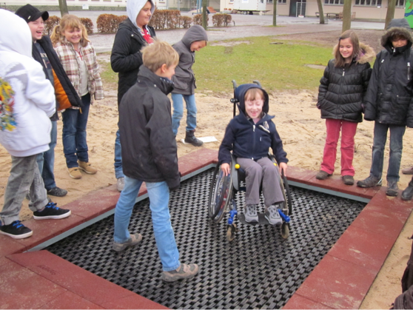
Trampoline

Slide 15
Path

Slide 16
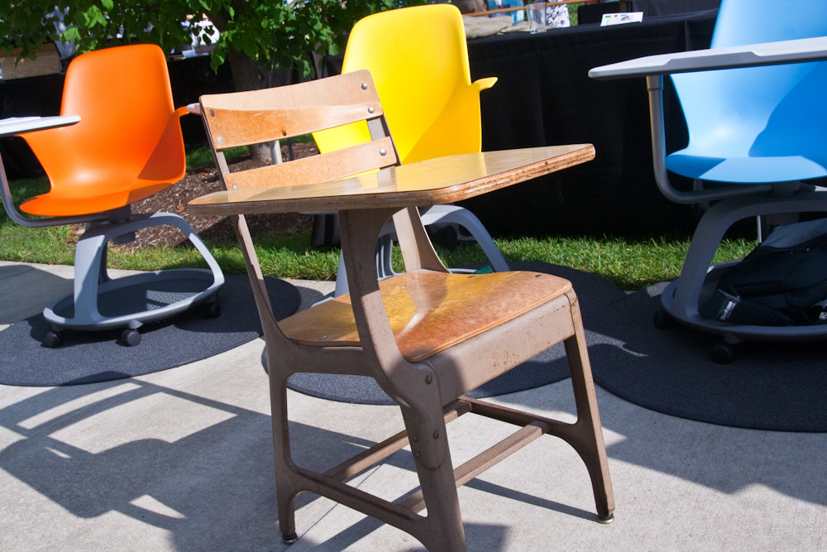
Chair

Slide 17
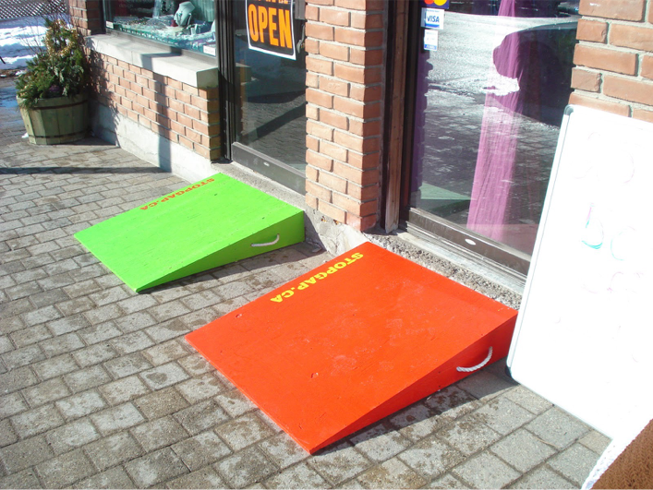
StopGap

Slide 18
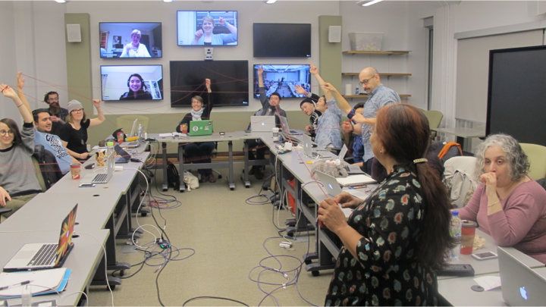
Learning

Slide 19
Contacting Me:
Twitter: @jesshmitchell
Email: jmitchell@ocadu.ca

Slide 20
Images used:
Welcome Mat
Flickr Link
Picnic Table
Wikipedia Link
Accessibility images
Wikipedia image link
Wikipedia image link
Wikipedia image link
Wikipedia image link
Square Peg – Round Hole
Flickr Link
Trampoline
Image Link
Path in park
Image Link
Desk Chair Combo
Flickr Image
StopGap Wedge
Image Link

Slide 21
Discussion Questions
how are you “accomplishing” or solving for inclusion now?
What are practical ways you can approach inclusion differently after today?
What are particular areas of inclusion and accessibility you’d like to address that are not changing?

