Slide 1
Inclusive Design: Perspectives in Action
Colin Clark, Lead Software Architect
Inclusive Design Research Centre, OCAD University

Slide 2
Ethics, in themselves, are boring…
Inclusion is a catalyst for change and innovation, not a constraint or just a professional obligation
You can’t separate the context of the work, and the values you practice, from the ethics
You have to look at power
How do you put your values into practice?

Slide 3
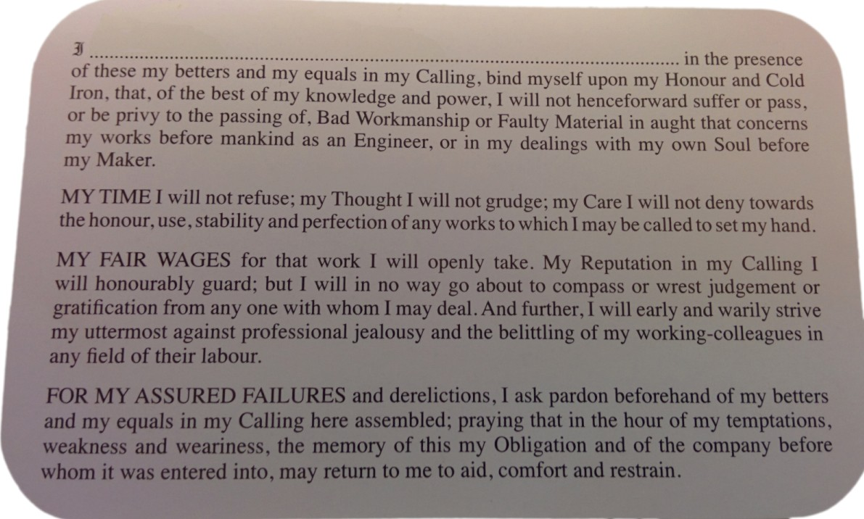

Slide 4
The Calling of an Engineer
Not an oath, but an obligation to:
  Workmanship
  Material
  The honour, use, stability, and perfection of any works
An obligation to built objects, but what about to people and the environment?

Slide 5
Context matters

Slide 6
Inequality is Growing
  85% of post-2008 economic growth was pocketed by the richest 1%
  The U.S. ranks 35th out of 37 OECD countries in terms of poverty and inequality
  More than 1 in every 8 Americans are living in poverty
  Only 64% of U.S. voting-age population was registered to vote in 2016—a smaller share of potential voters than just about any other OECD country
  Philip Alston, UN OHCHR Report on extreme poverty and human rights

Slide 7
Our Technologies are Complicit
  “The United States is one of the world’s richest, most powerful and technologically innovative countries; but neither its wealth nor its power nor its technology is being harnessed to address the situation in which 40 million people continue to live in poverty…
  Much more attention needs to be given to the ways in which new technology impacts the human rights of the poorest Americans.”

Slide 8
Technology is practice; “the way things are done around here.”
Ursula Franklin
The Real World Of Technology, 1989
Notes:
This is to say, and perhaps I’m pointing out the obvious, that the ways in which we create our technologies—the techniques and values and social dynamics that we practice with, and invest within them—will have fundamental shaping effects on the kinds of technologies we can create, and on what can be done and expressed with them. Put simply, too simply, how we design is what we design.

Slide 9
Inclusive Design is design that considers the full range of human diversity with respect to ability, language, culture, gender, age and other forms of human difference.

Slide 10

Rethinking Disability

Slide 11
Rethinking Disability
A mismatch between the
individual
and the
  environment

Slide 12
Accessibility is...
the ability of the environment
to meet the needs of the individual

Slide 13
Three Dimensions of Inclusive Design
Recognize, respect, and design for human uniqueness and variability.
Use inclusive, open & transparent processes, and co-design with people who have a diversity of perspectives, including people that can’t use or have difficulty using the current environments.
Realize that you are designing in a complex adaptive system

Slide 14
Reflecting on our power

Slide 15
The Tyranny of Change
More than 80% of the total cost of software development is devoted to software maintenance… mainly due to the need for software systems to evolve in the face of changing requirements.
Unanticipated requirement changes… account for most of the technical complications and related costs of evolving software.
Kniesel, et. al. (2002) “Unanticipated Software Evolution.” In J. Hernandez and A. Moreira (Eds.): ECOOP 2002 Workshops, LNCS 2548, pp. 92–106.
Notes:
These are statistics that feel like common sense to anyone who has written their own programs, who has felt the fear that comes with realizing that a seemingly simple functional change may result in cascading, fundamental effects throughout a hard-earned code base.

Slide 16

Change is Hard for Designers…
Change has, from the perspective of software practice, inordinately been treated as something to avoid, minimize, control, or manage.
On one hand, methods for requirements management that aim to get it right from the start, and freeze it—change, here, is cast as risk
On the other hand, agile methods cast their gaze inwards; teams “embrace change” but only within a bounded scope—change becomes a choice to be wielded by expert designers and developers alone

Slide 17
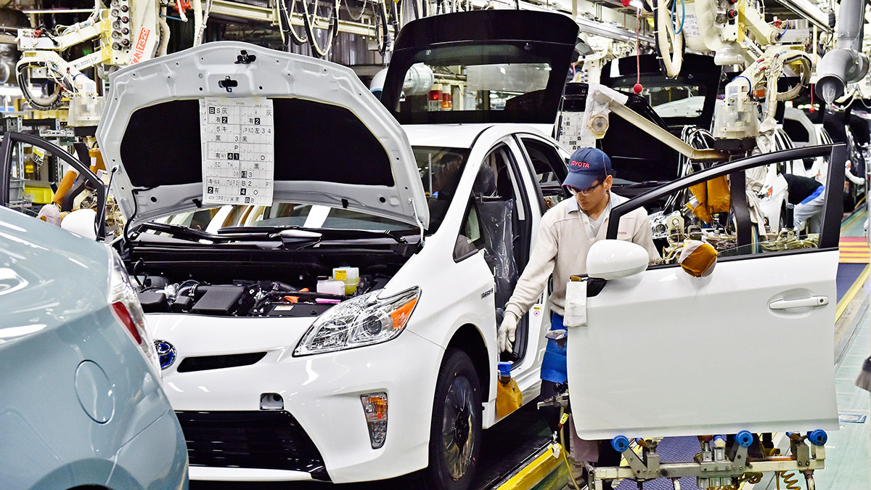

Slide 18
Notes:
So if change is hard for those of us who design and implement software systems, what is change like for users?

Slide 19
…But change is Intolerable for Users
For users, software products tend to be a “take it or leave it” proposition; if someone needs something different, often their only recourse is to look elsewhere, at other products
Beloved features may disappear, move, or be recast by software designers at any time and without notice or permission, leaving users to adapt or relearn their hard-earned workflows
The power to enact (or forgo) changes, to manage their impacts, scales and timing, rests overwhelmingly in the hands of those who initially created the software—this is, I believe, what constitutes substantive ownership of software

Slide 20
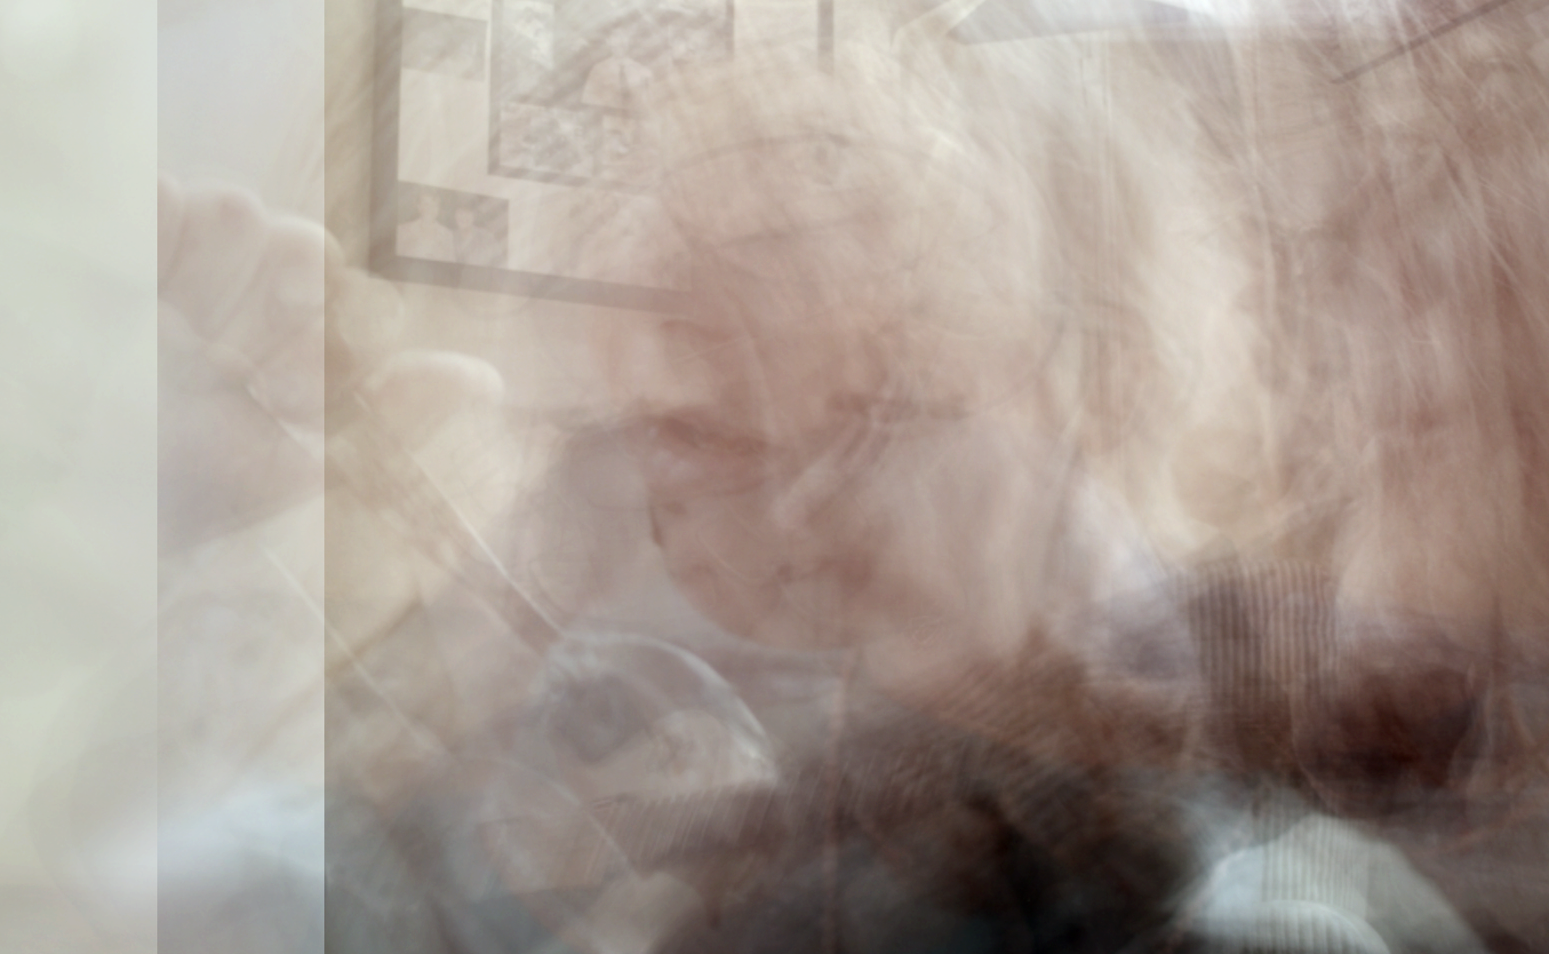

Slide 21
The Failure of Models
Personas typically “blur” individuals by representing multiples as one—they’re static
However, we are all multiplicities: dynamic, evolving, and with changing needs and preferences under different circumstances and in different environments
Industrial design literature emphasizes using personas to reduce diversity and avoid edge cases (See About Face, Alan Cooper)
More importantly, if personas stand in for our absent users during the design process, where are they?

Slide 22
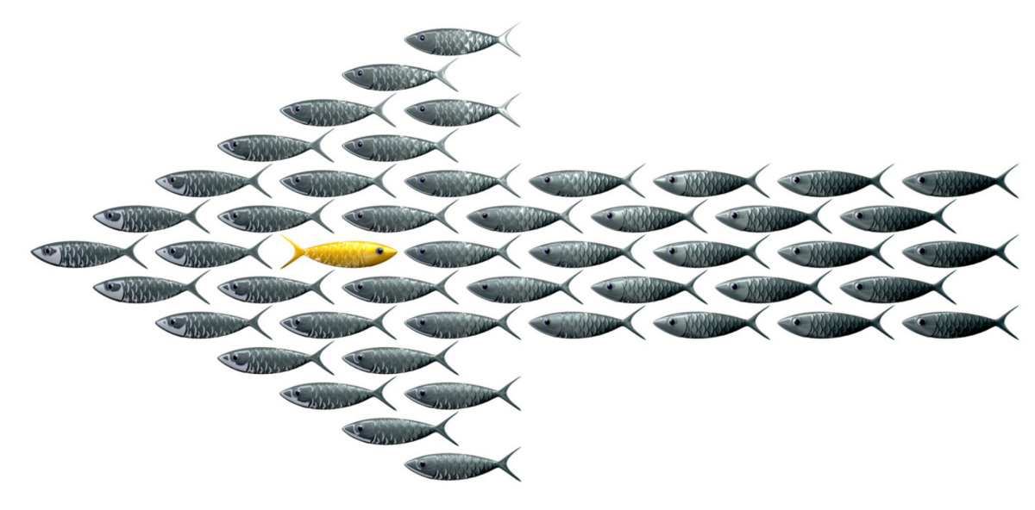

Slide 23
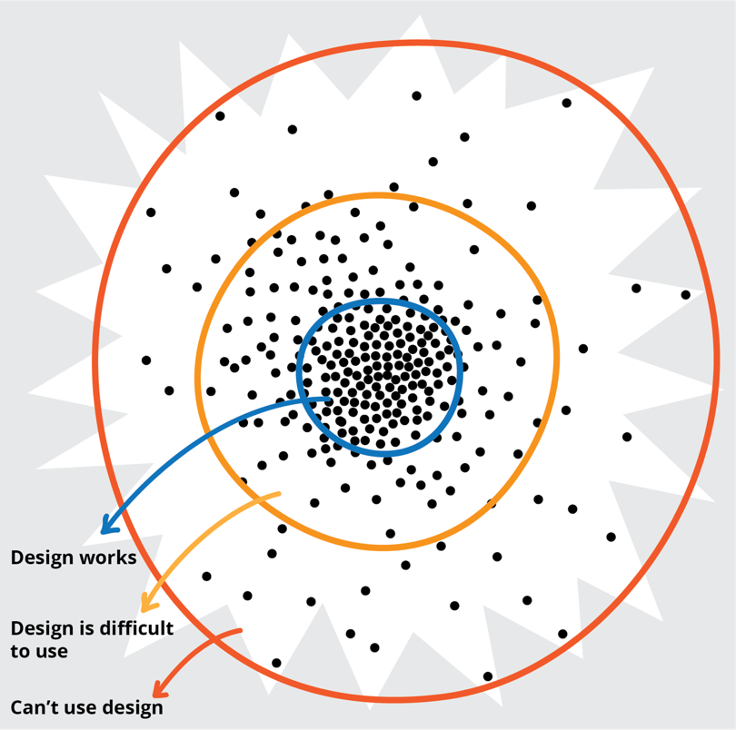

Slide 24
Machine Ignorance
Put simply, people on the margins are different
Machine learning algorithms, inherited from quantitative and statistics-based research, too often assume that there is a “norm,” and treats outlier data as just “noise.”
Yet these algorithms are increasingly used to recognize speech, faces, illnesses, or to predict loan and credit worthiness, academic potential, terrorists and future employment performance!
Think about privacy in this context, too!
We need to develop new approaches to big data/ML that explicitly account for diversity—and new metaphors other than intelligence, learning, etc.

Slide 25
“The single story creates stereotypes, and the problem with stereotypes is not that they are untrue, but that they are incomplete. They make one story become the only story."
Chimamanda Ngozi Adichie,
“The Danger of a Single Story”

Slide 26
Changing the status quo

Slide 27

An open community for co-design, including designers, users, artists, testers, accessibility experts, thinkers, and all the other people who don’t usually fit in open source software communities.
fluidproject.org

Slide 28
Co-Design and Community
Co-design is designing with, not simply for. It involves asking the people who might otherwise just be "users," particularly those on the margins of today’s technology experiences, to be part of the design process.
Co-design typically starts with a process of discovering and negotiating roles—asking participants how, when, and how often they want to be involved, and making space to accommodate different “scales” of investment and engagement. It takes time.
It demands that all participants have equal access to the information—plans, ideas, prototypes, and works in progress—that is essential for full decision-making and responsible contribution.
A starting point for this involves an opening up of agile’s iterative and incremental processes and open source’s collaboration to be more porous and include a broader range of team participants and modes of engagement.

Slide 29
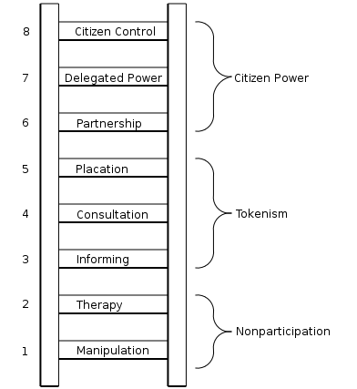

Slide 30
“Citizen participation is… citizen power. It is the redistribution of power that enables the have-not citizens, presently excluded from the political and economic processes, to be deliberately included in the future. It is the strategy by which the have-nots join in determining how information is shared, goals and policies are set… resources are allocated, programs are operated, and benefits… are parceled out. In short, it is the means by which they can induce significant social reform which enables them to share in the benefits.”
Arnstein, Sherry. (1969). “A Ladder of Citizen Participation.” AIP, Vol. 35, No. 4, July 1969, pp. 216-224.

Slide 32
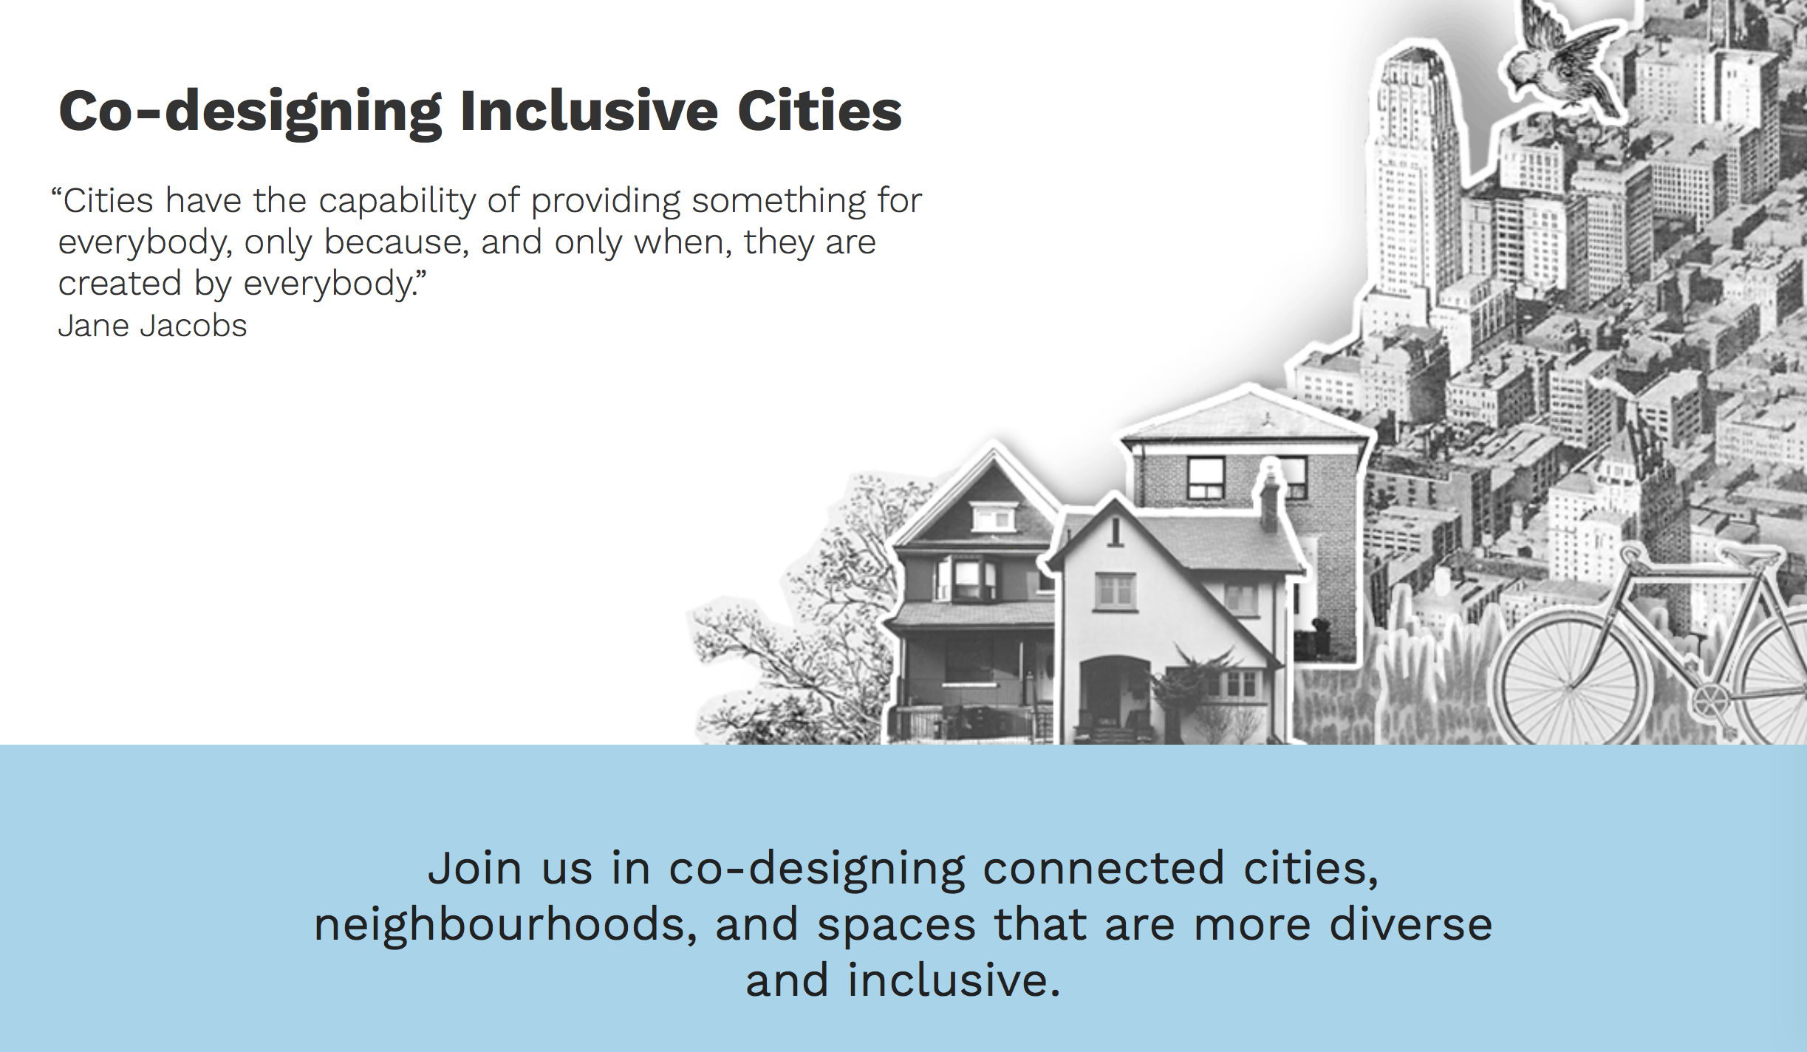
cities.inclusivedesign.ca

Slide 35
Modes of Co-Design
Workshops and synchronous events led by facilitators
Embedded co-design toolkits (led by community members themselves)
Open Studio methods and crits (open source designing)
Paired designer/user methods (working together on day-to-day designs)
…Users designing it themselves

Slide 37
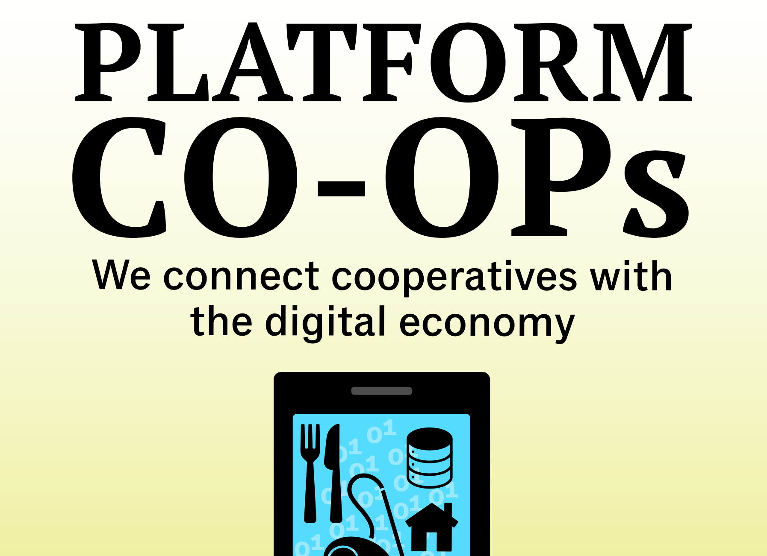

Slide 38
Digital Labour Today
Inequality and rise in precarity of labour
Online labour brokerages enable wage theft, discrimination, and exploitation (e.g. Taskrabbit, care.com, Airbnb, Uber)
Lack of workplace democracy
Stalled worker rights
Rise of “gig economy”
Stagnating wages

Slide 39
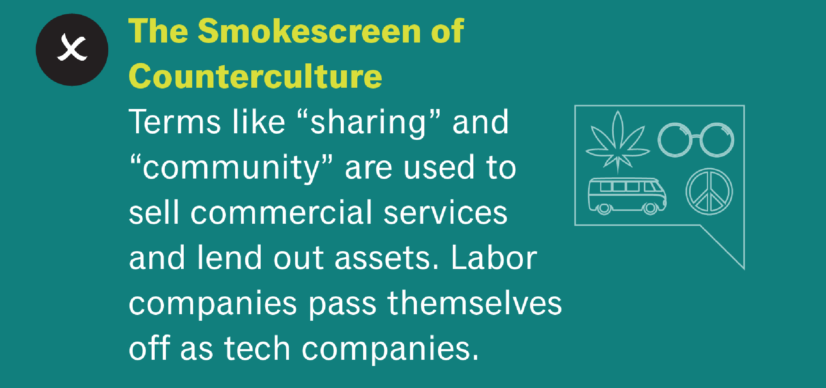

Slide 40
Case Study: CoRise Cooperative
A cooperative for childcare workers in Illinois
Average childcare worker makes $16,000 USD/year
Works 67 hours/week
Depends on subsidies from the state, yet the state pays inconsistently
Huge burden of paperwork and licensing bureaucracy
A cooperative will support matching of parents to caregivers, economies of scale for supplies, user-friendly form processing, and payment smoothing via collective loans

Slide 41
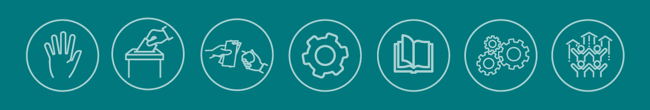
The Digital Economy
Imagine a digital economy that would follow the 7 co-operative principles
1. Voluntary and Open Membership
2. Democratic Member Control
3. Member Economic Participation
4. Autonomy and Independence
5. Education, Training, and Information
6. Cooperation among Cooperatives
7. Concern for Community

Slide 42
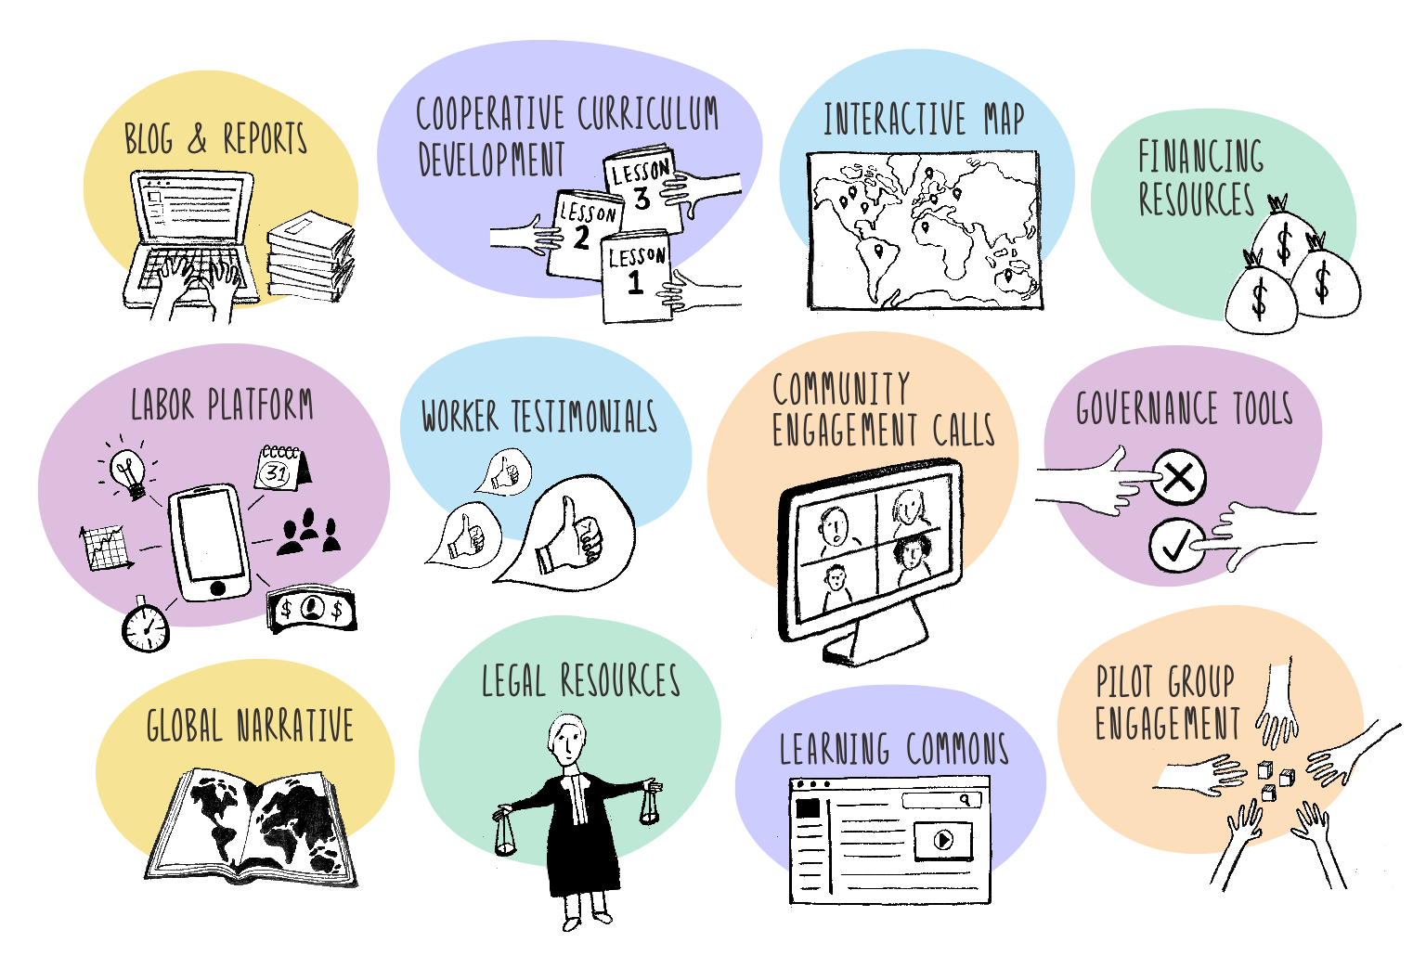

Slide 43
The power to create

Slide 44
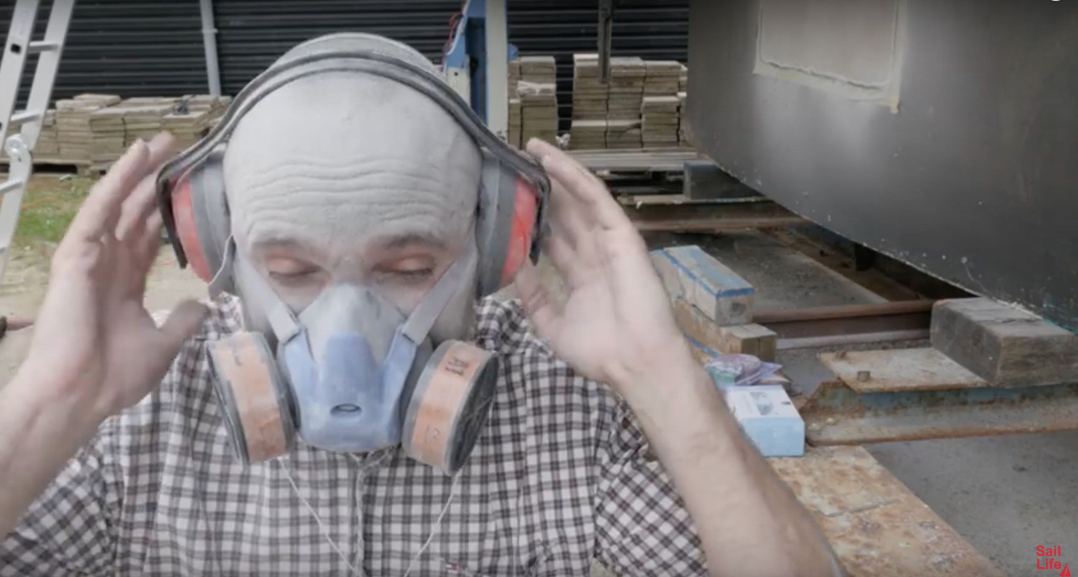

Slide 45
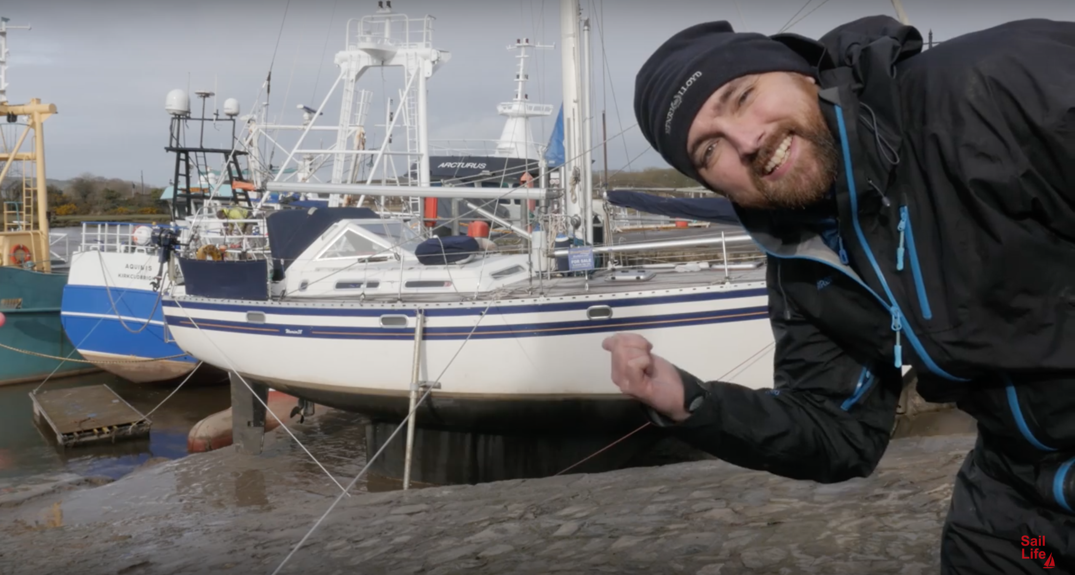

Slide 46
Material Case Study: Mads Dahlke
Mads Dahlke is the host of the YouTube channel Sail Life, and (coincidentally) a software developer.
He’s doing something with his sailboat, I argue, that simply can’t be done with software.
Dahlke has customized his boat substantively, including:
  removing and replacing the boat’s entire deck
  designing custom-fit fuel tanks
  completely reconfiguring the layout of a cabin to better suit his needs as a workspace
  repaired and redesigned many flaws resulting from oversights or cut corners during the boat’s original design and construction.
Indeed the boat’s original designers likely never conceived that their product would still be in active use today, nor did they design it with any intention of it being modified in the ways that Dahlke has accomplished
Yet Dahlke is not a professional boat builder or expert restorer. He has pursued his project by acquiring some generalized technical skills and commodity tools, while participating in a larger community of other sailors and do-it-yourselfers who have worked on similar projects and shared their own learnings.

Slide 47
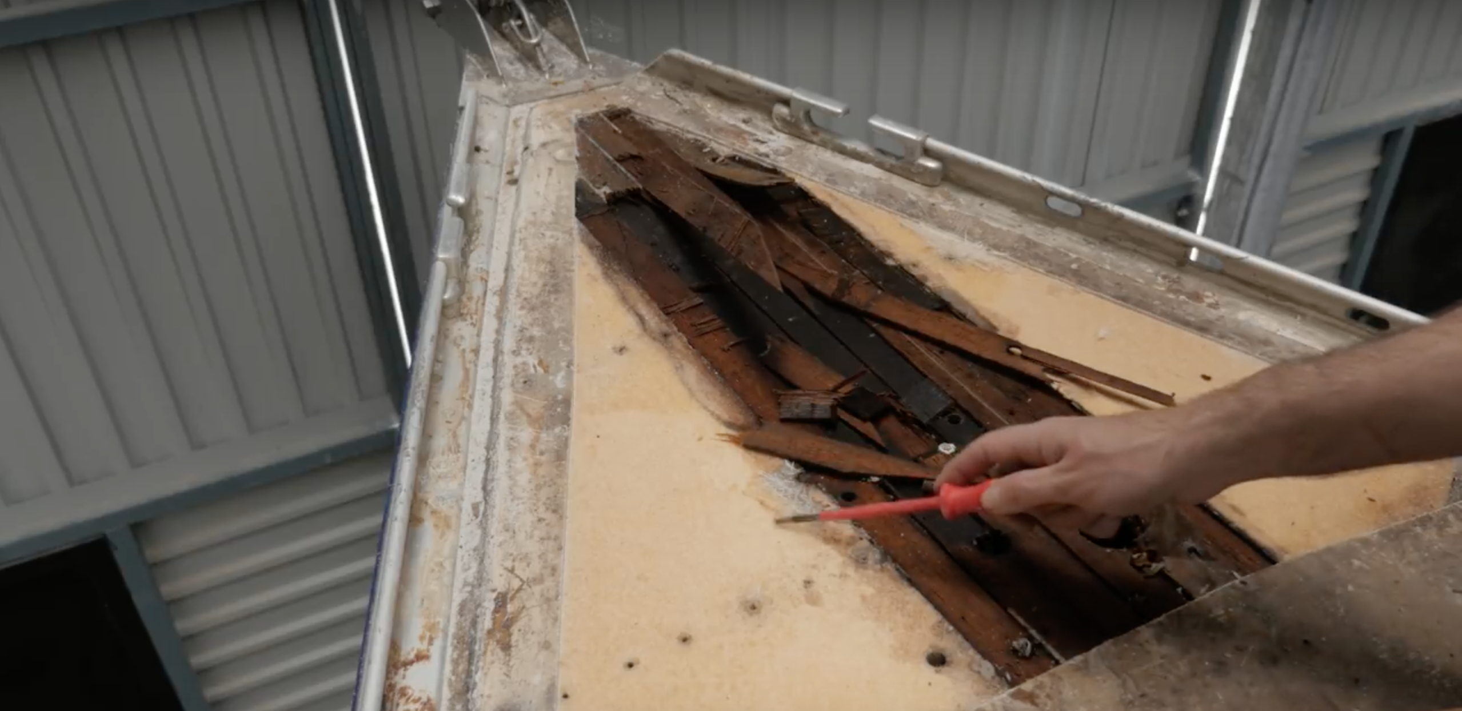

Slide 48
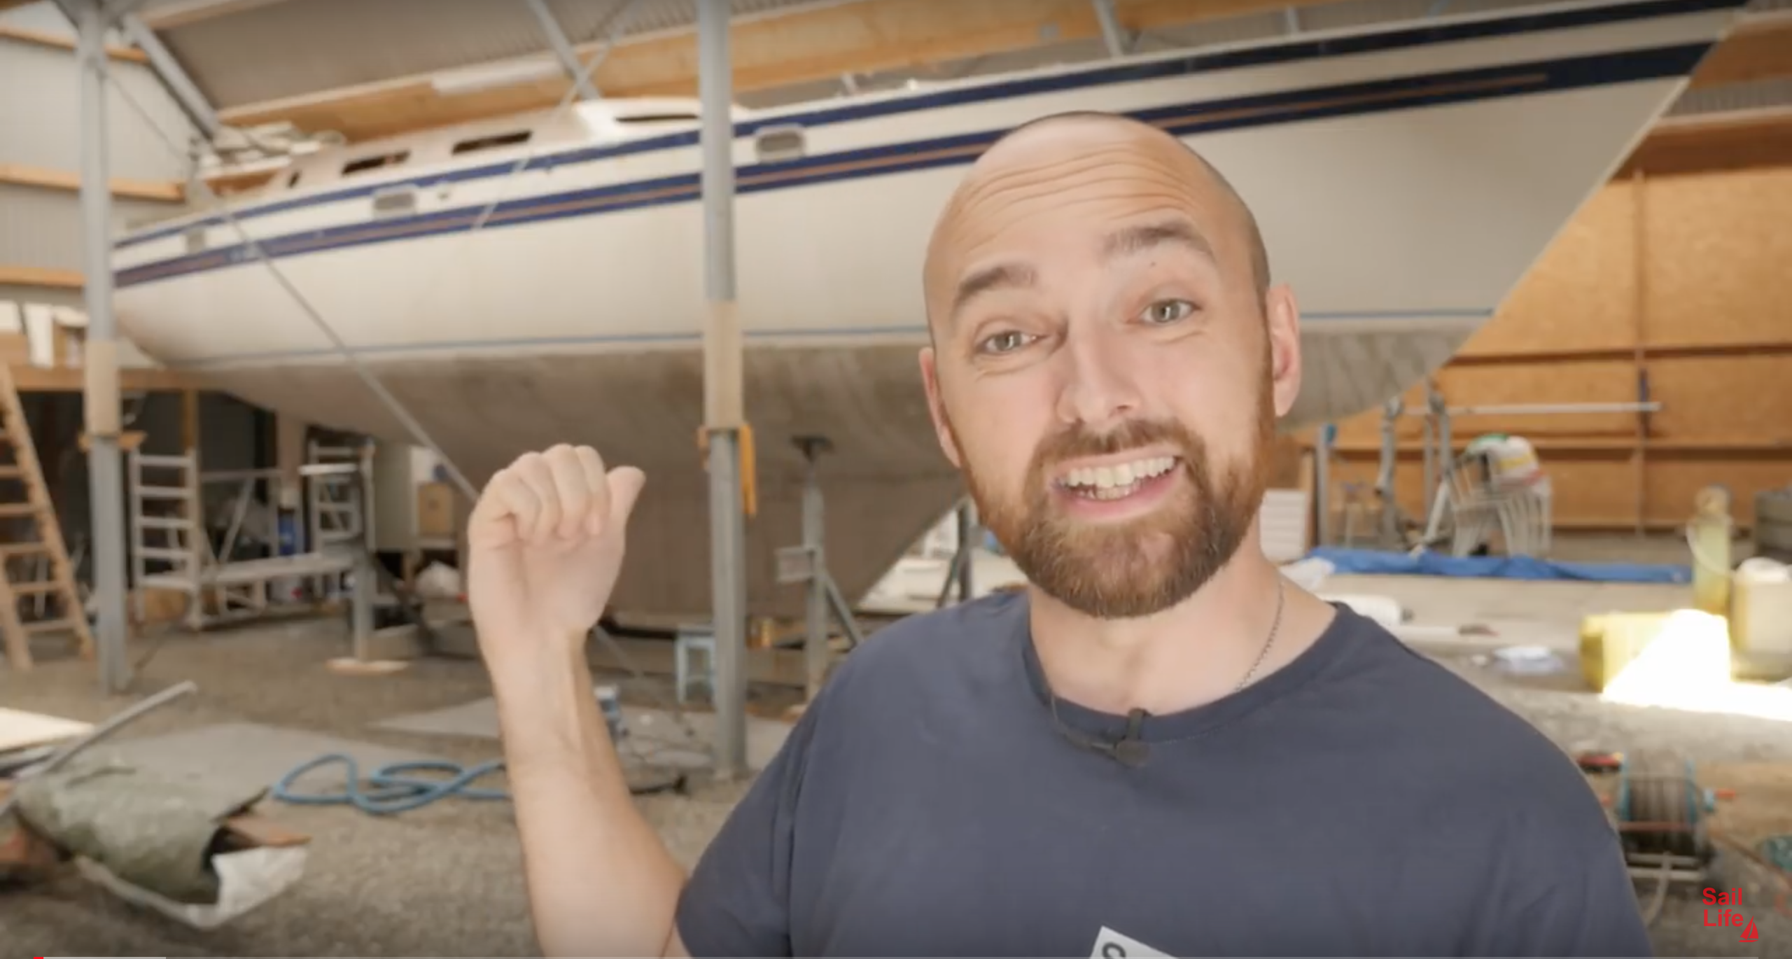

Slide 49
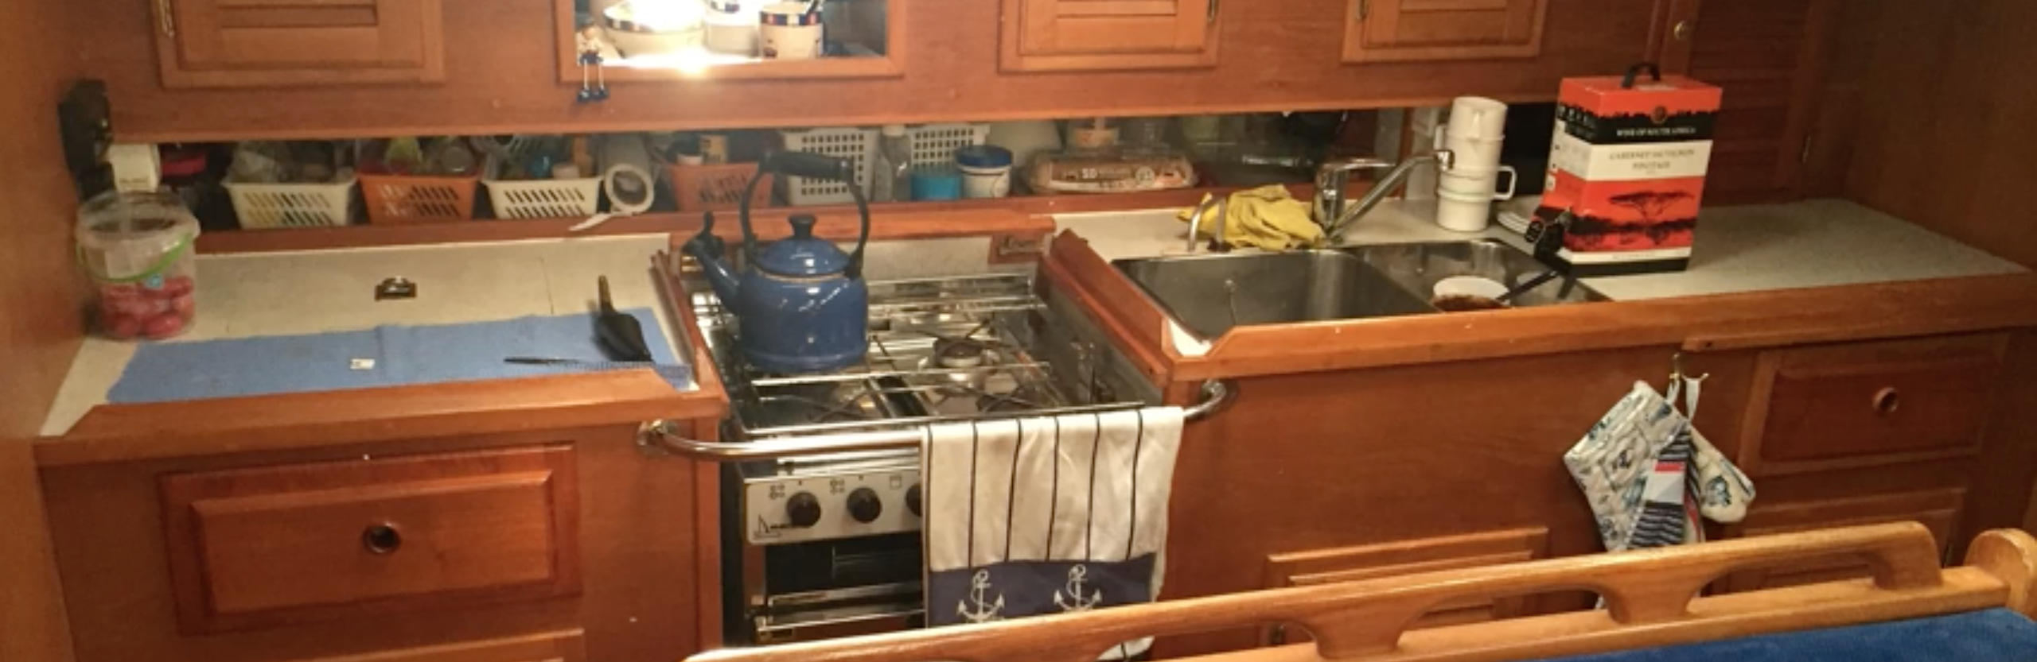
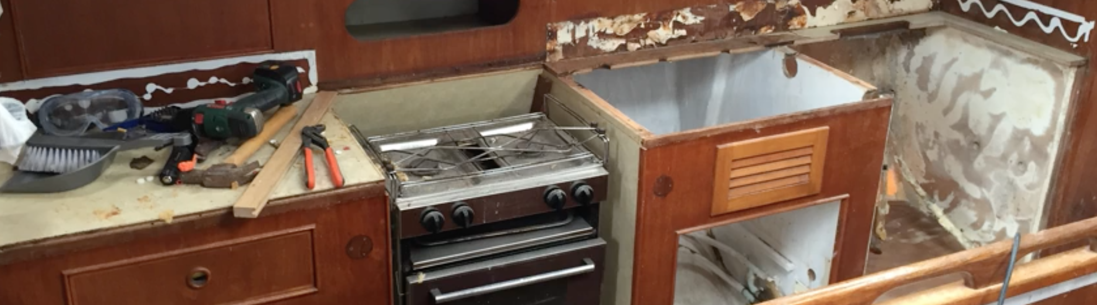
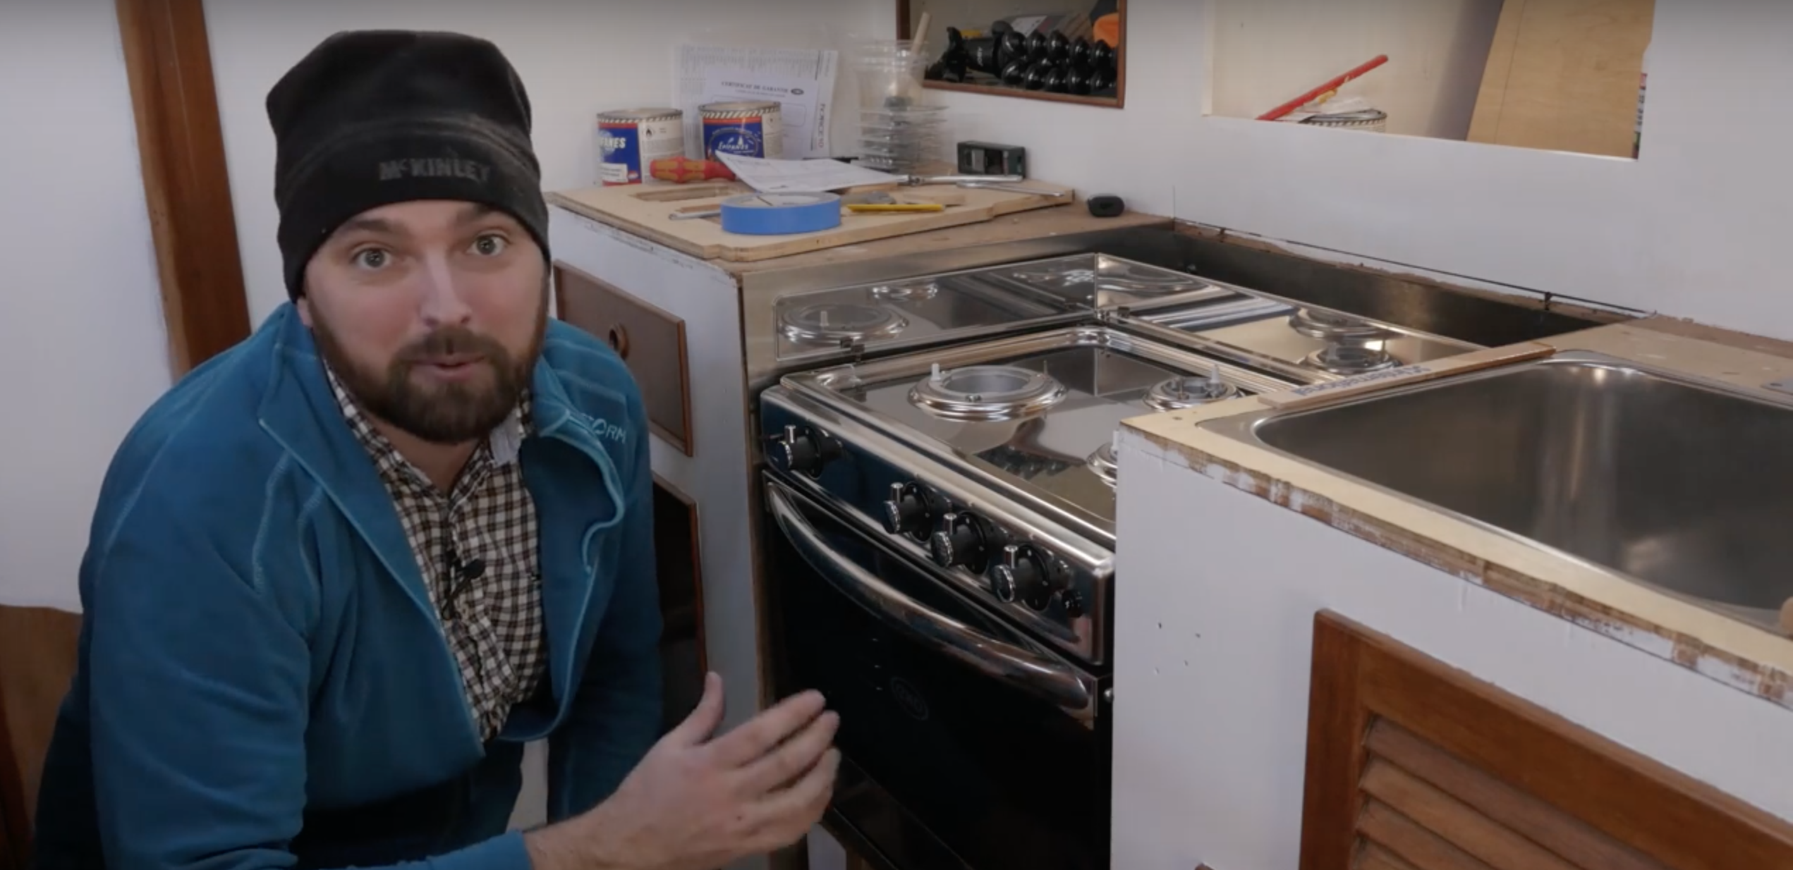

Slide 50
How can we give an individual the power to (re)make this decision?
How can we support the serendipitous, unexpected, and informal?
What communities might arise around this design choice?

Slide 51
Continuing Design and Accessibility
Accessibility is the primary use case, and driver of innovation, for design continuation tools
Assistive technologies like screen readers, literacy tools, etc. support largely unanticipated alternative modes of presentation and control
“Extreme users” tend to push the boundary of customizations, as well as repurposing tools unexpected and satisficing with those they can’t customize enough
e.g. JAWS scripts
Greater acknowledgement of mixed agency—community, collaboration, assistance

Slide 52
User Interface Options Demo

Slide 53
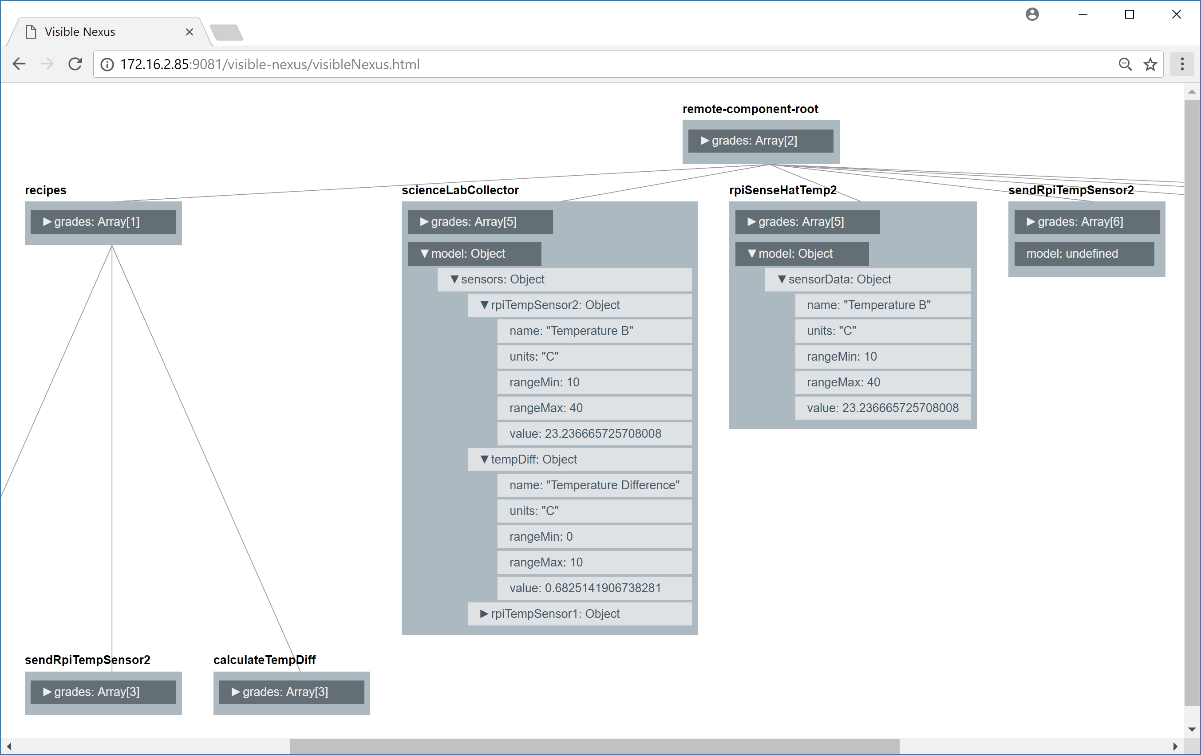

Slide 54
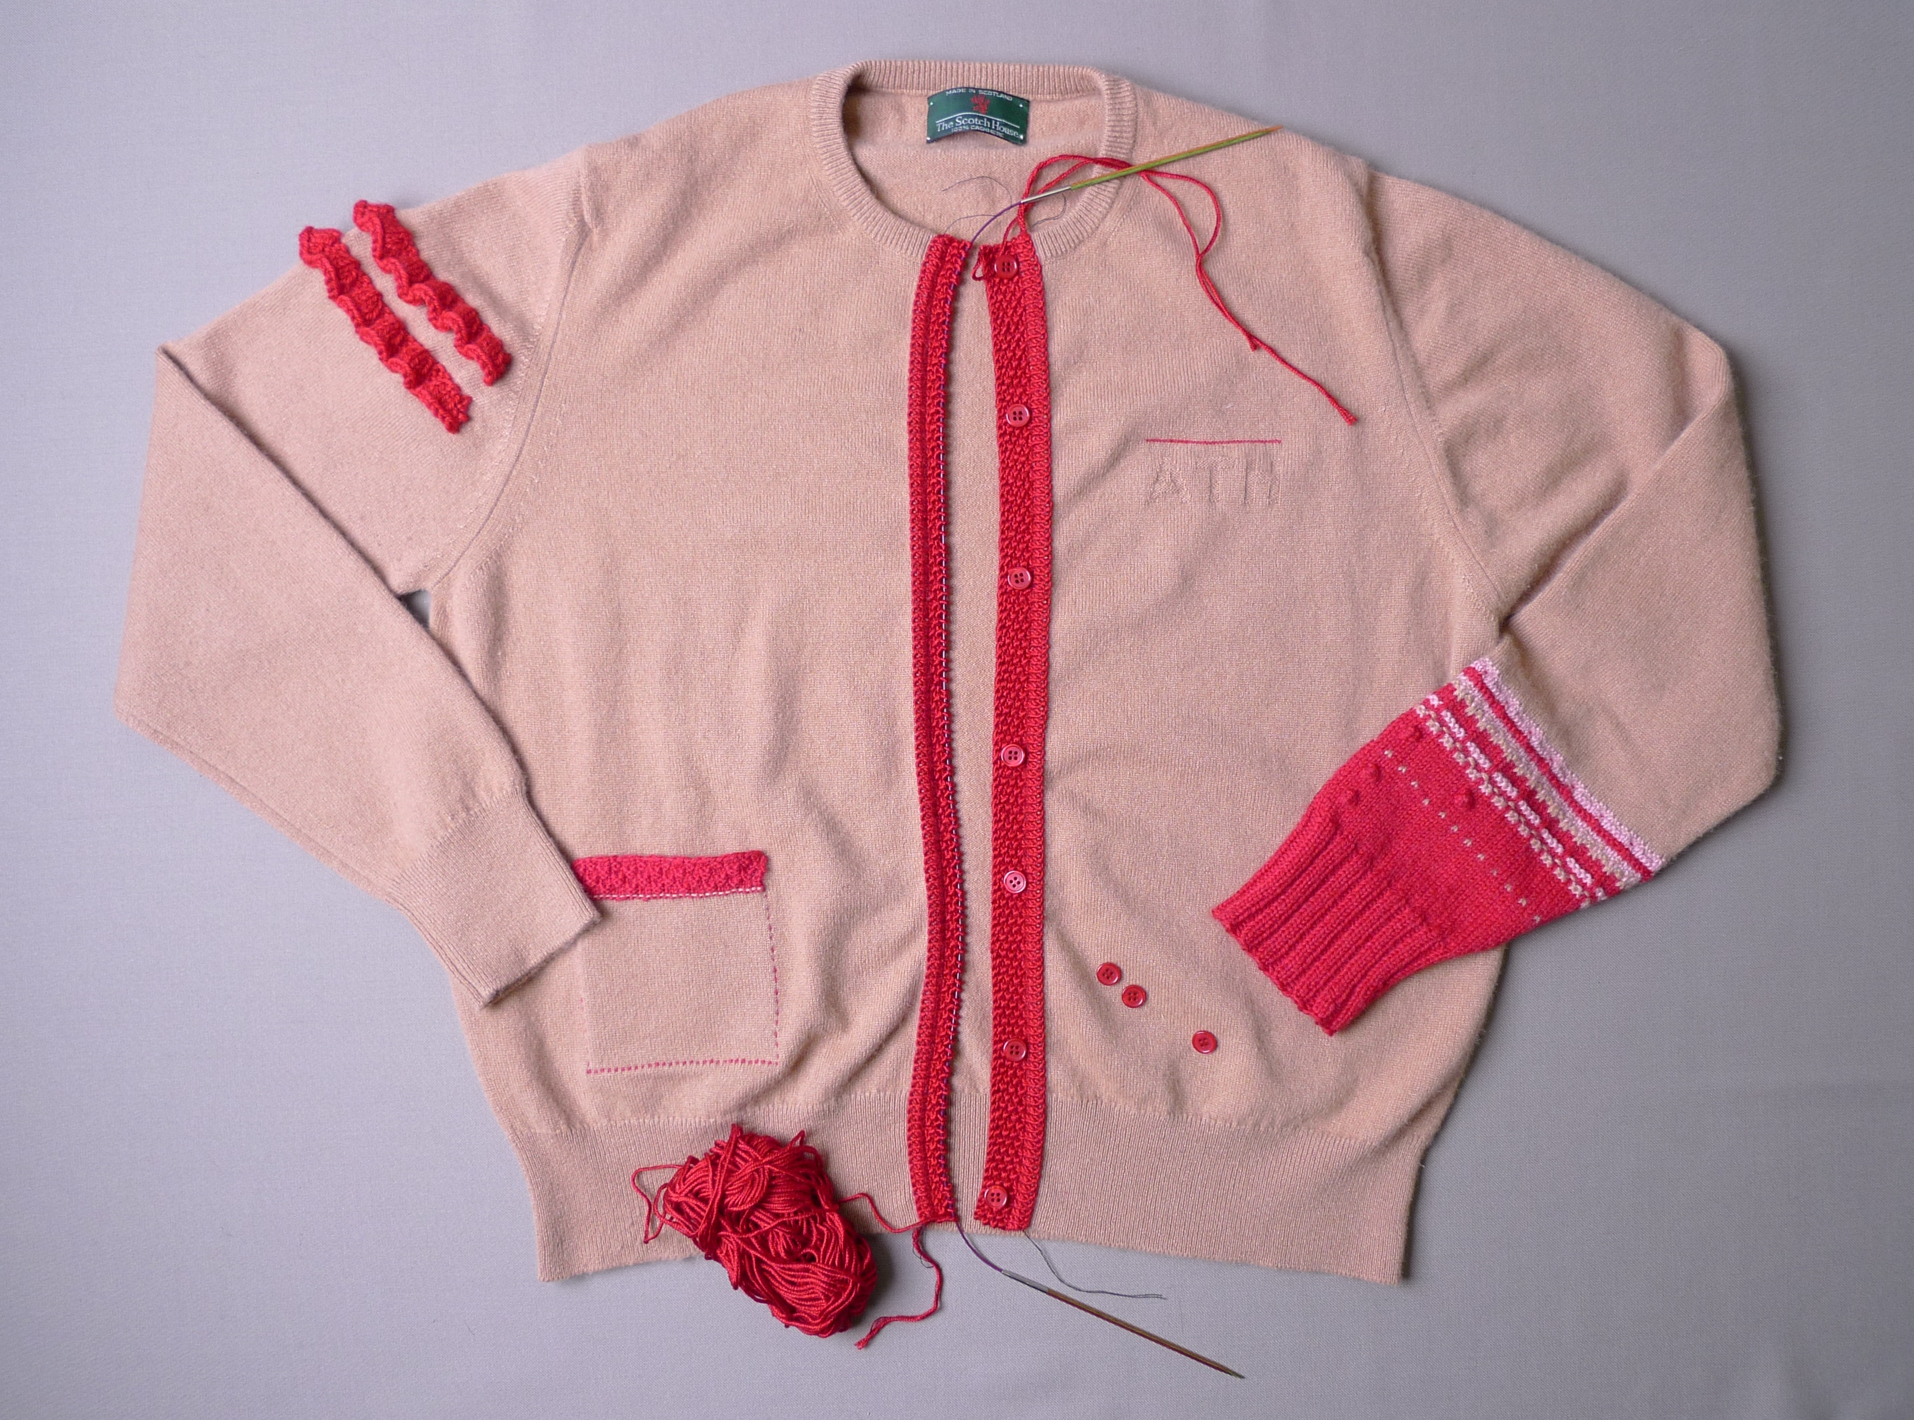

Slide 55
Material Case Study: Amy Twigger-Holroyd
Amy’s reknitting methods provide knitters with a way to modify, add to, or subtract from already-completed knitted garments (including industrially produced, machine-made)
  Unravelling, cutting, grafting, insertions, stitch hacks, and replacements
Knitting, viewed materially, has a remarkably dual quality—you can take yarn and knit a sweater, and you can “frog it,” taking it back to its elements (yarn), and knit something new with its materials
Re-knitting is not simply an idiosyncratic personal practice of Twigger Holroyd or her colleagues, but “an integral part of the practice of knitting” generally, a characteristic of the medium and the traditional methods of knitting itself
A speculative future: what if software was like knitting?

Slide 56
Characteristics of Material Software
Representation of program code as data—material for reflection and modification by other programs or by authors who come along later in the process. An ecosystem of authoring and customization tools.
Availability of landmarks—names or other stable means of reference (e.g. via CSS selectors)—for behavioural and compositional points within program code, such that another author, working outside the original program’s code, can identify these points and issue their own alternative logics.
Complete externalization of program state, also as data, in a form that it can be understood, manipulated, and modified live by programs located outside of the runtime of the software, so that software can be redesigned piecemeal and from a distance.

Slide 57
In Summary
Increasingly, our responsibility and engagement needs to be with communities and their environments
Innovation and change will never be found in the familiar and the “normal”—look to the edges
We have to be aware of our power, and design ways to give it up
Our technology discipline(s) need diversity and change, and we need to bring “users” into the process as serious co-creators, and by giving them new powers to continue the design process

Slide 58
Thank you!
Colin Clark
Inclusive Design Research Centre
cclark@ocadu.ca
colinclark.org
fluidproject.org
cities.inclusivedesign.ca
platform.coop

