Slide 1
What Machine Learning can do and cannot do?
by Ted Thompson

Slide 2
Outline
Probability and Statistics Connection
Optimization
Generative vs Discriminative Models
Types of Models
What Machine Learning cannot do
What Machine Learning can do

Slide 3
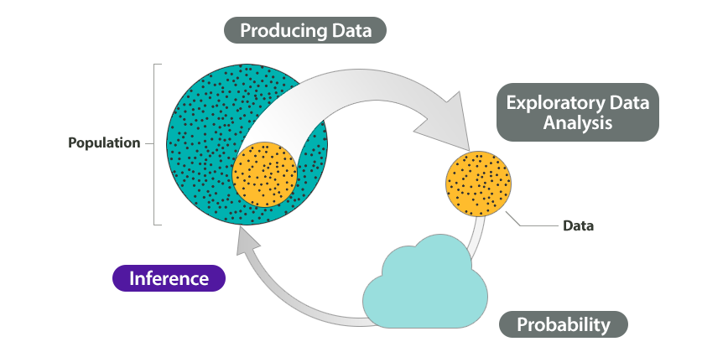
Probability and Statistics Connection

Slide 4
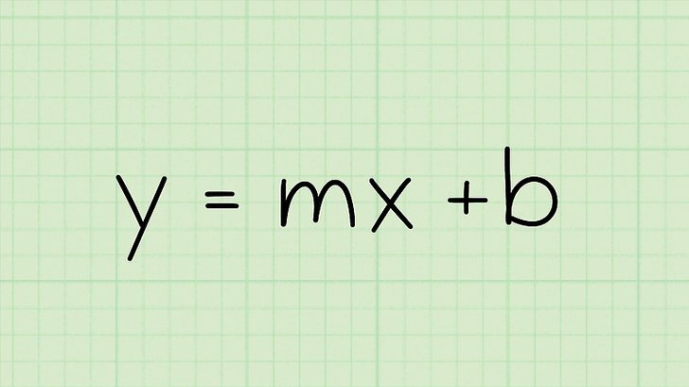
Optimization

Slide 5
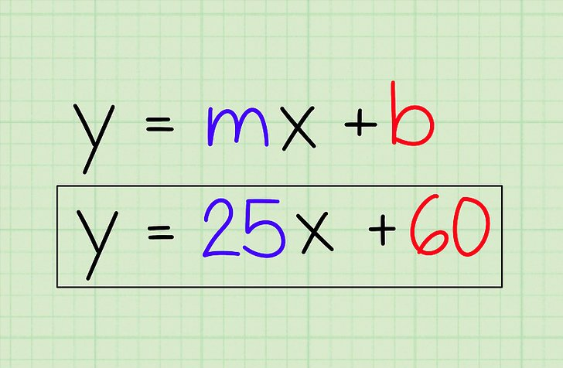
Optimization

Slide 6
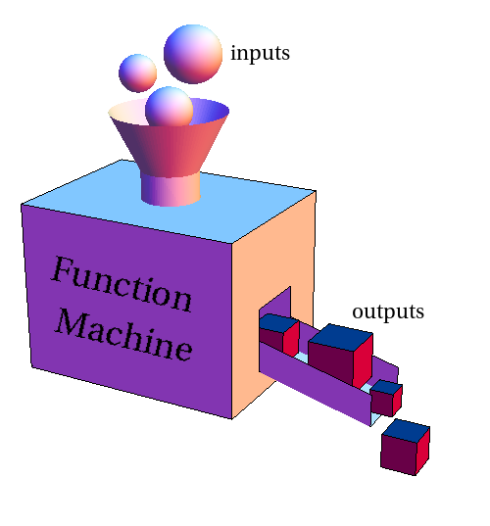
Optimization

Slide 7
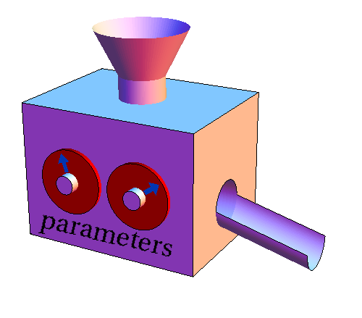
Optimization

Slide 8
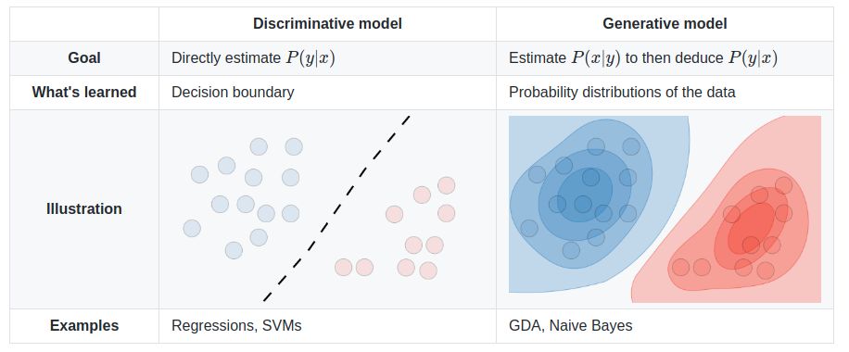
Discriminative Model
Generative Model

Slide 9
Discriminative Model
Generative Model
Support vector machine (SVM)
logistic regression
most deep neural networks
Naive Bayes
latent Dirichlet allocation (LDA)
Generative Adversarial Networks (GAN)
Variational Autoencoders (VAE)

Slide 10
What Machine Learning cannot do
Learn Without Sufficient Data
Explain itself (some models)
Reason
Do the Right Thing

Slide 11
Learn Without Sufficient Data
To little volume
Generalize without influence of practitioner (mostly)
Only knows what it was trained to do
Context

Slide 12
Explain itself (some models)
“…. It looked familiar?”
Machine Learning Model

Slide 13
Reason
A
C
B

Slide 14
Reason
B
A

Slide 15
Reason
C
B

Slide 16
Reason
C
B
A

Slide 17
Reason
C
A

Slide 18
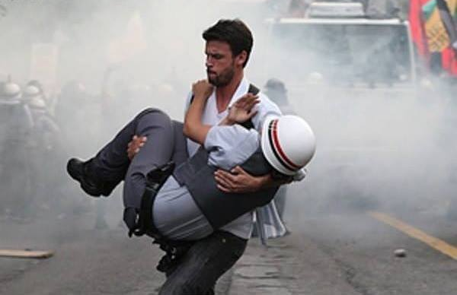
Do the Right Thing

Slide 19
What Machine Learning can do
Repetitive Tasks Really Fast
Drive you crazy
Generate Synthetic Data

Slide 20
Repetitive Tasks Really Fast

Slide 21
Drive You Crazy
It keeps overfitting

Slide 22
Generate Synthetic Data

Slide 23
The End.

