Slide 1
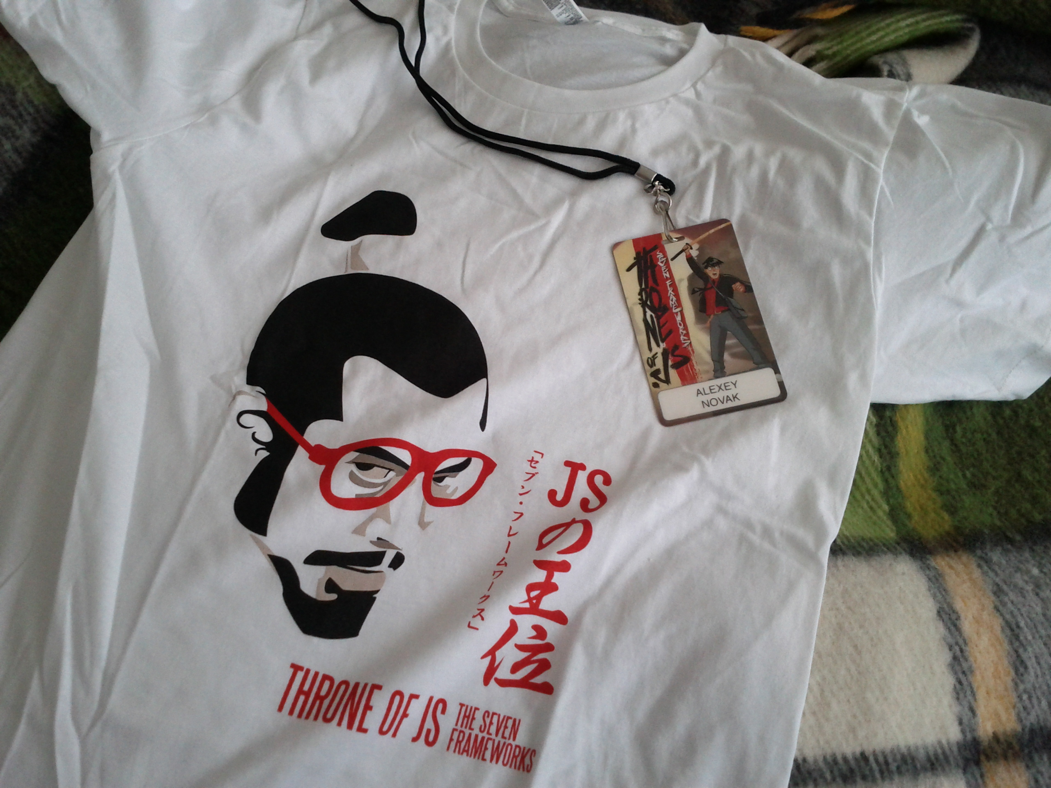
Throne.JS + frameworks

Slide 2
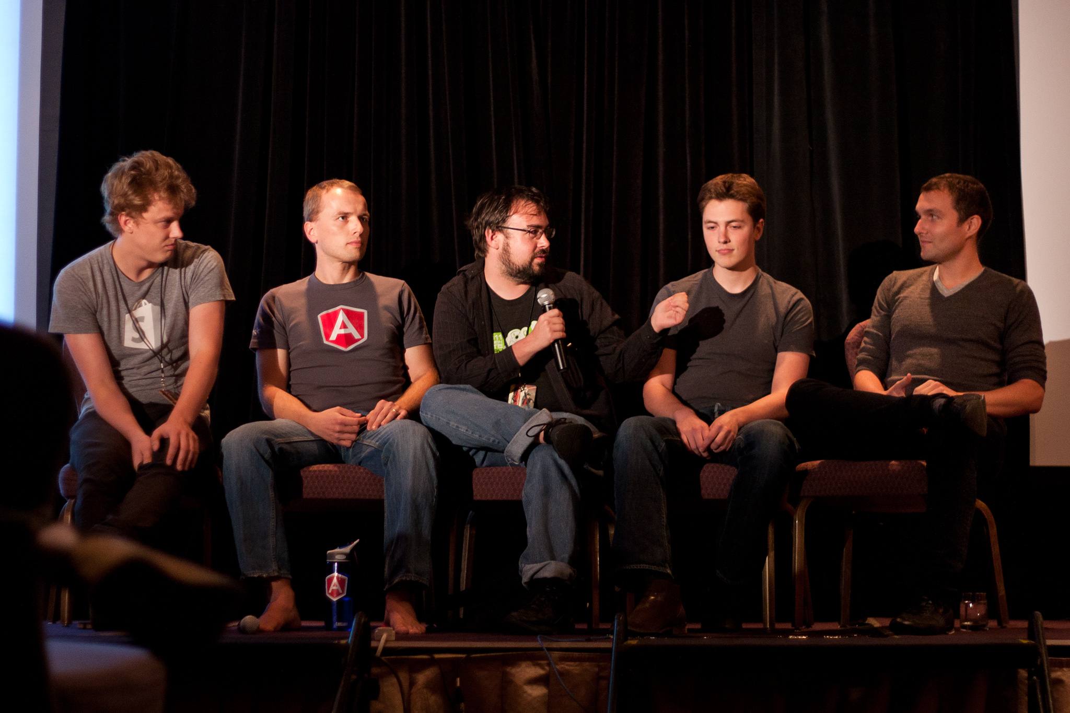

Slide 4
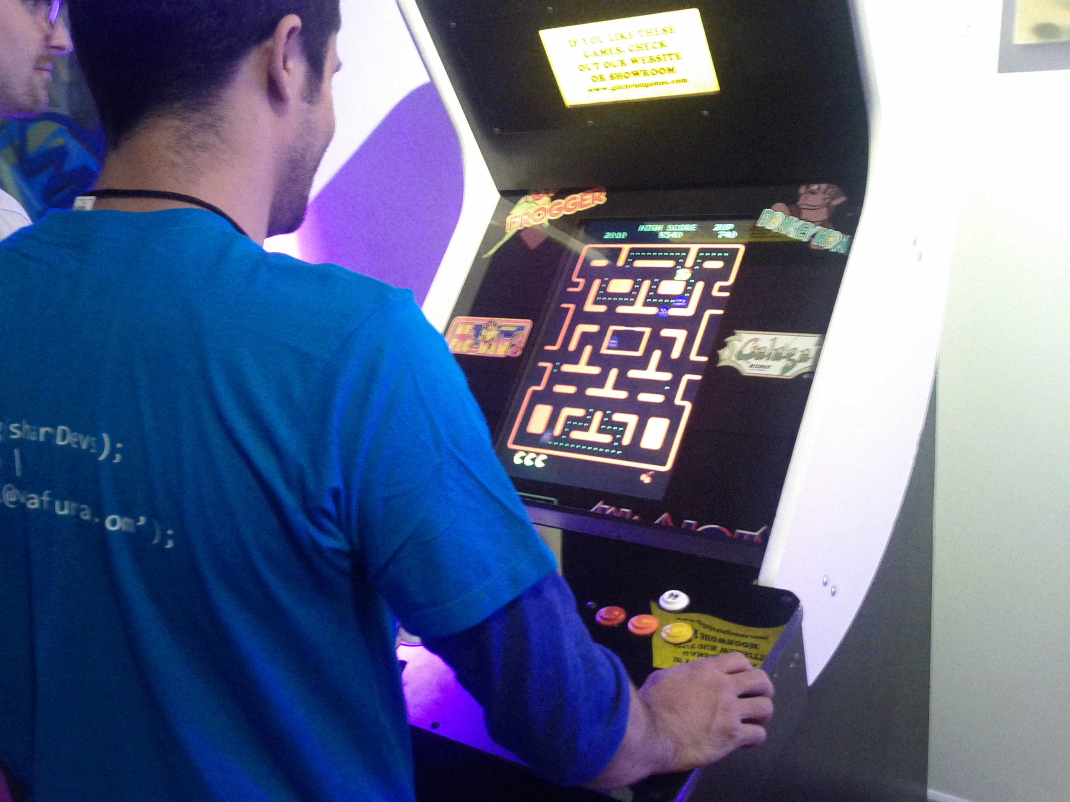
+

Slide 5
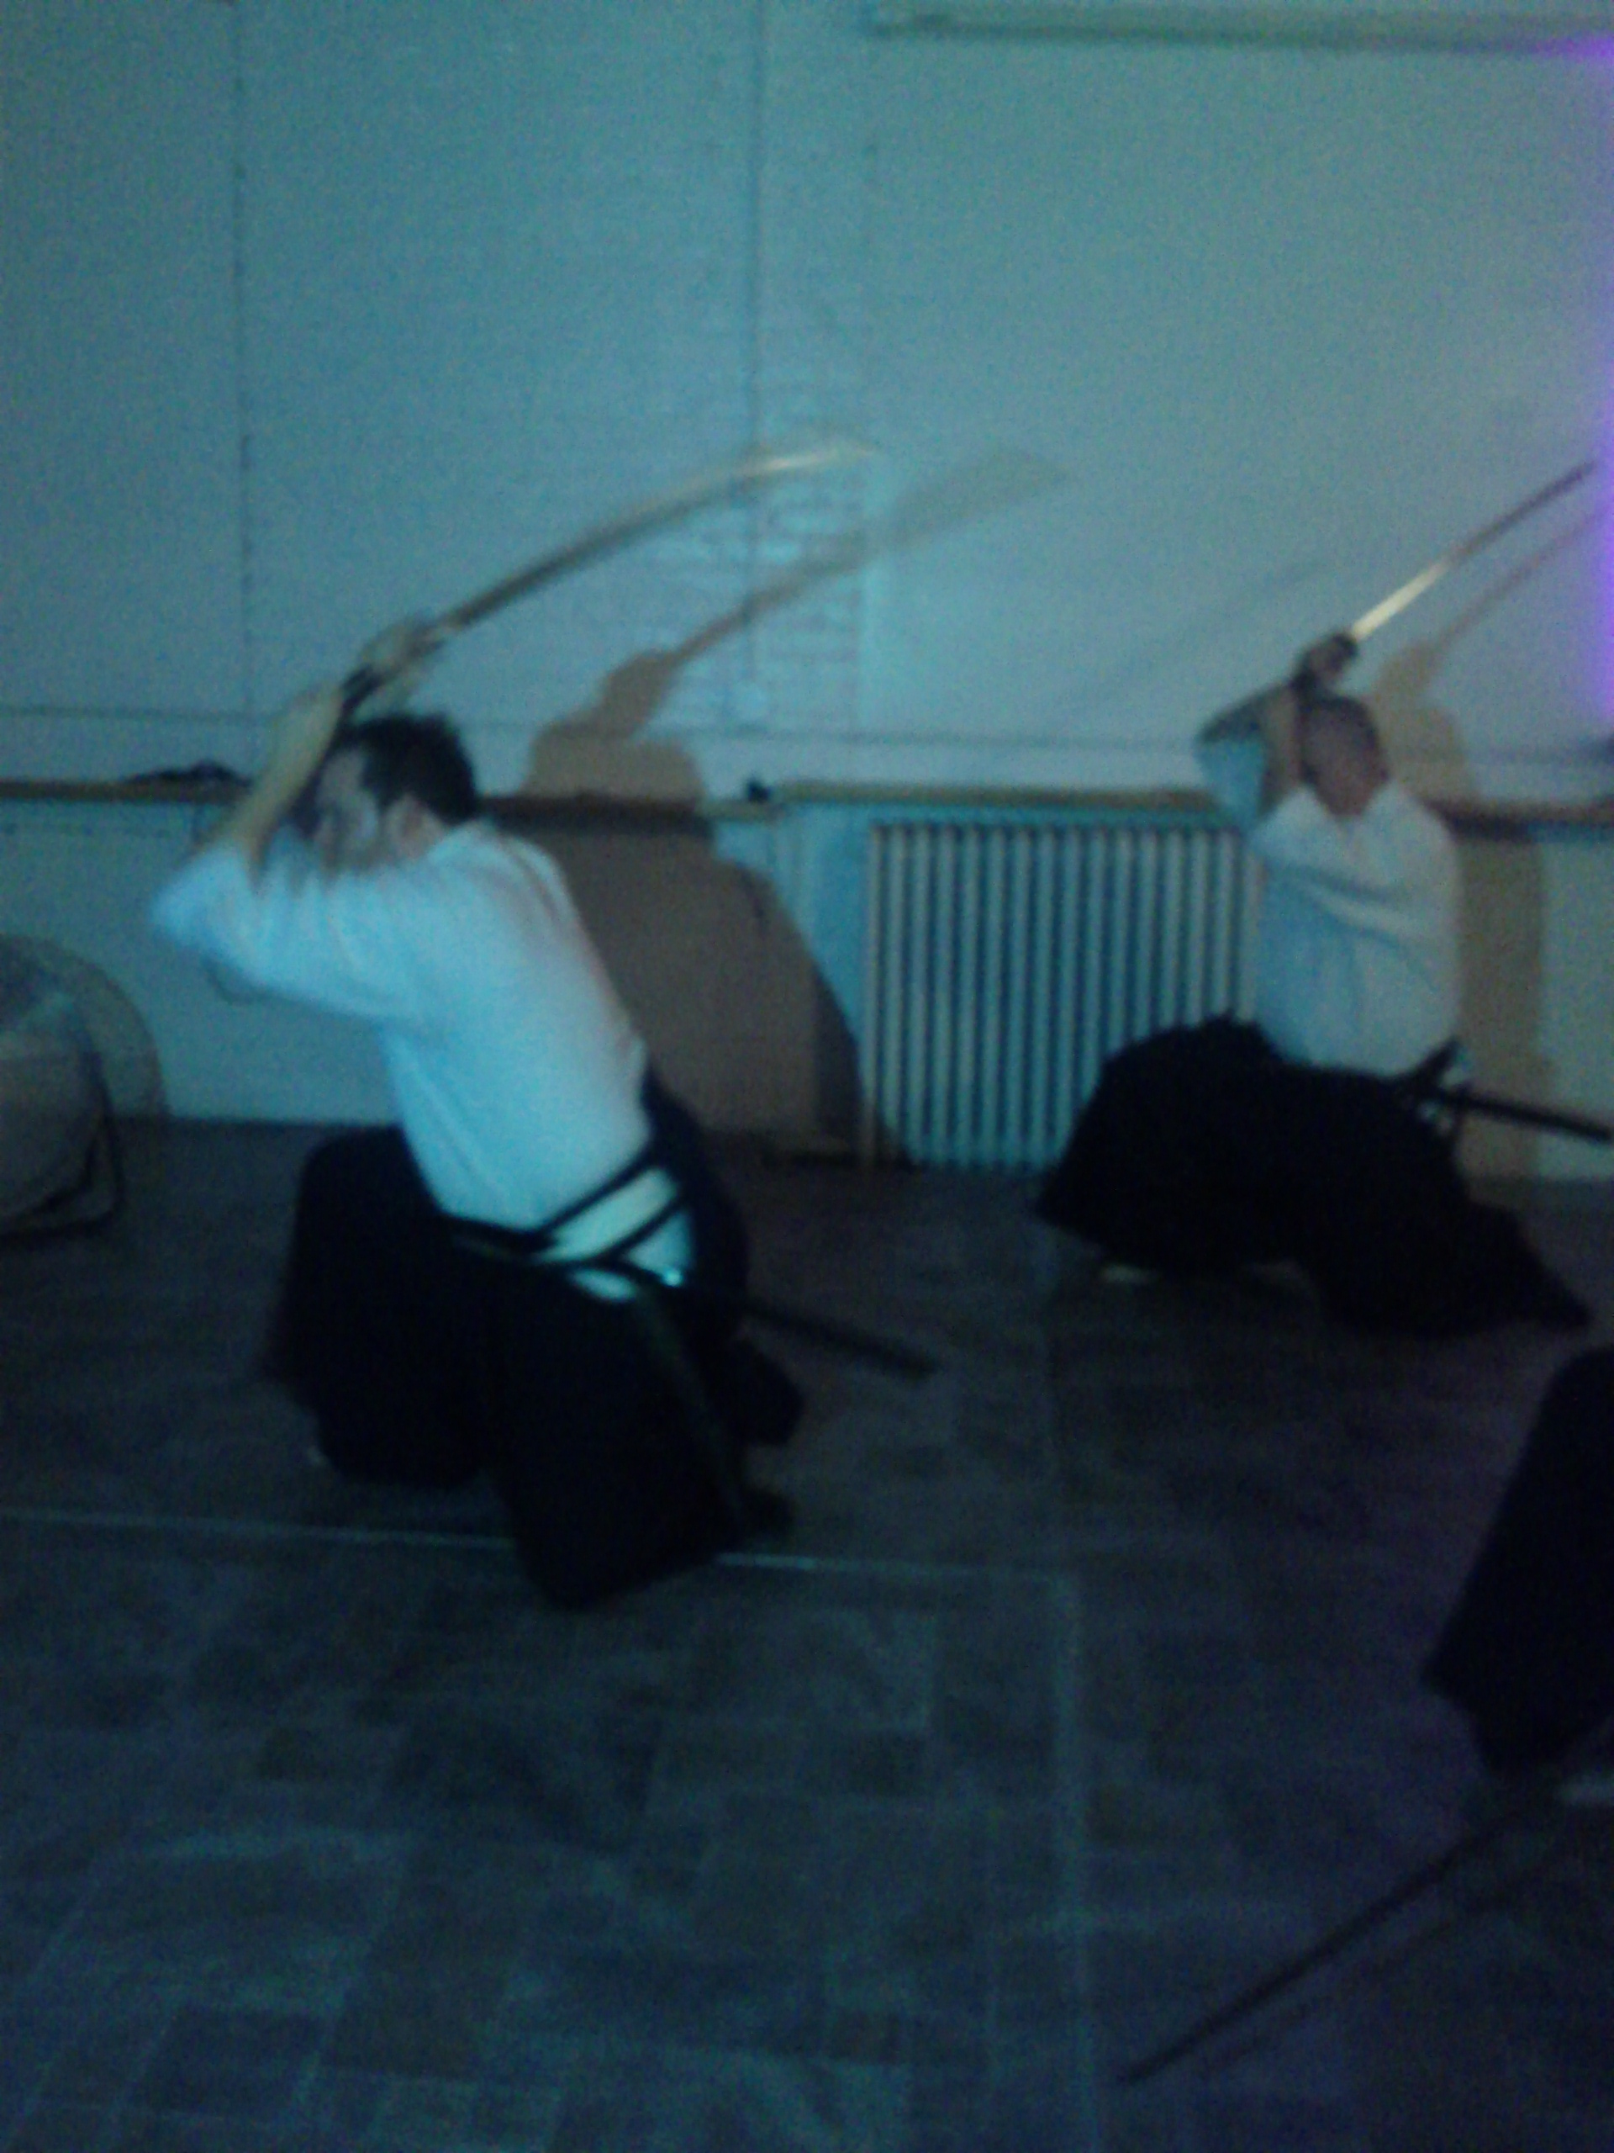
+
+

Slide 6
?

Slide 7
?
YUI
CanJS

Slide 8
????????
YUI
CanJS

Slide 9
+
+
+
In yo face!

Slide 10
What is in common ?

Slide 11
What is in common ?
Documentation and lots of it!

Slide 12
What is in common ?
Documentation and lots of it!
Side note
“Shipping is more important than the perfect code.”
- Yehuda Katz (Ember.JS)

Slide 13
What is in common ?
Does size matter?

Slide 14
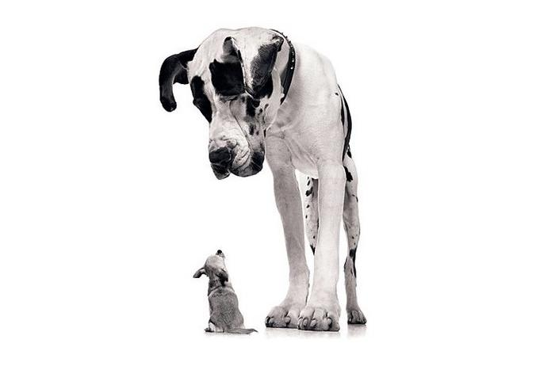
What is in common ?
Does size matter?

Slide 15
What is in common ?
Does size matter?
> 100 Kb ??
42 Kb
5.6 Kb

Slide 16
What is in common ?
Does size matter?

Slide 17
What is in common ?
Does size matter?
“Framework size? Include one less JPEG for your fancy website…”
- Throne.JS panel

Slide 18
Does size matter?
“You can get away by writing 1000 extra lines of code
on a server whatever language you would chose – Java or C#...
You cannot do the same with JavaScript. That makes
JavaScript an honest language. There is no chance for you
to write 1000 of additional JavaScript code without having
an impact on your data model or performance.”
- Jeremy Ashkenas (Backbone.js)

Slide 19
Audience question
> 100 Kb ??
42 Kb
5.6 Kb
?? Kb

Slide 20
Audience question
> 100 Kb ??
42 Kb
5.6 Kb
563 Kb ??

Slide 22
What is in common ?
Easy to learn.

Slide 23
What is in common ?
Easy to learn.
Create a website in 30 minute ?

Slide 24
What is in common ?
Easy to learn.
Create a website in 30 minute ?
Spend more time on a problem logic and less on a framework

Slide 25
Spend more time on a problem logic and less on a framework
“If complexity of your app grows over time and it becomes
so complex that you stop understanding how it works or
it is too hard to understand for others
- You do it wrong.”
- Igor Minar (Angular.js)

Slide 26
What is in common ?
Less “boilerplate”
In computer programming, boilerplate is the term used to describe sections of code
that have to be included in many places with little or no alteration.
It is more often used when referring to languages which are considered verbose,
i.e. the programmer must write a lot of code for minimal functionality.
The need for boilerplate can be reduced through high-level mechanisms.
Wikipedia

Slide 27
What is in common ?
MV*

Slide 28
What is in common ?
MV* = MVW

Slide 29
What is in common ?
MV* = MVW =
Model
View
Whatever

Slide 30
What is in common ?
MV* = MVW =
Statelessness

Slide 31
What is in common ?
MV* = MVW
Similarities or
Differences in
Infusion ?

Slide 32
What is in common ?
Performance/Features
Observables
Dynamic bindings
Routing
Offline storage
Speed

Slide 33
What is in common ?
Performance/Features
Observables
Dynamic bindings
Routing
Offline storage
Speed

Slide 34
“Optimization for a failure is very important”
- Alex MacCaw (Spine.js)

Slide 35
What is in common ?
Performance/Features
Observables
Dynamic bindings
Q #1 ?
Routing
Offline storage
Speed

Slide 36
What is in common ?
Performance/Features
Observables
Dynamic bindings
Q #1 !
Accessibility ??
Routing
Offline storage
Speed

Slide 37
What is in common ?
Dom Templating
vs
String Templating
(Handlebars/Moustache)

Slide 38
What is in common ?
Dom Templating
vs
String Templating
(Handlebars/Moustache)

Slide 39
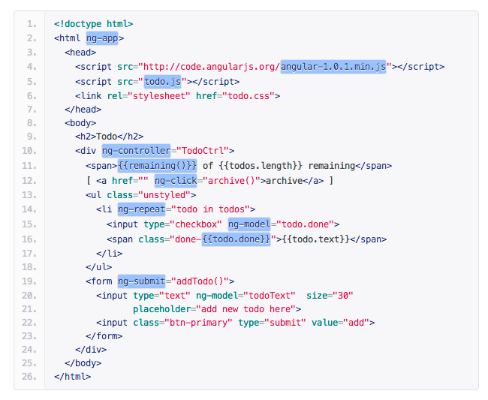
What is in common ?

Slide 40
What is in common ?
<h1>{{header}}</h1>
{{#bug}}
{{/bug}}
{{#items}}
{{#first}}
<li><strong>{{name}}</strong></li>
{{/first}}
{{#link}}
<li><a href="{{url}}">{{name}}</a></li>
{{/link}}
{{/items}}
{{#empty}}
<p>The list is empty.</p>
{{/empty}}

Slide 41
Why so technical ! Does it make any sense ?

Slide 42
If a designer does not understand concepts of
conditionals and iterations then no matter how easy we
design the tool for dynamic page creation it would not
help…
Panel

Slide 43
Any news for mobile?

Slide 44
Any news for mobile?
+
+

Slide 45
“Android is a new Internet Explorer from the mobile dev
perspective”
- John Bender (Jquery Mobile)
Any news for mobile?
+
+

Slide 46
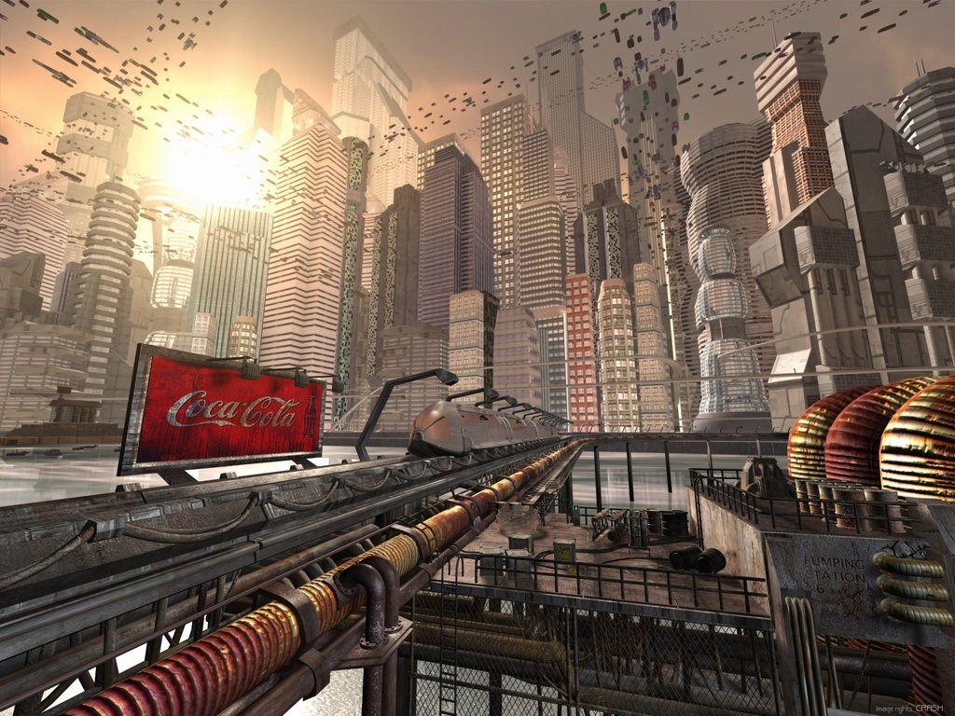
Future

Slide 47
Future

Slide 48
Function debouncing/thrashing
GIT model for records
Advanced offline storage
Rendering before server responded
More refine and advanced way to do your work
Future

Slide 49
??
Function debouncing/thrashing
GIT model for records
Advanced offline storage
Rendering before server responded
More refine and advanced way to do your work
Future

Slide 50
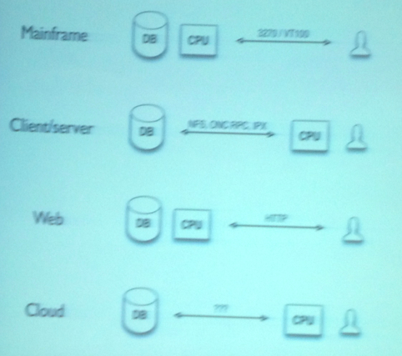
??
Future

Slide 51
??
first round funding
> 10 millions
HTTP is a stateless request/response: poor fit for real-time apps.
REST is also a poor fit.
We need a session-based *data* protocol
Data at the center of the World
Data on the wire not in the HTML
http://blog.blazingcloud.net/2012/07/22/meteor-throneofjs/
Future

Slide 52
“Coding is not the hardest part. The hardest part is to
deliver something usable and useful to the user.”
- Eric Ferraiuolo (YUI)

Slide 53
Throne.JS + frameworks

