Slide 1
Overview of WAI-ARIA and Accessibility APIs
Joseph Scheuhammer
Inclusive Design Research Centre
OCAD University
http://idrc.ocad.ca

Slide 2
WAI-ARIA: Accessibility APIs
Odd thing to talk about…
Cannot manipulate Accessibility API using JavaScript.
Cannot bind to it from within user agent’s JS interpreter.
Why talk about it in the context of JavaScript and jQuery?
It is what ARIA markup is for.
It is what Assistive Technologies (ATs) use.
“I added ARIA, but the screen reader isn’t using it”.
Accessibility API is very useful to know about.
Use an inspector tool to see how ARIA attributes are exposed to ATs.

Slide 3
WAI-ARIA: Accessibility APIs
What is an Accessibility API?
What is it for?
How does ARIA fit into the picture?
Why should I care?

Slide 4
WAI-ARIA: Accessibility APIs
Accessibility API contains semantic information of what is running on the user’s desktop.
“AAPI”
“A11y API”
Applications publish this information.
Assistive Technologies relay the information to the user.

Slide 5
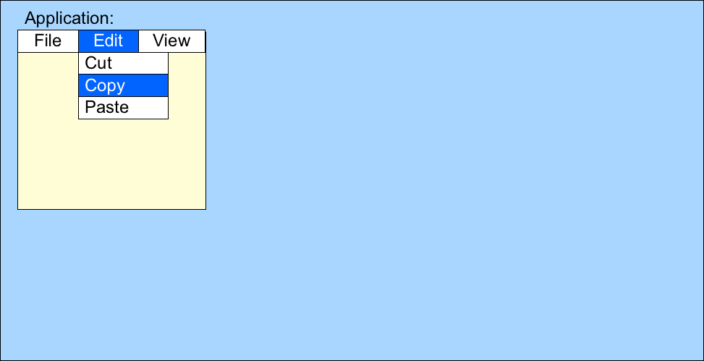
WAI-ARIA: Accessibility APIs
Desktop:

Slide 6
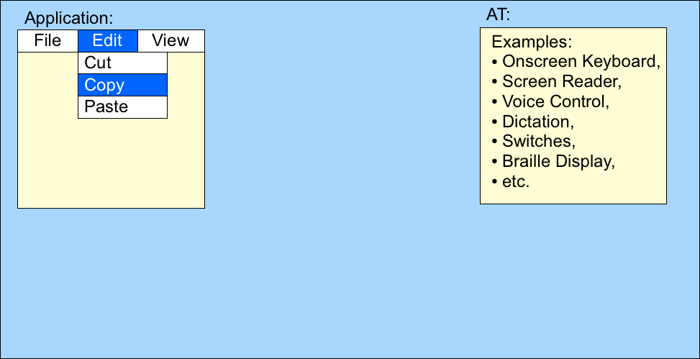
WAI-ARIA: Accessibility APIs
Desktop:

Slide 7
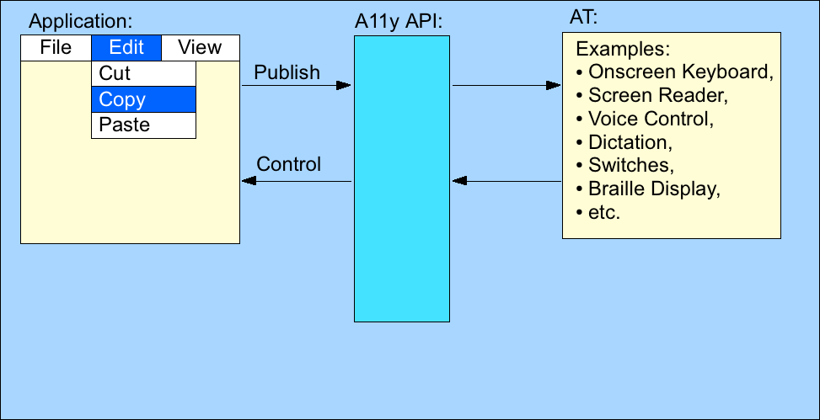
WAI-ARIA: Accessibility APIs
Desktop:

Slide 8
WAI-ARIA: Accessibility APIs
What is published?
A tree data structure of accessible objects.
Accessible has:
Role: Menu item.
Name: “Copy”.
Description (optional).
States and properties: “Enabled, focusable, focused”.
…
Events to notify AT about changes (focus, selection).
Note: AAPI events.
AT is informed about what is going on.

Slide 9
WAI-ARIA: Accessibility APIs
History
AAPIs developed back in ancient times: ‘80s and mid to late ‘90s.
MSAA, IA2, ATK/AT-SPI.
More recently: UIA, AX.
Effort directed towards desktop GUI applications.
Web was young – Web 1.0.
The same technique worked with browsers because:
Web documents were document oriented.
Headings, paragraphs, etc.
Similar to how word processors documents were handled.
Form elements exposed as native controls.

Slide 10
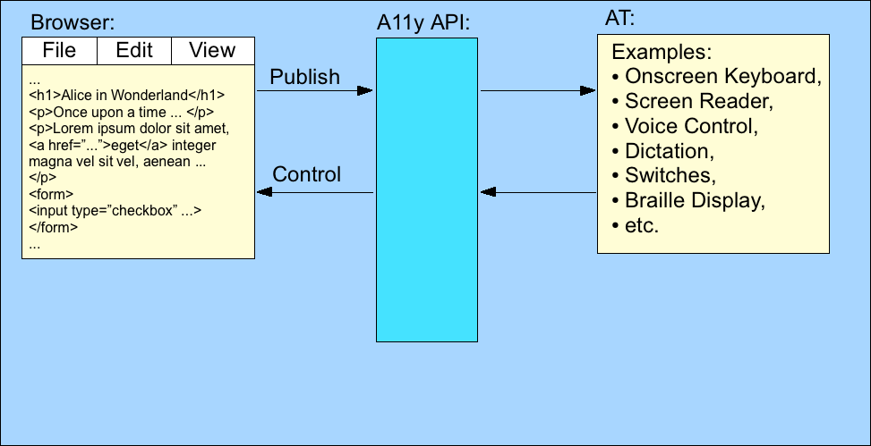
WAI-ARIA: Accessibility APIs
Desktop:

Slide 11
WAI-ARIA: Accessibility APIs
Web 2.0
DHTML
Use of CSS and JavaScript to mimic desktop applications.
Extend the interactivity of the web page.
No longer documents with a few controls.
Web as a platform for Rich Internet Applications.

Slide 12
WAI-ARIA: Accessibility APIs
Web 2.0
DHTML not exposed in AAPI in a useful way.
Not document-like.
“Div-itis”
Spaghetti: lots of nested <div>s and <span>s.
Visually: renders to look like a desktop GUI.
Behaves: similar to its desktop counterpart.
Need to expose the information as intended by the author.
“This is not a Checkbox” example.

Slide 13
WAI-ARIA: Accessibility APIs
WAI-ARIA
Accessible Rich Internet Application.
A set of attributes for describing what the markup + CSS + JavaScript really is.
Initial version back-ported from AAPIs.
Turning AAPI data structures into markup since 2006.
Role attribute: role=“toolbar”.
Property attributes: aria-label=“Cut”.
State attributes: aria-checked=“true” or “false”.
Browser’s job is to publish ARIA information to the standard AAPI.
Note: ARIA does not define an event system. See IndieUI.

Slide 14
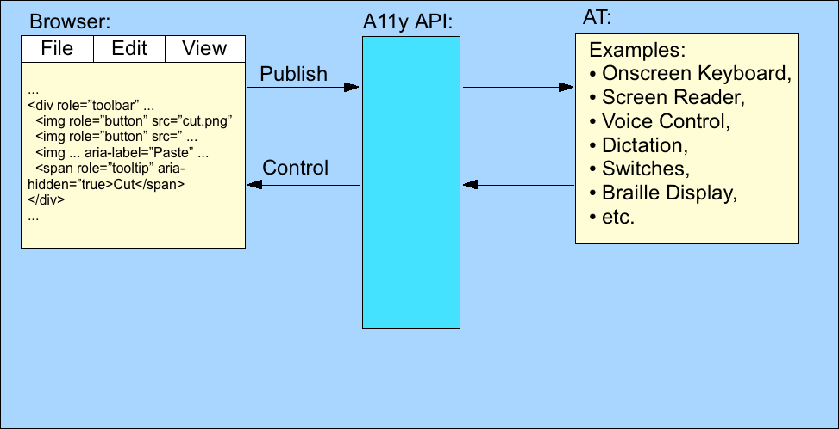
WAI-ARIA: Accessibility APIs
Desktop:

Slide 15
WAI-ARIA: Accessibility APIs
WAI-ARIA
Unobtrusive.
After the fact.
Will not magically transform elements into something they are not.
Assumes that elements are styled and scripted to look and behave other than their native semantic.
Annotations.
“ARIA doesn’t do anything”.
Recall “This is not a Checkbox” example.
Markup with and without ARIA behaves the same in the browser window.

Slide 16
WAI-ARIA: Accessibility APIs
WAI-ARIA
Can, however, link styling to changes in ARIA states.
[aria-checked="true"]:before { background-image: url(checked.gif); }
Language neutral
Initial targets: HTML 4/XHTML 1 and HTML5.
Next: SVG
Also used by XUL (Xml User interface Language).
Used in Mozilla products for their own UI.

Slide 17
WAI-ARIA: Accessibility APIs
Unobtrusive Implication: Conflict with Host Semantics
Rule: ARIA role wins.
<h1 role=“checkbox” …>
Exposed as checkbox in AAPI.
Caution: <button role=“heading” …>
Exposed as heading in AAPI.
Browser: looks and acts like a button, unless …
Rule: ARIA state/property loses.
<input type=“checkbox” checked aria-checked=“false” …>
= checked.
Must use element lacking native ‘checked’ for tri-state checkbox.

Slide 18
WAI-ARIA: (Very) Brief Introduction to ARIA Markup
Roles
Abstract (don’t use):
command, landmark, range, …
Widget:
button, checkbox, menubar, dialog, …
Document:
article, note, directory, heading, …
Landmark:
main, search, navigation, application …
Live regions:
alert, log, status, timer, marquee.

Slide 19
WAI-ARIA: (Very) Brief Introduction to ARIA Markup
States/Properties (aria-*)
Number of ways to classify.
Global
Role not required.
aria-label, aria-describedby, aria-flowto, aria-owns, …
Non-global
Use with specific role(s).
aria-checked: option, checkbox, menuitemcheckbox, radio, menuitemradio, treeitem.
Values: true, false, mixed (tri-state).

Slide 20
WAI-ARIA: (Very) Brief Introduction to ARIA Markup
States/Properties (aria-*)
Widget
Global: aria-label, aria-haspopup, …
aria-checked: option, checkbox, menuitemcheckbox, radio, menuitemradio, treeitem.
Values: true, false, mixed (tri-state).
Relationships:
aria-owns (global).
aria-posinset, aria-setsize: listitem, treeitem, option.
Can be used in dynamically loaded tree where not all of the items are present at once.

Slide 21
WAI-ARIA: (Very) Brief Introduction to ARIA Markup
States/Properties (aria-*)
Live region (global):
aria-live, aria-busy, aria-atomic, aria-relevant.
aria-live == (region-is-live && how polite)
off: updates not reported by AT unless focus is on region.
polite: updates reported at next graceful opportunity – don’t interrupt.
assertive: updates reported immediately.
Drag-and-drop (global):
aria-grabbed, aria-dropeffect (on targets).

Slide 22
WAI-ARIA: Accessibility APIs
AAPI Inspection tools.
DOM Inspector (FF plugin):
https://addons.mozilla.org/en-US/firefox/addon/dom-inspector-6622/
Accprobe (Windows MSAA, IA2):
http://accessibility.linuxfoundation.org/a11yweb/util/accprobe/
Accerciser (GNOME/Linux ATK/AT-SPI):
https://wiki.gnome.org/Accerciser
Accessibility Inspector (Mac OS X AX):
https://developer.apple.com/library/mac/documentation/Accessibility/Conceptual/AccessibilityMacOSX/OSXAXTesting/OSXAXTestingApps.html

Slide 23
WAI-ARIA: Accessibility APIs
AAPI Inspection tools.
The Paciello Group’s AViewer (MSAA, IA2, UIA):
http://www.paciellogroup.com/resources/aviewer

Slide 24
WAI-ARIA: Accessibility APIs
W3C Standard (Candidate Recommendation).
Specification:
http://www.w3.org/WAI/PF/aria/
Authoring Practices Guide:
http://www.w3.org/WAI/PF/aria-practices/
User Agent Implementation Guide:
For Browser and AT vendors.
http://www.w3.org/WAI/PF/aria-implementation/
Using WAI-ARIA in HTML:
http://www.w3.org/TR/2013/WD-aria-in-html-20130822/

Slide 25
Thank You!

