Slide 1
Inclusive Design: Transforming Libraries
Alan Harnum
Senior Inclusive Developer
Inclusive Design Research Centre
OCAD University
March 13, 2018

Slide 2
Outline
Who Am I? Who Are You?
What Is Inclusive Design? How Do We Practice It?
Manifestations of Inclusive Design in Libraries
Towards an Inclusive Design Community in Libraries
Questions and Feedback
Notes:
Welcome, and thank you for attending this webinar on inclusive design and libraries; I’m glad you could be here.
An hour is not a lot of time; here’s what going to happen in the next hour.
I’ll introduce myself and ask you to introduce yourselves; I like to know my audience and I like my audience to know each other.
First, I’ll talk generally about what inclusive design as it is studied, practiced and grown at the Inclusive Design Research Centre, and in the wider world.
Secondly, I’ll discuss some examples I’m aware of from the library world that manifest aspects of inclusive design. If you’ve got your own examples, that would be a good time to share them.
Thirdly, I’ll talk about how we might continue the conversation about inclusive design in libraries. An hour, as I said, is not a lot of time.
In closing, I’ll take any questions in the remaining, and share my contact information if you have follow-up questions.

Slide 3
WHO AM I? WHO ARE YOU?
“If you do not know where you come from, then you don't know where you are, and if you don't know where you are, then you don't know where you're going. And if you don't know where you're going, you're probably going wrong.”
- Terry Pratchett, I Shall Wear Midnight

Slide 4
WHO AM I?
Notes:
If you read my bio in Winter 2018 Education Institute brochure, I describe myself as “a design researcher, software developer and former public librarian”.
I think those last two are relatively straightforward – I am currently a software developer and formerly a public librarian – but I wanted to talk briefly about what a design researcher is and about where I work now.
Where I work now is the Inclusive Design Research Centre, “a research and development centre at OCAD University where an international community of open source developers, designers, researchers, advocates, and volunteers work together to ensure that emerging information technology and practices are designed inclusively.” [https://idrc.ocadu.ca/about-the-idrc]
The IDRC defines inclusive design as “design that considers the full range of human diversity with respect to ability, language, culture, gender, age and other forms of human difference”. [https://idrc.ocadu.ca/resources/idrc-online/49-articles-and-papers/443-whatisinclusivedesign]
A design researcher is, tautologically speaking, someone who researches design. Design is a broad term and the Wikipedia article [https://en.wikipedia.org/wiki/Design] is worth a read for understanding some of the diverse understandings of the term. As I often think about it, design is an intentional consideration and refinement of processes, tools, systems and people as they interact and shape each other to produce particular outcomes. Those outcomes could be material or digital objects, or new or changed services.
So it is equally coherent to talk about graphic design, software design, architectural design, furniture design, service design or business process design, though the methods, tools, systems and people involved in those design practices are often very different.
So an inclusive design researcher is someone who tries to better understand, shape and communicate about processes, tools, systems and how all those interact with people (and how people interact with each other, and how processes, tools and systems influence human interaction) with an overarching goal of considering and respecting the full range of human diversity and difference in what we build and how we build it, whether it’s web applications, library buildings or customdf service processes.
Because my background is in software development and the public sector (via libraries), most of my work day to day is in software development, with a sideline into writing, outreach, project management and policy work. But I work as part of a collaborative team that includes visual designers, artists and experts on accessibility technology, law and policy.
Because my research group’s background is in accessibility, we continue to have a large role in those conversations – our director Jutta Treviranus was and is closely involved in the development of the Accessibility for Ontarians with Disabilities Act – but our interests also include topics such as economic marginalization and discrimination in algorithmic systems. And we’re a node in a larger network of academics, advocates and community members who have interests of one kind or another in building a more inclusive (and, I’d venture to even say, just) world.

Slide 5
WHO ARE YOU?
? ? ? ?
Notes:
But I’d like to know something about you all as well, so please answer the two polls that come up – and feel free to type something more detailed about yourself into the chat window. I’d be particularly curious to hear why you chose to attend this webinar today.
POLL 1: What kind of library system are you from?
Public
Academic
Special
Other
POLL 2: How familiar are you with the Accessibility for Ontarians with Disabilities Act (or similar legislation if you are outside Ontario) and accessibility in general?
Not familiar.
Some familiarity such as taking training on the AODA from my organization
Part of my job specifically involves accessibility work, such as helping my organization comply with the AODA and other accessibility-related legislation.
I ask about people’s familiarity with the AODA because this is something of a proxy for general knowledge about accessibility. I’m not going to go into detail about the AODA because that’s not the focus here, but knowing the audience composition is helpful for me.

Slide 6
WHAT IS INCLUSIVE DESIGN?
“Designing for inclusivity not only opens up our products and experiences to more people with a wider range of abilities. It also reflects how people really are. All humans are growing, changing, and adapting to the world around them every day. We want our designs to reflect that diversity. Every decision we make can raise or lower barriers to participation in society. It’s our collective responsibility to lower these barriers though inclusive products, services, environments, and experiences.”
- Inclusive: A Microsoft design toolkit
https://www.microsoft.com/en-us/design/inclusive

Slide 7
THE idrc’s definition
“We have defined Inclusive Design as: design that considers the full range of human diversity with respect to ability, language, culture, gender, age and other forms of human difference.”
https://idrc.ocadu.ca/resources/idrc-online/49-articles-and-papers/443-whatisinclusivedesign
Notes:
The IDRC’s working definition of inclusive design is, as previously mentioned, “design that considers the full range of human diversity with respect to ability, language, culture, gender, age and other forms of human difference”.
I emphasize the “working” part of “working definition” because we don’t think we’ve got inclusive design perfected (far from it!), but we believe in the goal we’re working towards: design practice in terms of philosophy, method, tools and culture that considers, respects and involves the full range of human difference. We aspire to this both because we believe in it as a core value of design practice, but also because we believe it leads to better outcomes for everyone.
There are other definitions of inclusive design. The Design Council of the UK has this one, which focuses on the built environment; I like its sentiment a lot: “Inclusive design aims to remove the barriers that create undue effort and separation. It enables everyone to participate equally, confidently and independently in everyday activities”
The IDRC emphasises three specific dimensions of inclusive design, which we sometimes also call the “three pillars”. I’m going to go over these briefly – if you’d like to read about them in more detail there is more of that on the IDRC’s website.

Slide 8
1: Recognize diversity and uniqueness
https://idrc.ocadu.ca/resources/idrc-online/49-articles-and-papers/443-whatisinclusivedesign
Notes:
As individuals spread out from the hypothetical average, the needs of individuals that are outliers, or at the margins, become ever more diverse. Most individuals stray from the average in some facet of their needs or goals. This means that a mass solution does not work well. Optimal inclusive design is best achieved through one-size-fit-one configurations. Flexible or adaptable systems such as digital systems are most amenable to this but the emergence of 3D printers and other mechanisms of bespoke manufacturing and component-based architectures can also achieve diversity-supportive physical design.
It’s important to emphasize this does not imply a separate, specialized or segregated solution. We do not consider segregated solutions sustainable economically or technically. We emphasize and direct our efforts towards personalization and flexibility in our designs, valuing user choice and self-determination.
To that end, this dimension emphasizes:
one-size-fits-one as a design principle – the best possible design would be one fitted to an individual’s unique needs in the moment. Practically speaking, this is often an aspirational goal, but it fits into the principle of…
adaptive design, designs that can be flexed, changed and altered. Consider being able to raise or lower an office chair, or adjust the font size on a computer.
self knowledge, the principle that users, especially outliers, are experts on their lived experience, and should be empowered to describe it, and to participate in the design.

Slide 9
2: Inclusive process and tools
https://idrc.ocadu.ca/resources/idrc-online/49-articles-and-papers/443-whatisinclusivedesign
Notes:
We believe diverse perspectives lead to better outcomes, especially perspectives from the margins. We value lived experiences, especially of “extreme users”, and the edict “nothing about us without us” that originates in the activism of people with disabilities to be involved decision-makers rather than research subjects or token participants, but is broadly applicable to others who tend to have designs imposed upon them.
To that end, this dimension emphasizes:
diverse perspectives and diverse participation in terms of who is consulted, who has the power. We emphasize participatory design processes such as co-design, and environments of close collaboration between specialized “professionals” and others.
accessible tools for design and development to enable diverse participation and perspectives. We release our software under open source licenses, and work in the open using tools such as wikis and public GitHub repositories. We recognize that technology can have both a multiplying effect and a limiting one, depending on an individual’s needs.

Slide 10
3: Broader beneficial impact
https://idrc.ocadu.ca/resources/idrc-online/49-articles-and-papers/443-whatisinclusivedesign
Notes:
It is the responsibility of inclusive designers to be aware of the context and broader impact of any design and strive to effect a beneficial impact beyond the intended beneficiary of the design.
To that end, this dimension emphasizes:
the interconnectedness of users and systems. We want to assess technology and design through a critical lens that considers its place within society, how it operates socially, how it encodes power relationships.
The possibility of virtuous cycles of inclusion, where work to make a design more inclusive can shape future iterations of the design by opening more possible spaces, refining the design’s adaptability, letting us learn more as the design widens to include more diverse needs and perspectives.
The reality of impact beyond the intended audience, what is sometimes called the curb-cut effect [https://ssir.org/articles/entry/the_curb_cut_effect} where a change to a design specific to one need benefits others unexpectedly. The now-ubiquitous curb cut was aimed at making sidewalks accessible to wheelchair users in the 1970s, but has proved of use to strollers, wheeled luggage, moving dollies and other uses.
Along with the three dimensions, there is an underlying principle about the disability and accessibility that informs all of our work…

Slide 11
relative nature of DISABILITY & accessibility
https://www.europeana.eu/portal/en/record/91658/MM_objekt_26051.html
Notes:
https://www.europeana.eu/portal/en/record/91658/MM_objekt_26051.html
Within the design context, the IDRC approaches disability not as a personal characteristic or binary state (disabled vs. non-disabled), but as a mismatch between the needs of the individual and the design of the product, system or service. With this framing, disability can be experienced by anyone excluded by the design. Consider the hypothetical example of a one-floor library with automatic doors, low and widely-spaced shelving, and English-only signage. This design might be accessible for a wheelchair user, but inaccessible for someone who cannot read English, or cannot read at all.
Under this approach, accessibility is the ability of the design or system to match the requirements of the individual. It is not possible to determine whether something is accessible unless you know the user, the context and the goal.
It is also possible with this framing to see how “disability” can be a shifting category, existing in relation to technology, design, societal attitudes and other factors. I suspect many of us on this call (myself included) wear glasses, but we do not typically consider people who wear glasses to be “disabled”. This is a case where (at least in Canada) an assistive technology has become so ubiquitous and accessible that a condition that might have been considered disabling in the past is no longer considered in this way.

Slide 12
HOW DO WE PRACTICE IT?
“Diversity and inclusion have become trending topics over this past year. The terms are used so casually of late that they have almost lost their meaning. Although we often glibly state our commitment to diversity, in reality, most of the tools and practices we currently hold dear are in opposition to diversity. This means there is a great deal to unlearn to realistically achieve inclusive change.”
- Jutta Treviranus, If You Want the Best Design, Ask Strangers to Help
https://medium.com/ontariodigital/if-you-want-the-best-design-ask-strangers-to-help-e37bdb73567
Notes:
So, we know what inclusive design is now (at least in definition) – what are some practical ways we can apply it to our work in libraries?
The Inclusive Design Guide (https://guide.inclusivedesign.ca/index.html) is the IDRC’s living document of insights, practices, tools and activities that we’ve found useful in applying inclusive design practices to our work. I’m going to highlight a few of these, but encourage you to refer to the Guide yourself for much more than I cover here.
Most of the processes are applicable or adaptable to various design contexts people who work in libraries find themselves in, which includes areas like:
Digital design, like the development of new website features, or the redesign of internal digital tools used by staff.
Service design, where we make changes to improve existing services or create entirely new ones.
Design of the built environment, including everything from signage to renovations to the construction of new libraries.

Slide 13
PRACTiCing co-design
https://guide.inclusivedesign.ca/activities/InclusiveDesignMapping.html
Notes:
Co-design can be a powerful means of allowing diverse perspectives early in the design process. Under co-design, we try to bring end users into the design process from conception, rather than as research subjects or consultants after the major decisions have been made, such as after the architectural drawings are created or the new features of a website redesign are decided.
Our approach to co-design is especially interested in considering the needs of those “at the margins” early in the design process, to ensure that features they need can be smoothly integrated into the final design. This helps avoid the segregation of “special” solutions and expensive future redesign or retro-fitting.
In the library context, practicing co-design might mean forming end-user groups with diverse experiences early on in a design process, and ensuring the process gives them real input into the design as it evolves. The role of the “designer” expands to include responsibility for ensuring diverse participation and for ensuring that diverse voices are heard.
The image on the slide is an inclusive design map, one of the tools we use in our co-design activities to piece together a map of user needs and functional requirements.

Slide 14
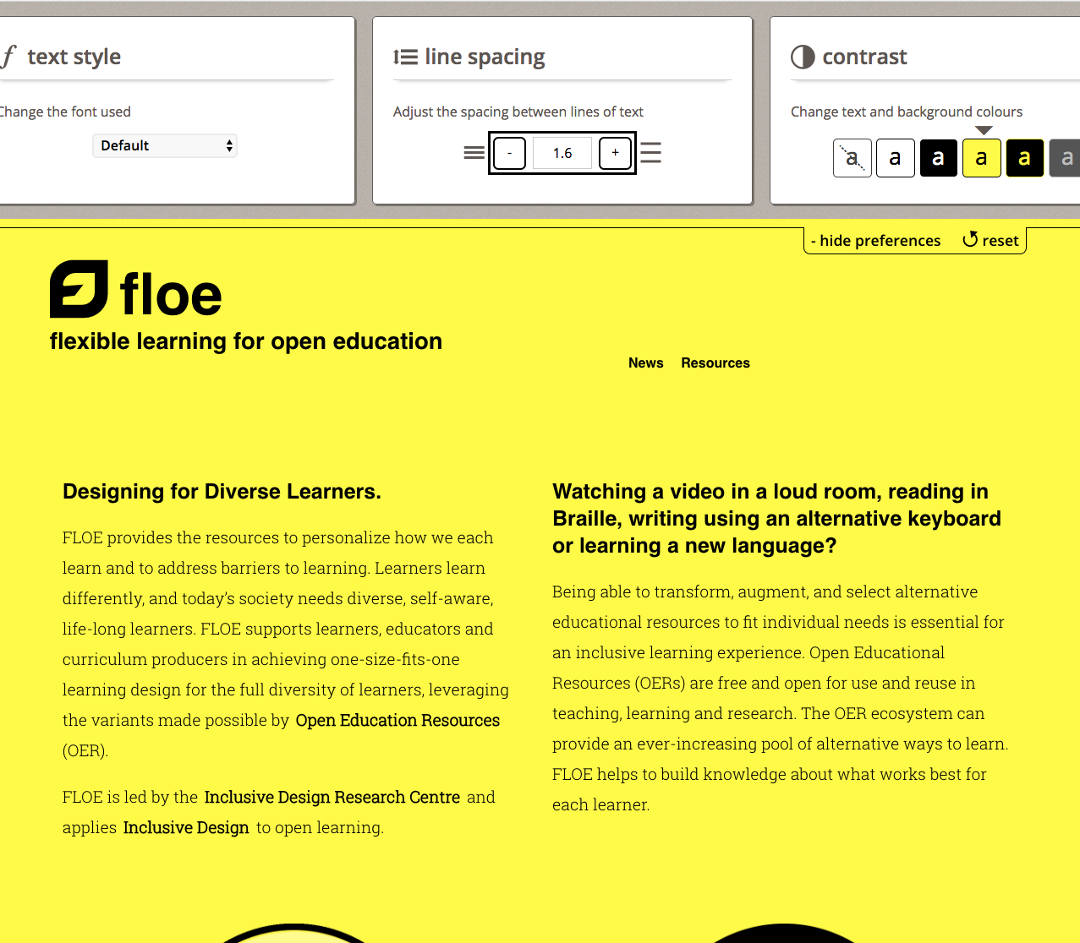
Designing for ONE-size-fits-one
https://floeproject.org/
Notes:
We all have diverse needs, and we all experience changes in our lives, in both the short-term and long-term, that affect our interests, goals and desires. As a result, designs that are flexible and allow for customization are more likely to meet our needs.
Adaptable designs that allow for personalization result in integrated systems that work better for everyone. In the digital world, we have the freedom to create a design system that can adapt, morph, or stretch to address each design need presented by each individual. But we should also consider ways we can allow for this adaptability in other forms of design – consider how we are able to adjust things like office chairs, multi-height desks that allow both sitting and standing, etc.
Library examples of flexible design that can accommodate diverse needs include things like:
Multilingual signage and other informational materials
Public workstations with access to accessible software like screen readers and magnifiers

Slide 15
Innovation from the edges
https://guide.inclusivedesign.ca/insights/VirtuousCycles.html
Notes:
Some approaches to accessibility in organizations are founded upon risk management and legal compliance. While not discounting the importance and effort involved in complying with legislation such as the AODA, we encourage you to think of becoming more inclusive in your design practices as a means of improving products and services for everyone.
We have talked previously about the ”curb cut effect”, when a change in design originally aimed at one group (wheelchair users) turns out to be broadly useful to others. Our position is that designs that work well for people with “extreme” needs will result in designs that work better for everyone. People with disabilities often experience a “magnifying” effect from poor design – a system or product that is cumbersome for the theoretical “average” user may be unusable for them. Making a system usable by those on the margins will typically improve its usefulness for the “average” user as well.
Practically speaking, focus on extreme needs as well as “average” needs – think of your library buildings from the perspective of users in wheelchairs, users who are visually impaired. Better yet, involve them from the beginning in the design and testing. It can be very hard for us to get outside our own knowledge, our own experiences and perspectives. We do not, as the saying goes, know what we don’t know, but we can compensate by working together.

Slide 16
Manifestations of inclusive design in libraries
“Answering the question of how library culture contributes to social exclusion can be a disconcerting and painful consideration for a profession that has long viewed itself as open and welcoming of everyone in our communities. Regardless of how painful this discussion can be, the truth is that, while we employ many staff who are approachable and concerned as individuals, as institutions, we create policies, processes, and attitudes that contribute to the exclusion of the people who need our services the most.”
- Working Together Project, Library Culture
http://www.librariesincommunities.ca/?page_id=12
Notes:
This next section is my own personal collection of projects, articles and otherwise that I feel manifest inclusive design in the library context. They may not explicitly reference inclusive design, but they are in keeping with its spirit.
This is my collection only – unsurprisingly, I’m not as up to date on what’s going on in the library world as I was three years ago, and there’s always a lot going on. I’d encourage you to assemble your own and I’d love to add to this list of examples if you have your own to share with me.

Slide 17
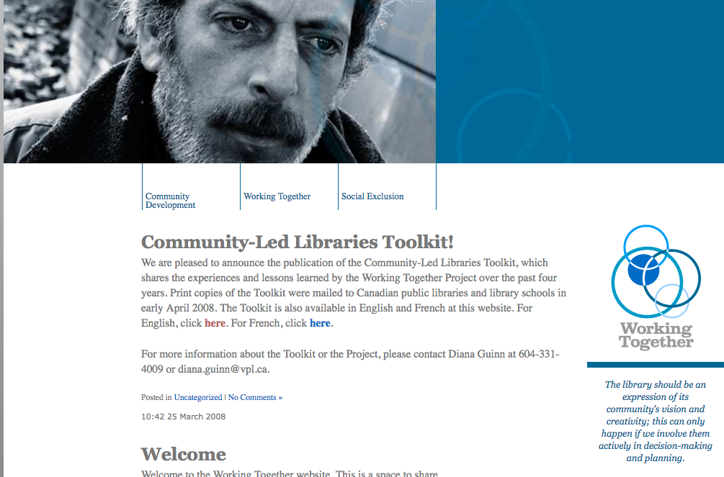
The Working together project
http://www.librariesincommunities.ca/
Notes:
Notably, this year marks the ten-year anniversary of the final product (the Community-Led Libraries Toolkit) of this HRSDC-funded project originating at the Vancouver Public Library. It’s one of the more serious non-academic attempts I’m aware of to grapple with systemic barriers to use in public libraries, and contains some valuable material about working together in a co-design manner with communities.

Slide 18
Mukurtu
https://mukurtu.org/
Notes:
Mukurtu is a digital cultural heritage platform originally developed in collaboration with the Warumungu indigenous community in Australia. Built on top of the possibly familiar Drupal system, it is notable for how it can conceptually model cultural protocols for digital objects and collections at the system level, and restrict access to certain materials based on indigenous community needs and values around access to traditional knowledge and cultural objects.
To my mind, it’s one of the most interesting examples of a co-designed system in the Galleries, Libraries, Archives and Museums (GLAM) space.

Slide 19
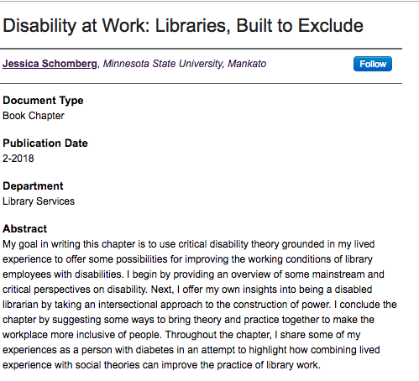
Disability at Work: Libraries, Built to Exclude
https://cornerstone.lib.mnsu.edu/lib_services_fac_pubs/149/
Notes:
This is a very recent book chapter by Jessica Schomberg applying critical disability theory towards the experience of being a library worker with a disability.
I really like this chapter for focus on the experience of people with disabilities as library workers, as opposed to library users, and would make the point that inclusive design methods can be used to rethink how the library operates as a workplace, not just how it delivers services to external users.

Slide 20
“A Model for Disciplined Empathy”
http://2017.code4lib.org/talks/Participatory-User-Experience-Design-with-Underrepresented-Populations-A-Model-for-Disciplined-Empathy
Notes:
Finally, a really interesting presentation from last year’s code4lib conference by Scott W.H. Young and Celina Brownotter of Montana State University that describes their UXUP (User Experience with Underrepresented Populations) project, which makes use of participatory design methods to work with Native American students to improve the undergraduate experience of the library.
Along with details about the specific project, this is very valuable for demonstrating a co-design process in detail in an academic library setting.

Slide 21
Towards an inclusive design community in libraries
“The Library didn’t only contain magical books, the ones which are chained to their shelves and are very dangerous. It also contained perfectly ordinary books, printed on commonplace paper in mundane ink. It would be a mistake to think that they weren’t also dangerous, just because reading them didn’t make fireworks go off in the sky. Reading them sometimes did the more dangerous trick of making fireworks go off in the privacy of the reader’s brain.”
- Terry Pratchett, Soul Music

Slide 22
Where to go next?
Inclusive Design Community Mailing List https://lists.idrc.ocadu.ca/mailman/listinfo/community
The Inclusive Design Guide https://guide.inclusivedesign.ca/
Inclusive Design In Libraries Zotero Group https://www.zotero.org/groups/2141702/inclusive_design_in_libraries

Slide 23
Questions and feedback
Contacting Me
Email: aharnum@ocadu.ca
Twitter: waharnum (currently on semi-hiatus)

