Slide 1
Pattern Languages
IDRC
February 7, 2018

Slide 2
Overview
Pattern Languages
Applications to computer software
A Pattern Language for Infusion

Slide 3
Christopher Alexander book series
Volume 1, The Timeless Way of Building (1979)
Volume 2, A Pattern Language (1977)
Volume 3, The Oregon Experiment (1975)

Slide 4
Patterns
“…we must begin by understanding that every place is given its character by certain patterns of events that keep on happening there.”
“These patterns of events are always interlocked with certain geometric patterns in the space. Indeed, as we shall see, each building and each town is ultimately made out of patterns in the space, and out of nothing else: they are the atoms and the molecules from which a building or town is made.”
Christopher Alexander, The Timeless Way of Building

Slide 5
Watching the World Go By
“Consider, for example, the pattern of events which we might call ‘watching the world go by.’
“We sit, perhaps slightly raised, on the front porch, or on some steps in a park, or on a café terrace, with a more or less protected, sheltered, partly private place behind us, looking out into a more public place, slightly raised above it, watching the world go by.
I cannot separate it from the porch where it occurs.”
Christopher Alexander, The Timeless Way of Building

Slide 6
Writing Generative Patterns
“Each pattern is a rule which describes what you have to do to generate the entity which it defines.”
“Each pattern describes a problem which occurs over and over again in our environment, and then describes the core of the solution to that problem, in such a way that you can use this solution a million times over, without ever doing it the same way twice.”
Christopher Alexander, The Timeless Way of Building and A Pattern Language

Slide 7
The Quality Without a Name
Patterns that generate places with the quality without a name
Alive
Whole
Comfortable
Free
Exact
Egoless
Eternal

Slide 8
The Quality in Software (excerpts)
“I can’t tell you what the quality is, but I can tell you some things about software that possesses it:
Its modules and abstractions are not too big
If I look at any small part of it, I can see what is going on
If I look at any large part in overview, I can see what is going on
I can imagine changing it, adding more functionality
I am not afraid of it”
Richard Gabriel, Patterns of Software

Slide 9
A Pattern Language
Network of 253 patterns, structured in 3 sections:
Towns: town and country, roads and paths, work and family, public institutions for a neighbourhood (1-94)
Buildings: “we are dealing for the first time with patterns that are under the control of individuals or small groups of individuals, who are able to build the patterns all at once.” (95-204)
Construction: concrete patterns for building (205-253)

Slide 10
Alexander Pattern Form
Picture
Introductory paragraph setting context and explaining how it helps to complete larger patterns
Headline (bold)
Body of the problem; Therefore:
Solution (bold)
Diagram
Final paragraph tying the pattern to smaller patterns needed to complete the pattern

Slide 11
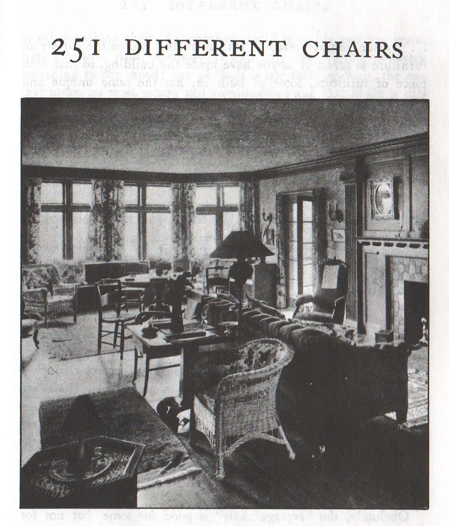

Slide 12
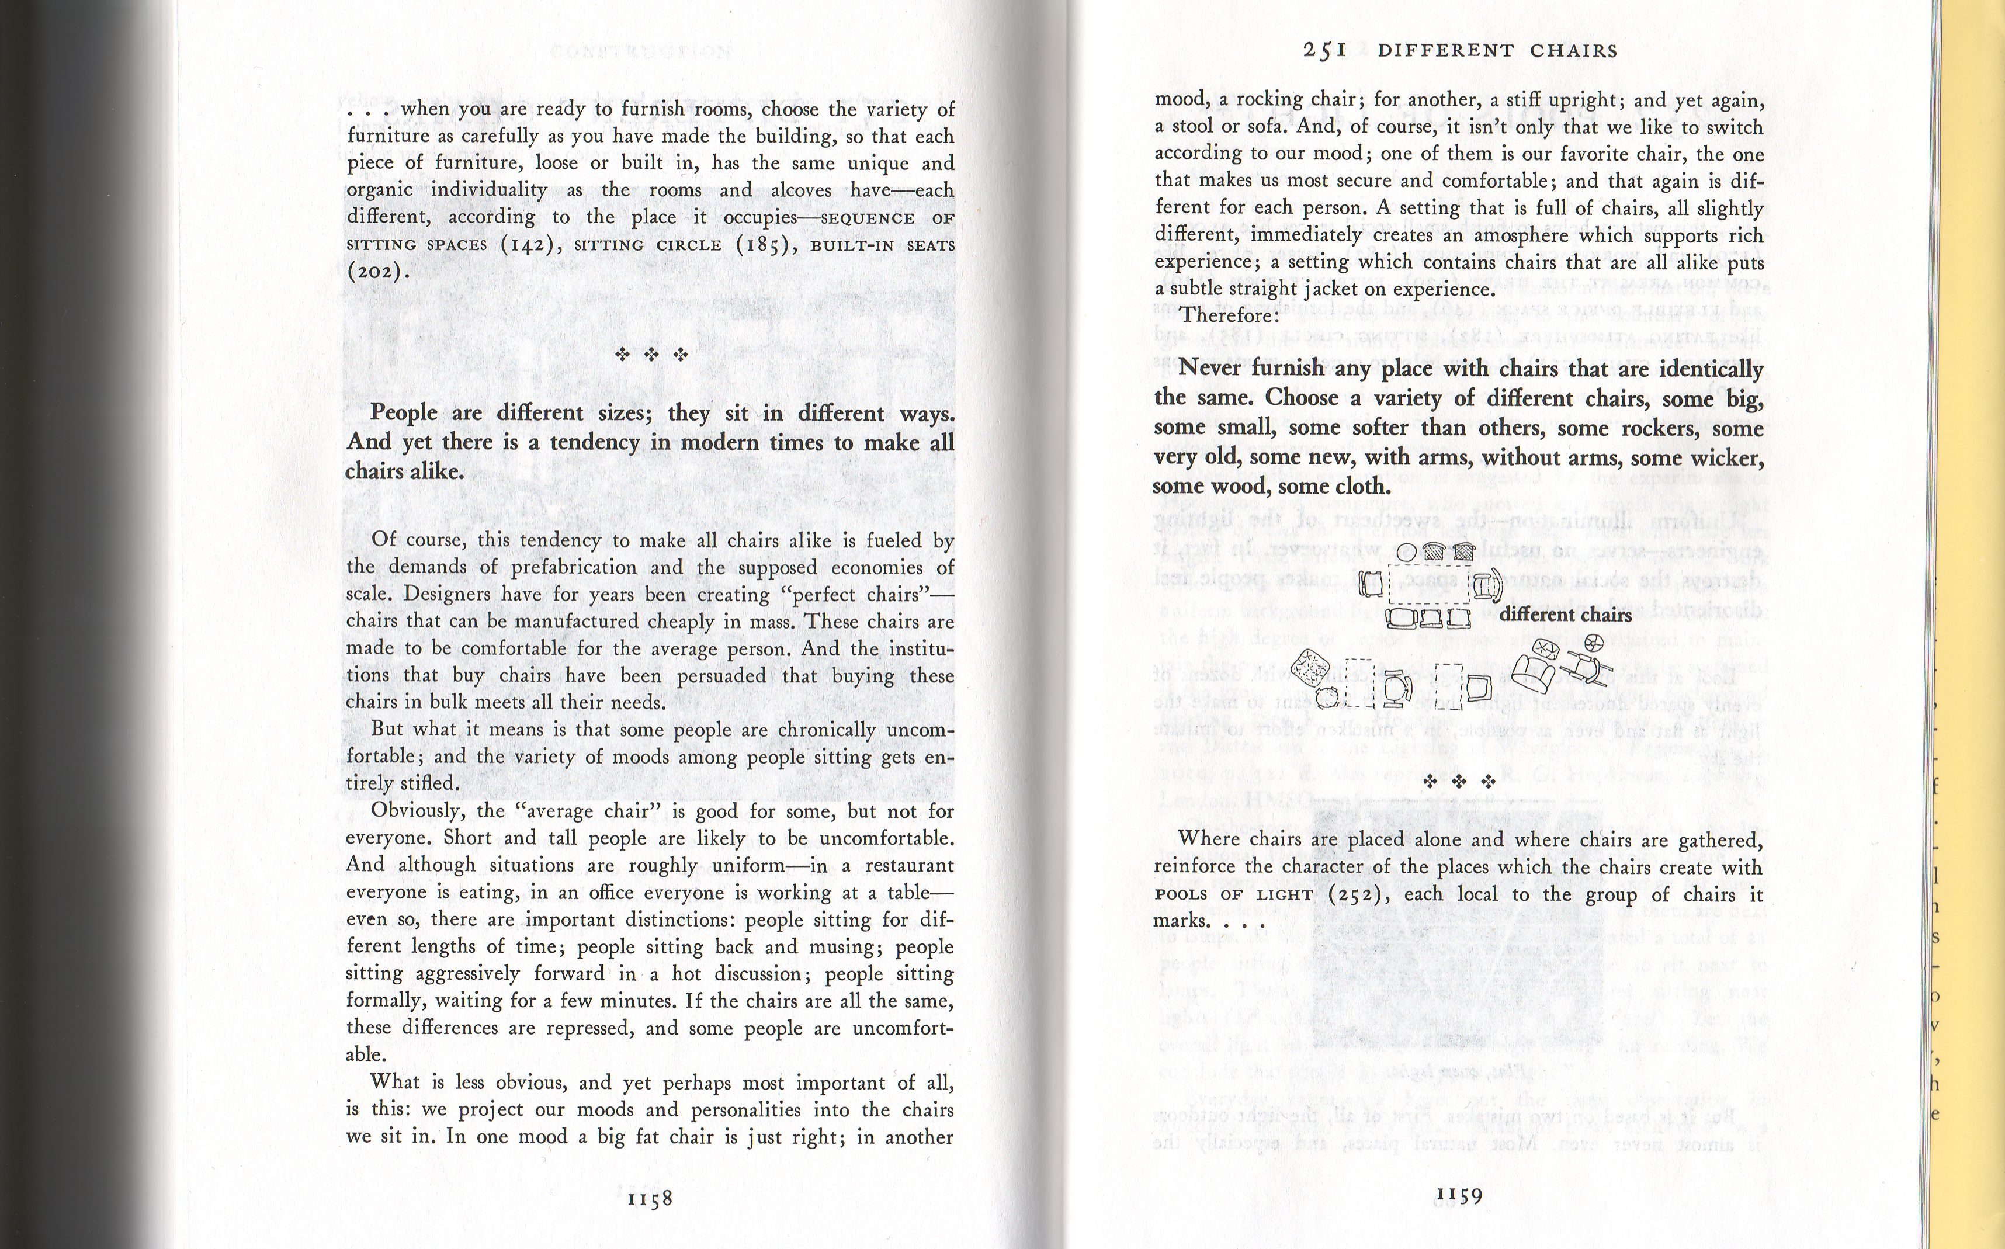

Slide 13
251 Different Chairs
People are different sizes; they sit in different ways. And yet there is a tendency in modern times to make all chairs alike.
Therefore:
Never furnish any place with chairs that are identically the same. Choose a variety of different chairs, some big, some small, some softer than others, some rockers, some very old, some new, with arms, without arms, some wicker, some wood, some cloth.

Slide 14
Language for a Porch (page xxxv)
Private Terrace on the Street (140)
Sunny Place (161)
Outdoor Room (163)
Six-foot Balcony (167)
Paths and Goals (120)
Ceiling Height Variety (190)
Columns at the Corners (212)
Front Door Bench (242)
Raised Flowers (245)
Different Chairs (251)

Slide 15
Pattern Relationships
Common Areas at the Heart (129): Create a single common area for every social group. Locate it at the center of gravity of all the spaces the group occupies, and in such a way that the paths which go in and out of the building lie tangent to it.
A Room of One’s Own (141): Give each member of the family a room of his own, especially adults.
Use this pattern as an antidote to the extremes of ‘togetherness’ created by Common Areas at the Heart.

Slide 16
Application of Patterns to Software
1987: Kent Beck and Ward Cunningham, Using Pattern Languages for Object-Oriented Programs
1992: Peter Coad, Object-oriented Patterns
1994: First Pattern Languages of Programs (PLoP) conference
1995: Jim Coplien and Doug Schmidt, Pattern Languages of Program Design
1995: Erich Gamma et al. Design Patterns: Elements of Reusable Object-Oriented Software
1996: Richard Gabriel, Patterns of Software: Tales from the Software Community

Slide 17
Composed Method (Kent Beck SBPP)
How do you divide a program into methods?
Divide your program into methods that perform one identifiable task. Keep all of the operations in a method at the same level of abstraction. This will naturally result in programs with many small methods, each a few lines long.
Controller>>controlActivity self controlInitialize. self controlLoop. self controlTerminate

Slide 18
Intention Revealing Selector (SBPP)
What do you name a method?
Name methods after what they accomplish
Collection>>includes:
(rather than linearSearchFor:, hashedSearchFor:, or searchFor:)

Slide 19
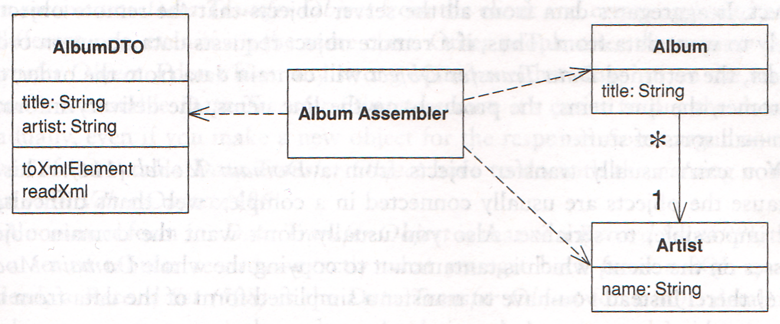
Data Transfer Object (Fowler PEAA)

Slide 20
Patterns for End-user-programmers
“Alexander proposes homes and offices be designed and built by their eventual occupants. These people, he reasons, know best their requirements for a particular structure. We agree, and make the same argument for computer programs. Computer users should write their own programs.”
Kent Beck and Ward Cunningham (1987) Using Pattern Languages for Object-Oriented Programs

Slide 21
Patterns for Programmers
“At least one computer scientist identified the ‘user’ of a piece of software as the end user. This appears to make sense at first, but when you read Alexander, it is clear that a ‘user’ is an inhabitant – someone who lives in the thing constructed. The thing constructed is under constant repair by its inhabitants, and end users of software do not constantly repair the software, though some might want to.”
Richard Gabriel (1996) The Quality Without a Name in Patterns of Software

Slide 22
Patterns of User Experience
“As a rule of thumb, anyone who regularly refers to pattern languages of programming is not likely to be the intended audience for patterns of user experience. Patterns of user experience are, however, more closely related to the architectural interpretation of Alexander’s work. The ‘internal’ design patterns so popular in the software patterns community might be compared to a particular pattern of screws and brackets with which two beams can be securely connected…”
Alan Blackwell and Sally Fincher (2010) PUX: Patterns of User Experience

Slide 23
A Pattern Language for Infusion
For Infusion, can we make a network of patterns at different ‘scales’?
User experience
System integration
Software design/architecture
Construction

Slide 24
Creative User Rights
Take a software application apart and use only one piece of it
Combine two software applications together into one
See the state of a software application, and present it differently inside another software application
Customize the user interface so that the material presented inside it is easier for me to read
Break a software application down into smaller (independently functioning) parts to understand how each part works

Slide 25
Resources
Hillside Group Patterns pages
Portland Pattern Repository
Kent Beck and Ward Cunningham: Using Pattern Languages for Object-Oriented Programs
Richard Gabriel: Patterns of Software [PDF]
Blackwell and Fincher: Patterns of User Experience [PDF]
Martin Fowler: Writing Software Patterns

Slide 26
Resources
Erin Malone: A History of Patterns in User Experience Design
Creative User Rights (Fluid wiki)
An Infusion Pattern Language (Fluid wiki)

Slide 27
Acronyms
SBPP: Smalltalk Best Practice Patterns by Kent Beck
PEAA: Patterns of Enterprise Application Architecture by Martin Fowler

