Slide 1
Usability Assessment: Making Software Work For Your Users!
Allison Bloodworth, User Experience Designer, ETS
Rachel Hollowgrass, User Experience Architect, Student Systems
Judy Stern, User Interaction Designer, ETS
6/16/11

Slide 2
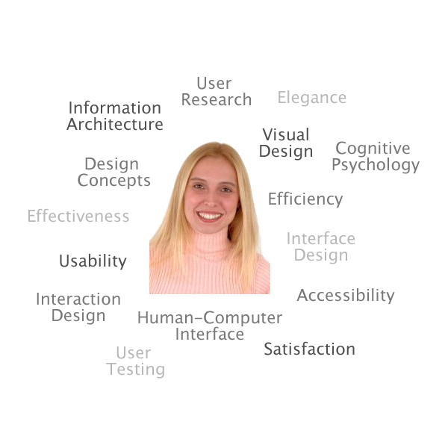
What is User-Centered Design (UCD)?
The user is put in the center of the design
Notes:
RACHEL
* The goal of user-centered design is to make the user's interaction experience as simple and intuitive as possible.
* User-Centered Design (UCD) - a design philosophy and a process in which the needs, wants, and limitations of the end user of an interface or document are given extensive attention at each stage of the design process. Adapted from Wikipedia, http://en.wikipedia.org/wiki/User_centered_design, 11-7-07.
* User-centered design is a product development methodology based on actual user needs, behaviors, abilities and perceptions.

Slide 3
What is …
User-Centered Design (UCD)
User-centered design (UCD) is an approach to design that grounds the process in information about the people who will use the product. UCD processes focus on users through the planning, design and development of a product. ¹
Goal: to make the user's interaction experience as simple and intuitive as possible
User Experience (UX)
The overall experience and satisfaction a user has when using a product or system²
UX Design Goal: help users fulfill their goals and perform their tasks while satisfying business and functional requirements
¹From Usability Professionals’ Association, http://www.upassoc.org/usability_resources/about_usability/what_is_ucd.html
²From Wikipedia, http://en.wikipedia.org/wiki/User_experience
Notes:
RACHEL
ALL ABOUT PAYING ATTENTION TO THE NEEDS OF YOUR USERS
･HCI: the study of the interaction between a human and a computer.
･UCD: tries to optimize the user interface around how people can, want, or need to work, rather than forcing the users to change how they work to accommodate the system or function. (Wikipedia)
･User Experience (UX)･the overall experience and satisfaction a user has when using a product or system. More about this later.
･Usability-The characteristic of being easy to use--something is easy to use to the extent that it effectively performs the task for which it is being used. (http://www.usabilityfirst.com/glossary/main.cgi?function=display_term&term_id=18
･Usability testing a method used in user-centered design, but there are many other ways to gain input and feedback from users.
UCD and USABILITY TESTING are techniques used to increase usability.

Slide 4
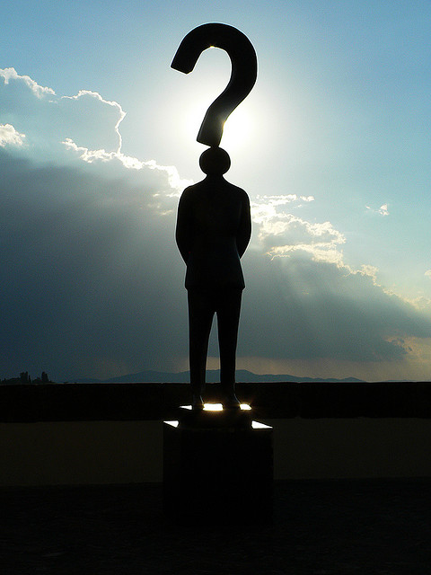
Why User-Centered Design?
Increased productivity
Increased usage and adoption
Decreased support and training costs
Reduced development time and costs
Reduced maintenance costs
Increased customer satisfaction
Adapted from Usability Professionals’ Association website, http://www.upassoc.org/usability_resources/about_usability/definitions_of_usability.html
Notes:
RACHEL
Fewer lawsuits--ADA, etc.
Better design=better usability & maintainability
･Start with a good design, know what your users need, don't waste time developing unnecessary features/fixing problems in the future
･if a system is not usable or seems to be designed without regard for the needs of the users, users may:
･be less productive
･be less accurate (in terms of data entered)
･be unhappy that they must use inefficient tools that make it more difficult for them to do their jobs

Slide 5
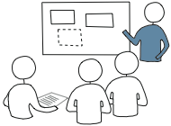
User-Centered Design at Berkeley
User Research
Modeling
Requirements Definition
UI Framework Definition
UI Design
Development Support
Notes:
JUDY
Research: interviews, observations, user feedback (contextual inquiries)
Modeling: personas, artifact models, cultural & physical models, activity diagrams/workflow
Requirements Definition: brainstorm, mental models, context scenarios, requirements list
UI Framework Definition: define posture (how the user interacts with the application—how much of their attention it takes) and input methods, define data and functional elements, sketch interaction framework
UI Design: wireframes, mockups, style guide

Slide 6
User-Centered Design at Berkeley
A lot of UX work is required before any UI design can begin. In the Agile process this is referred to as "iteration 0." Sometimes, there is no project-supplied UI. But there is always UX.
Notice how many phases come before UI Design.
User Research
Modeling
Requirements Definition
UI Framework Definition
UI Design
Development Support
Notes:
JUDY

Slide 7
What is Usability?
Usability is “the extent to which the product can be used by specified users to achieve specified goals with effectiveness, efficiency, and satisfaction in a specified context of use.”¹
Usability is defined by five quality components:
Learnability
Efficiency
Memorability
Errors
Satisfaction
Usability Evaluation is an assessment of the usability of a product, item, system, or interface.
¹ http://www.iso.org/iso/catalogue_detail.htm?csnumber=16883
Notes:
JUDY
How easy is it to use?
Learnability: How easy is it for users to accomplish basic tasks the first time they encounter the design?
Efficiency: Once users have learned the design, how quickly can they perform tasks?
Memorability: When users return to the design after a period of not using it, how easily can they reestablish proficiency?
Errors: How many errors do users make, how severe are these errors, and how easily can they recover from the errors?
Satisfaction: How pleasant is it to use the design?

Slide 8
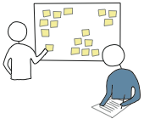
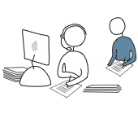
Types of Usability Evaluation
Inspection
Heuristic Evaluation, Cognitive Walkthrough, UX Walkthrough, Accessibility Review
Testing
Card Sorting, Paper Prototype Testing, Prototype Testing, Production System Testing, Naturalistic Usability Testing, Co-Discovery Testing, Hallway Testing, Formal (Lab) Usability Testing, Remote Usability Testing
Inquiry
Contextual Inquiry, Interviews, Focus Groups, Surveys, Diary Studies
For more info, see: http://wiki.fluidproject.org/display/fluid/User+Testing+Methods
Notes:
JUDY
- Inspection: usability specialists -- and sometimes software developers, users and other professionals -- examine usability-related aspects of a user interface.
Testing: representative users work on typical tasks using the system (or the prototype) and the evaluators use the results to see how the user interface supports the users to do their tasks.
Inquiry: usability evaluators obtain information about users' likes, dislikes, needs, and understanding of the system by talking to them, observing them using the system in real work (not for the purpose of usability testing), or letting them answer questions verbally or in written form.
From: http://www.usabilityhome.com/
A few other types of testing:
* 5 second page tests (http://www.uie.com/articles/five_second_test/)
* Inherent value testing (http://www.uie.com/articles/inherent_value_testing/)
* A/B testing

Slide 9
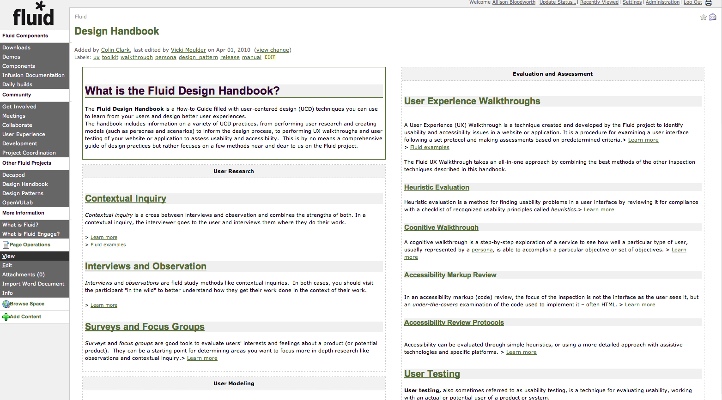
Fluid Design Handbook
For more information on these techniques, check out: http://wiki.fluidproject.org/display/fluid/Design+Handbook
Notes:
JUDY/ALLISON

Slide 10
Heuristic Evaluation
Visibility of system status
Match between the system and the real world
User control and freedom
Consistency and standards
Error prevention
Recognition rather than recall
Flexibility and efficiency of use
Aesthetic and minimalist design
Help users recognize, diagnose, and recover from errors
Help and documentation
From Jakob Nielsen, “Ten Usability Heuristics,” http://www.useit.com/papers/heuristic/heuristic_list.html
Notes:
ALLISON
Heuristic evaluation is a method for finding usability problems in a user interface by reviewing it for compliance with a checklist of recognized usability principles called heuristics. It is conventionally performed by a group of trained evaluators who individually evaluate a system and then combine their results to come up with a prioritized list of problems to be fixed. However, we believe that most anyone can use a heuristic checklist to spot usability problems.
Visibility of system status
The system should always keep users informed about what is going on, through appropriate feedback within reasonable time.
Match between system and the real world
The system should speak the users' language, with words, phrases and concepts familiar to the user, rather than system-oriented terms. Follow real-world conventions, making information appear in a natural and logical order.
User control and freedom
Users often choose system functions by mistake and will need a clearly marked "emergency exit" to leave the unwanted state without having to go through an extended dialogue. E.g. support undo & redo.
Consistency and standards
Users should not have to wonder whether different words, situations, or actions mean the same thing. Follow platform conventions.
Error prevention
Even better than good error messages is a careful design which prevents a problem from occurring in the first place. Either eliminate error-prone conditions or check for them and present users with a confirmation option before they commit to the action.
Recognition rather than recall
Minimize the user's memory load by making objects, actions, and options visible. The user should not have to remember information from one part of the dialogue to another. Instructions for use of the system should be visible or easily retrievable whenever appropriate.
Aesthetic and minimalist design
Interfaces should not contain information which is irrelevant or rarely needed. Every extra unit of information in an interface competes with the relevant units of information and diminishes their relative visibility.
Flexibility and efficiency of use
Shortcuts - Accelerators -- unseen by the novice user -- may often speed up the interaction for the expert user such that the system can cater to both inexperienced and experienced users. Allow users to tailor frequent actions.
Help users recognize, diagnose, and recover from errors
Error messages should be expressed in plain language (no codes), precisely indicate the problem, and constructively suggest a solution.
Help and documentation
Even though it is better if the system can be used without documentation, it may be necessary to provide help and documentation. Any such information should be easy to search, focused on the user's task, list concrete steps to be carried out, and not be too large.

Slide 11
Heuristic Evaluation
For more info: http://wiki.fluidproject.org/display/fluid/Heuristic+Evaluation
One checklist: http://www.stcsig.org/usability/topics/articles/he-checklist.html
Notes:
ALLISON

Slide 12
Cognitive Walkthrough
A step-by-step exploration of a service or interface to see how well a particular type of user (usually represented by a persona) is able to accomplish a particular objective or set of objectives.
Step 1: Choose a User
Step 2: Define the Goal & Task
Step 3: Perform the tasks
For more info: http://wiki.fluidproject.org/display/fluid/Cognitive+Walkthrough
Notes:
ALLISON

Slide 13
Accessibility Review
Accessibility can be evaluated through simple heuristics, or using a more detailed approach with assistive technologies and specific platforms.
Fluid’s Simple Accessibility Review Protocol¹
Step 1: Assess the overall layout, structure and content of the page
Step 2: Play around with the layout: enlarge the font size; change the size of the window (bigger and smaller); adjust your resolution
Step 3: Use the Tab key to navigate through the entire page.
Step 4: Use Internet Explorer or Firefox with Popup Alt Attributes Extension to check for alternative text for all images and title text for links.
¹ http://wiki.fluidproject.org/display/fluid/Simple+Accessibility+Review+Protocol
Notes:
ALLISON

Slide 14
Accessibility Tools
Validator: WAVE by WebAim
http://wave.webaim.org/
Quick Accessibility Page Validator
http://accessify.com/tools-and-wizards/accessibility-tools/favelets/quick-page-test/
Screen Readers
VoiceOver – comes standard on the Mac
JAWS – Most used screen reader for Windows
Web Content Accessibility Guidelines
http://www.w3.org/WAI/intro/wcag.php
Notes:
ALLISON
You can download JAWS for free and use it for 40 minutes at a time. Re-booting your computer resets that clock.

Slide 15
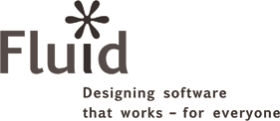
Fluid UX Walkthrough
Used to identify usability and accessibility issues in a website or application.
A combination of a:
Heuristic Evaluation
Cognitive Walk-through
Accessibility Markup Review¹
A procedure for examining a user interface following a set protocol and making assessments based on predetermined criteria.
Detailed protocols & checklists² are provided
Created and developed by the Fluid project³
¹ http://wiki.fluidproject.org/display/fluid/Accessibility+Markup+Review
² http://wiki.fluidproject.org/display/fluid/UX+Walkthrough+Protocols+and+Checklists
³ http://wiki.fluidproject.org/
Notes:
ALLISON
Accessibility markup review:
Is content separated from presentation through CSS?
Do pages have frames?
Are headings hierarchical?
Are tables properly structured?

Slide 16
What is Usability (a.k.a. User) Testing?
A technique used to evaluate a product or system by testing it on users.
The user completes certain typical tasks
An observer records the results
Formal vs. informal or guerrilla
Quantitative vs. qualitative
Formative vs. summative
Notes:
ALLISON
Formal (e.g. lab) vs. informal (e.g. hallway testing) - it's usually a range between the two
Quantitative is when you take measurements, qualitative is when you make judgments based on your individual, often subjective analysis
Formative (e.g. to help you make initial design decisions) vs. summative (to identify usability issues that would prevent users from completing tasks or to develop a benchmark for the efficiency of a site)
- Formal is often summative (e.g. # of clicks, understanding how site is used via eye tracking), informal is often formative

Slide 17
What is Usability (a.k.a. User) Testing?
While there can be wide variations in where and how you conduct a usability test, every usability test shares these five characteristics:
The primary goal is to improve the usability of a product.
For each test, you also have more specific goals and concerns that you articulate when planning the test.
The participants represent real users.
The participants do real tasks. You observe and record what participants do and say.
You analyze the data, diagnose the real problems, and recommend changes to fix those problems.
From "A Practical Guide to Usability Testing" (1990), J. Dumas and J. Redish
Notes:
ALLISON
Can gather data via:
Think aloud protocol
Note-taking
Eye-tracking
* Timing task completion

Slide 18
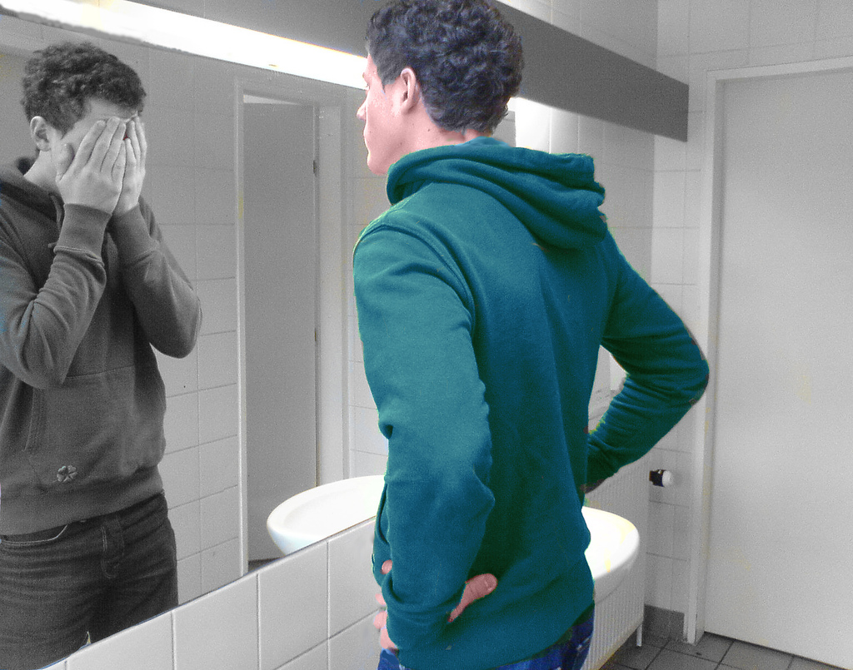
Why Usability Testing is Important
You are not your user
You know too much about your product and can't assess it with 'fresh eyes’
There is nothing as illuminating as watching a user struggle through your interface
Notes:
ALLISON

Slide 19
Test Early & Often!
Design
Prototype
Evaluate
Figure courtesy of James Landay
Notes:
ALLISON
Especially in paper prototype stage, iterations can be very fast--less than a day

Slide 20
Scenarios
Written description of a persona achieving a goal through a set of tasks in a specific context
A design technique used to envision future use of a system
Helps designers & developers understand how system will really be used
May be based on user research or a use case (or set of use cases)
Scenarios become progressively more detailed as project progresses
Can be used as the basis for for usability testing tasks
Info on writing scenarios & tasks:
http://wiki.fluidproject.org/display/fluid/User+Testing+Scenarios+and+Tasks
Notes:
JUDY

Slide 21
Scenario Example
It's Monday morning on the second week in the semester and Cobbler U is podcasting 40 different courses. When Mary comes in at 7:45 a.m., she takes a look to see which ones will be recorded today.* She also does a quick check to make sure that all the capture agents are online.*
No classes have started yet, but everything looks fine. Even Schulte Hall, the room in which the capture agent failed last week. Thinking about that, she takes an in-depth look at Schulte Hall,* to make sure that there are no problem areas or even potential problems. She then checks to see which recordings will happen in Schulte Hall today,* and see that there are four of these, one of which will start in a few minutes, at 8. She makes a mental note to take a look when class starts to be sure everything is okay. In the meantime she checks her email.
* = potential task
Notes:
JUDY

Slide 22
Usability Testing Tasks
You are the Webcast Administrator at your university. You are responsible for ensuring that recordings go smoothly, take place as scheduled, and are distributed to various distribution channels (e.g. YouTube, iTunes, your local portal). It's Monday morning on the second week in the semester and your university is podcasting 40 different courses.
When you come in at 7:45 a.m., you take a look to see which recordings are coming up today.
Next, you do quick check to make sure that all the capture agents are online.
Check to see what recordings will be happening today in Schulte Hall (known as "SH1"), the room in which the capture agent failed last week.
You see that one of the recordings in Schulte Hall is about to start in a few minutes, at 8:10. You make a mental note to take a look when the 8:10 class starts to be sure everything is okay. In the meantime you check your email. At 8:15 a.m., you turn back to Matterhorn. Check to see what is happening in Schulte Hall.
Notes:
JUDY
Keep in mind that it may be necessary to define unique tasks for different Personas or roles (e.g. student, instructor)

Slide 23
Preparing for a Usability Test
Define goals, objectives & success criteria
Write scenarios & testing tasks – ensure prototype can handle them
Create task sheets
Create consent form
If needed, create:
demographic questionnaire
pre-test questionnaire or interview
post-test questionnaire
Sample user testing protocol: http://wiki.fluidproject.org/display/fluid/User+Testing+Protocol
Protocol templates: http://wiki.fluidproject.org/display/fluid/User+Testing#UserTesting-templates
Notes:
JUDY
Use date picker as an example: * Can users figure out how to close or move the date & time pickers?
* Do users understand the meaning of the colors on the date picker?

Slide 24
Usability Testing Documentation
Notes:
JUDY

Slide 25
Usability Testing Documentation
Notes:
JUDY

Slide 26
Selecting Representative Users
Your results may not be valid if your users aren’t representative
Find users based on your personas/user profiles
Depending on your project 3-5 users (or less!) may be enough
If necessary, create a short screening questionnaire
In some domains, may be helpful to track users via a profile matrix
Don’t forget accessibility testing!
Notes:
RACHEL

Slide 27
Sample Profile Matrix
 | Never had webcast class | Has watched webcasts of class | Studies with class webcasts | Has computer at home | Works in computer lab
Undergrad Student | 2 | 1 | 1 | 1, 2 | 1
Graduate Student | 3 | 3 | 4 | 3 | 3,4
Virtual Student |  | 5,6 | 5 | 5,6
Notes:
RACHEL

Slide 28
How Many Users are Enough?
Broad activities such as surveys, data analysis, etc.
Focused, extended work such as participatory design
In-depth qualitative work such as contextual inquiry or usability testing
Notes:
RACHEL
Usually, it's enough to test with a handful of users and revise the design in the direction indicated by a qualitative analysis of their behavior.

Slide 29
Recruiting Users
Use your network
It’s often helpful to offer an incentive
If you can’t find representative users, you can try:
Friends and family testing
http://24ways.org/2006/fast-and-simple-usability-testing
Surrogate testing http://www.userfocus.co.uk/articles/surrogates.html
For more info: http://wiki.fluidproject.org/display/fluid/Selecting+and+Recruiting+User+Test+Participants
Notes:
RACHEL

Slide 30
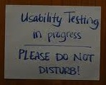
Usability Testing Facilitation
Explain that you’re testing the product, not the user
You may want to ask the user to think aloud
Distance yourself from the product
Don’t react
Don’t help
Don’t ask leading questions
Don’t give away your thoughts with facial expressions
Don’t lead with your note-taking
Often there is no need to write down exactly what each user does – trends will emerge
Save discussion or explanations for the end
Watch what people do with your site/application, not what they say about a design
Keep usability heuristics in mind
Notes:
ALLISON

Slide 31
During a Usability Test
Greet user.
Introduce them to any other observers or note takers.
Have user sign consent form
Explain user testing procedure and that you are testing the system and not them.
Ask them if they have any questions.
Have them complete the demographic questionnaire.
Ask an ice breaker question about some of the demographic information you want to collect anyway. Want to put user at ease if possible.
Have them sit down in front of computer (or in front of paper prototype).
Conduct user test.
Have them complete any post-test questionnaires.
Ask any questions you have (do this after they've completed the questionnaires so not to bias their answers).
Let them ask any questions and debrief them.
Let them know how they can find out about changes made to the software as a result of the user testing data.
Thank them for participating.
Give them their compensation.
Notes:
ALLISON

Slide 32
Note-Taking During a Test
Goal: Document user's experience with system
Activities:
The path they take to accomplish task
Challenges you see them having while trying to complete task
Questions they ask & comments they make (may ask them to think aloud)
How many attempts it took them to complete task
Time on task (if this is important to test)
Answers to any post-test questions
After tests:
Immediately write up top handful of issues you saw while it's fresh in your mind (can do this iteratively)
Discuss test with facilitator (others involved) while it's fresh in your mind
Notes:
ALLISON

Slide 33
Note-Taking Tools
Paper & pencil
Positives: non-distracting, easy to write without table if use hard notebook, can make pictures easily
Challenges: have to write fast (use drawings & short hand), may have to digitize later (depending on formality & needs of project)
Laptop
Positives: digitized notes easily shareable with team
Challenges: may not have good surface to set it on, can be off-putting to participant to hear you typing and the screen can be a "wall" between you
Tablet PC
Positives: can be good compromise
Challenges: most people find they write slower than on paper
Photos
Positives: help tell the story, a great compliment to notes
Challenges: makes some users nervous, you'll be busy writing can be hard to also take pics
Notes:
ALLISON

Slide 34
Note-Taking Tips
You are a fly on the wall. Too many people talking to participant can be confusing.
Using preset forms can help quickly capture expected results- Use short hand that makes sense to you
Can expand later – If you’re not sure if it's important, capture it
Sometimes hard to see exactly what challenges are in the thick of it so capturing every step will help you replay it
If using a camera, be very casual about it to make people more comfortable
Audio & video can be helpful but expect significant time transcribing, pulling out interesting snippets. can also make users less forthcoming if they are being recorded
Schedule time right after test to discuss amongst facilitation team while it's all still fresh
Notes:
ALLISON

Slide 35
Discount Usability - Nielsen
Create prototypes using scenarios
Usability test using simplified thinking out loud method
Do a heuristic evaluation
From Jakob Nielsen, “Guerrilla HCI: Using Discount Usability Engineering to Penetrate the Intimidation Barrier,” http://www.useit.com/papers/guerrilla_hci.html
Notes:
RACHEL
Scenarios take prototyping to the extreme by reducing both the level of functionality and the number of features. By reducing the part of interface being considered to the minimum, a scenario can be very cheap to design and implement, but it is only able to simulate the user interface as long as a test user follows a previously planned path.
Besides reducing the number of subjects, another major difference between simplified and traditional thinking aloud is that data analysis can be done on the basis of the notes taken by the experimenter instead of by videotapes.

Slide 36
Usability Testing Examples
Paper prototype testing – Allison
Distributed testing – Judy
Hallway testing – Rachel
Formal/lab testing – Rachel
Notes:
RACHEL
Other examples:
IS&T Staff Site
UC Berkeley Calendar Network
Fluid Components
Webcast.berkeley Approval http://confluence.media.berkeley.edu/confluence/display/WCT/Approval+form+user+testing
Webcast.berkeley Admin app http://confluence.media.berkeley.edu/confluence/display/WCT/User+testing+with+Richard%2C+6-9-08
bSpace Skin http://confluence.media.berkeley.edu/confluence/pages/viewpage.action?pageId=4526

Slide 37
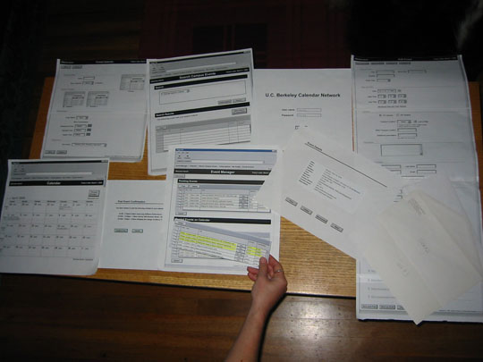
Usability Testing Examples
Paper Prototype Testing
For more info: http://wiki.fluidproject.org/display/fluid/Fluid+User+Testing
Notes:
ALLISON

Slide 38
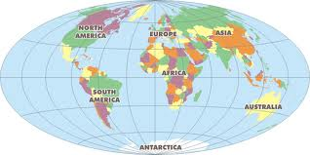
Usability Testing Examples
Distributed Testing
For more info: http://opencast.jira.com/wiki/display/MH/0.5+Admin+App+user+testing+--+RC+testing
Notes:
JUDY

Slide 39
Usability Testing Examples
Hallway testing
“Psst!
Want a Peet’s gift card? Come test our software for 5 minutes.”
Notes:
RACHEL

Slide 40
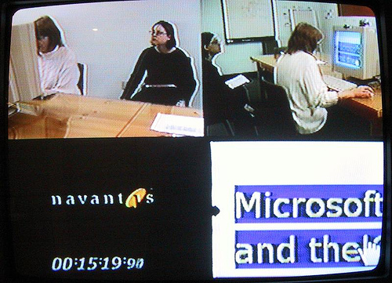
Usability Testing Examples
Formal/lab testing
Notes:
RACHEL

Slide 41
Recommended Usability Testing Books
Handbook of Usability Testing by Rubin J. and Chisnell, D.
A Practical Guide to Usability Testing by Dumas, J. and Redish, J.
Don't Make Me Think by Steve Krug
Usability Engineering by Jakob Nielsen
Notes:
RACHEL

Slide 42
Recommended User-Centered Design Books
The Inmates are Running the Asylum and About Face 3.0 – Alan Cooper
The Design of Everyday Things and Emotional Design – Don Norman
User Interface Task Analysis - Joann T. Hackos and Janice Redish
Designing for Interaction - Dan Saffer
For more suggestions, check out:
Adaptive Path Reading List
Society for Technical Communication's Usability & User Experience Group's Bookshelf
Notes:
RACHEL

Slide 43
Recommended Websites
Fluid User Testing website: http://wiki.fluidproject.org/display/fluid/User+Testing
"UIE seminars" bSpace site: http://bspace.berkeley.edu
ask any of today's speakers to be added as a member
Useit.com: http://www.useit.com/
Usability Professionals Association: http://www.upassoc.org/
http://www.stcsig.org/usability/
http://usability.gov/
http://www.usabilityfirst.com/
http://www.usableweb.com/
http://usabilitynet.org/
ACM SIGCHI: http://acm.org/sigchi
IBM’s User-centered Design manual: http://www-3.ibm.com/ibm/easy/eou_ext.nsf/publish/13
Notes:
RACHEL

