Slide 1
PHP Overview
By Alex and Cindy. Jan 21,2013

Slide 2
What is PHP?
Stands for PHP: Hypertext Processor
An open source server-side programming language
To produce dynamic web pages
Can be embedded into an HTML source document/Pure backend processor

Slide 3
Interesting Statistics
Did you know ?
“PHP is used by 78.8% of all the websites whose server-side programming language we know”
W3techs.com

Slide 4
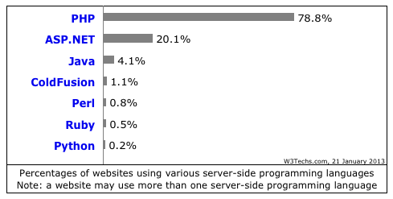
Interesting Statistics
Did you know ?
Most popular server side language.
W3techs.com

Slide 5
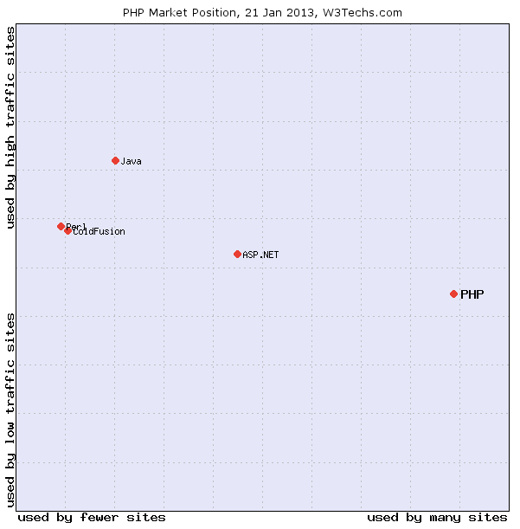
Interesting Statistics
Did you know ?
W3techs.com

Slide 6
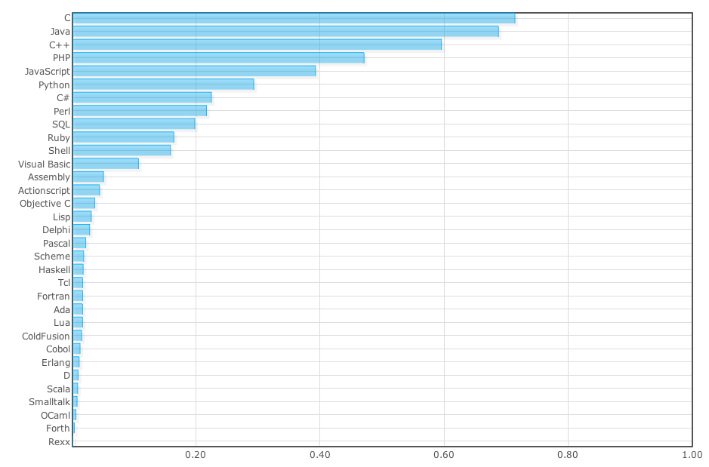
Interesting Statistics
Did you know ?
#4 popular Langpop.com

Slide 7
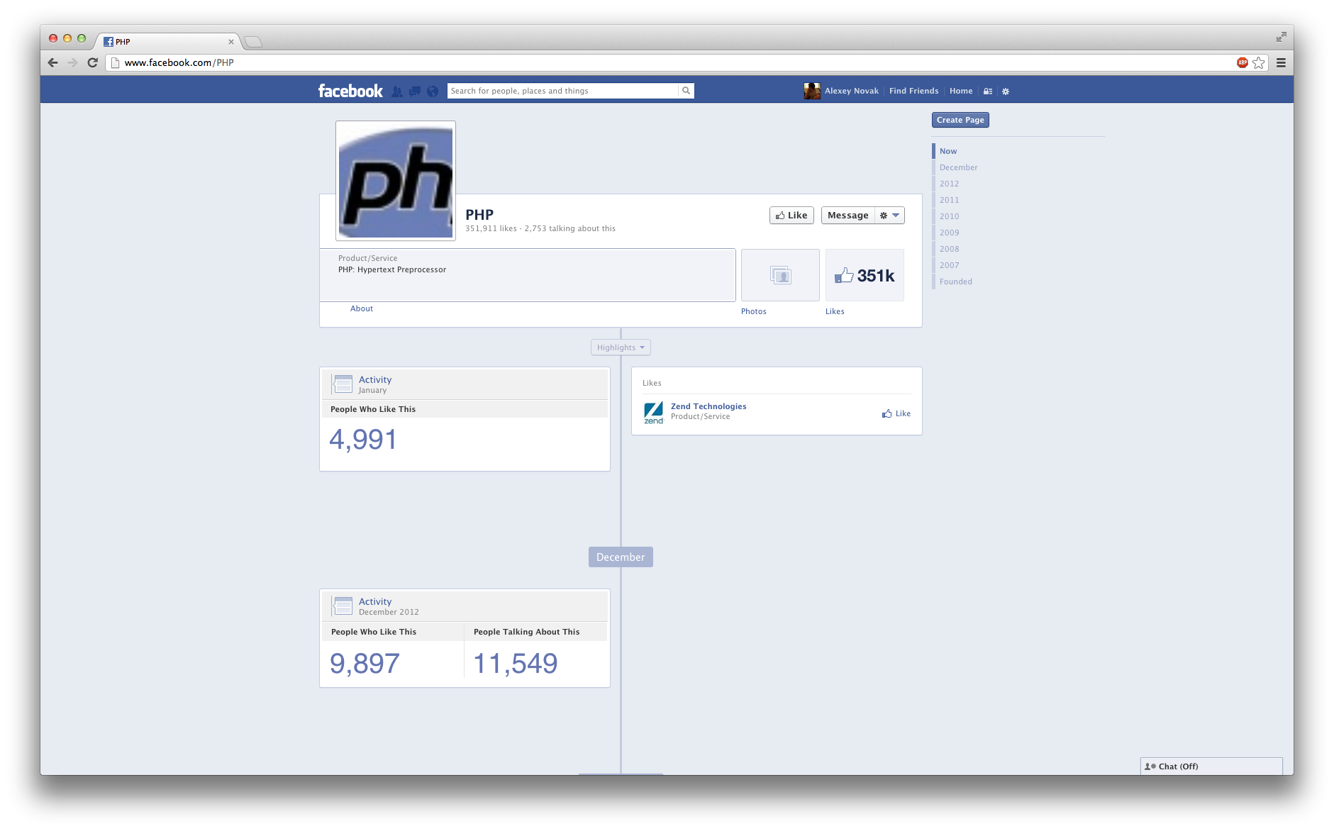
Web Examples (PHP)
Did you know ?
Facebook

Slide 8
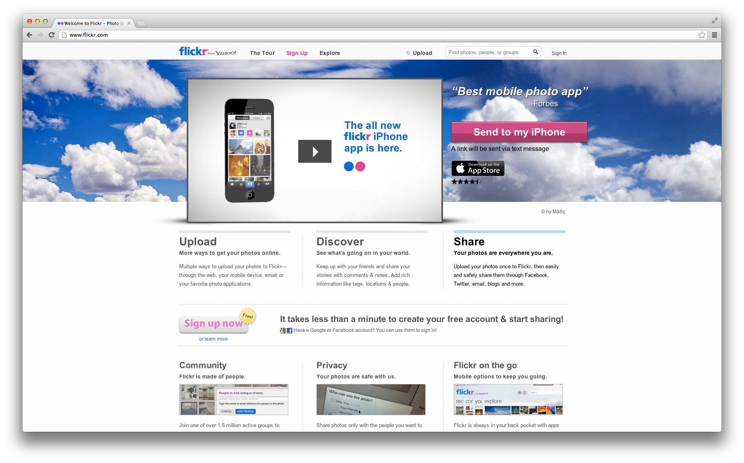
Web Examples (PHP)
Did you know ?
Facebook
Flickr

Slide 9
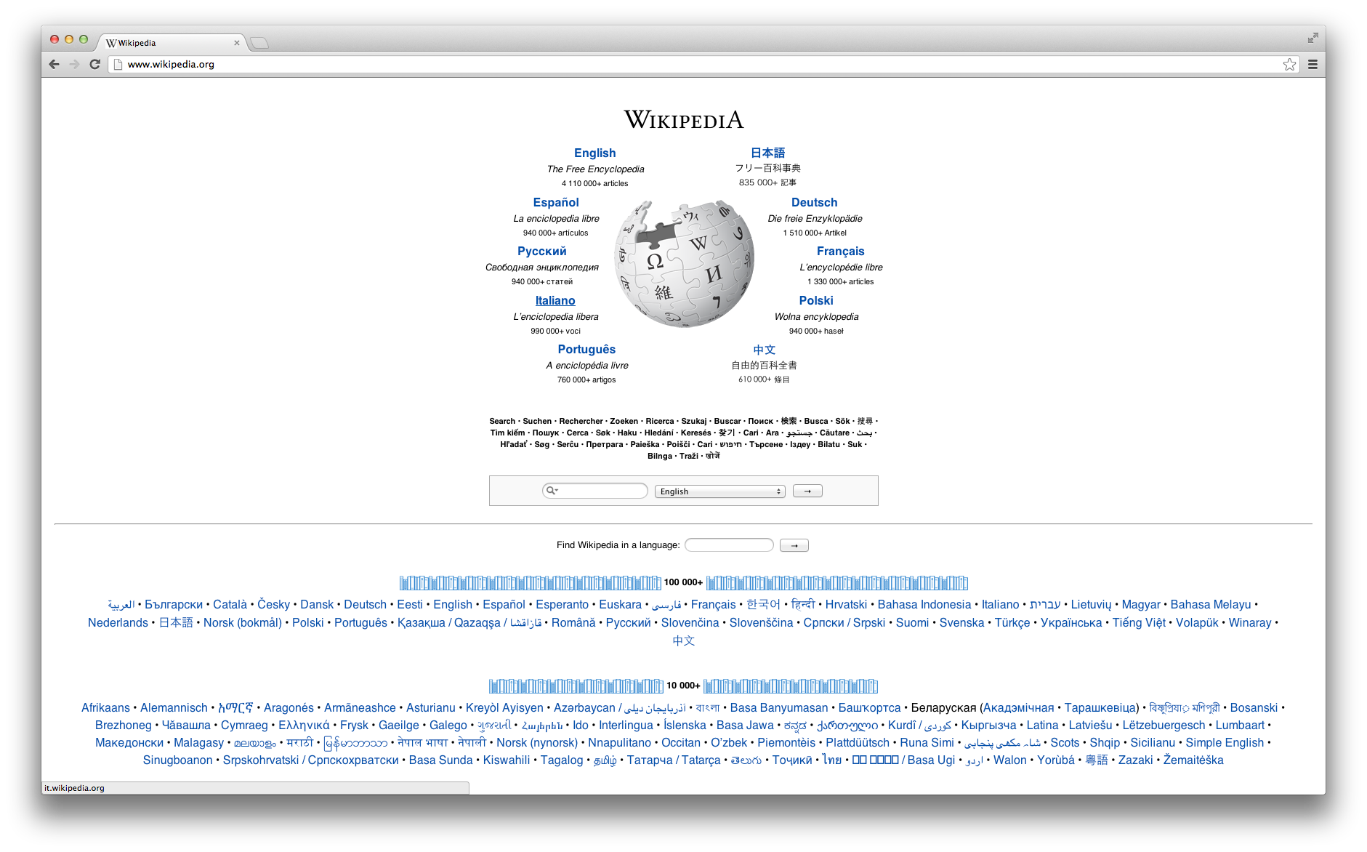
Web Examples (PHP)
Did you know ?
Facebook
Flickr
Wikipedia

Slide 10
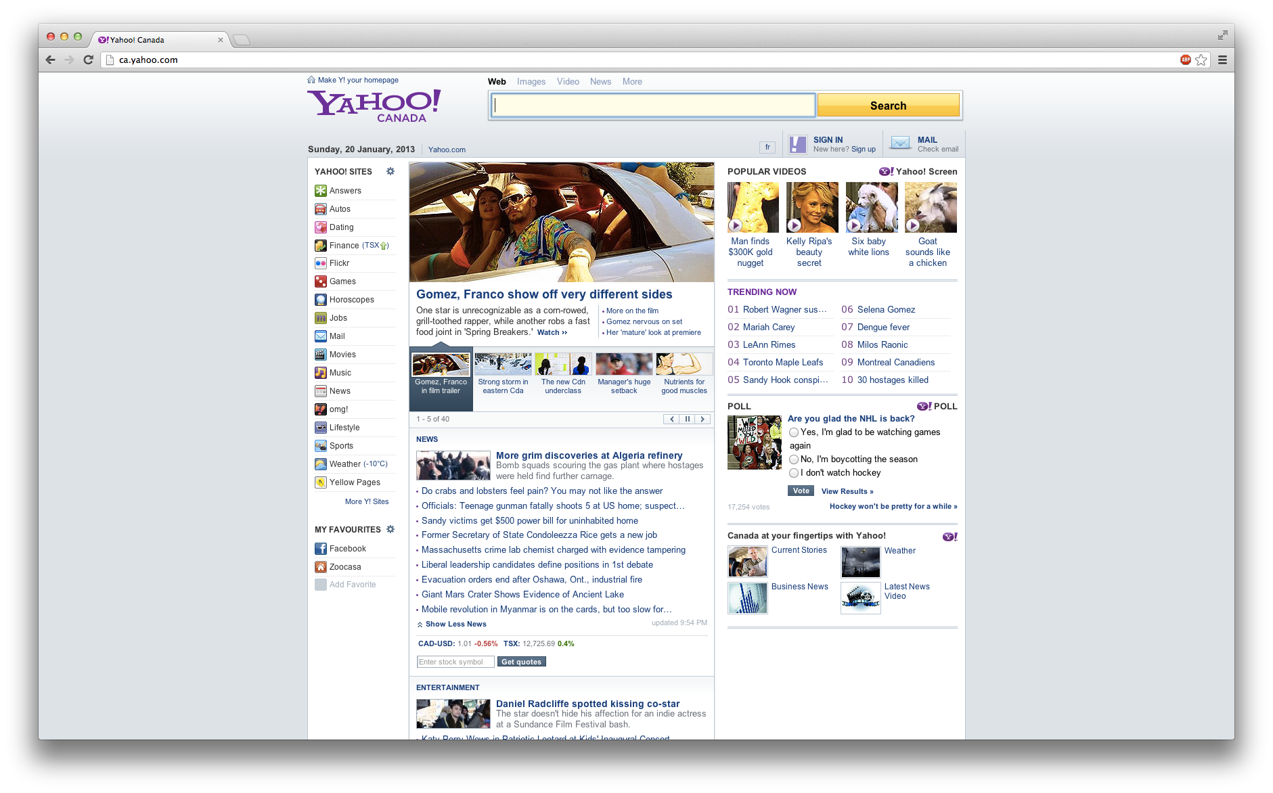
Web Examples (PHP)
Did you know ?
Facebook
Flickr
Wikipedia
Yahoo!

Slide 11
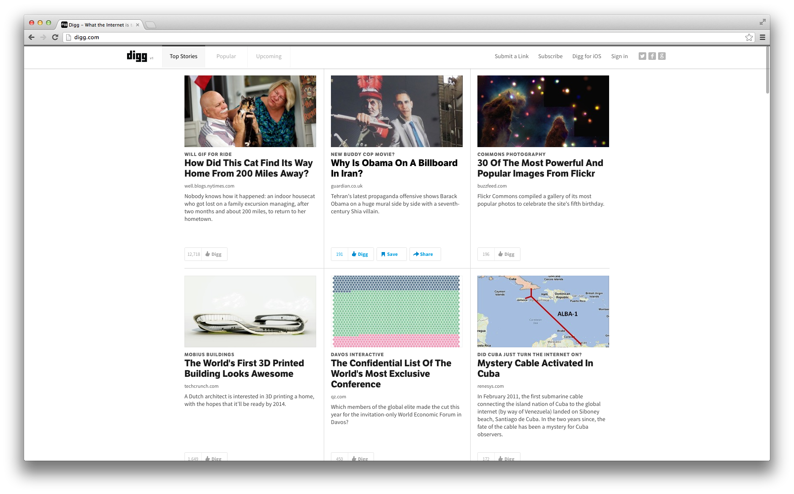
Web Examples (PHP)
Did you know ?
Facebook
Flickr
Wikipedia
Yahoo!
Digg

Slide 12
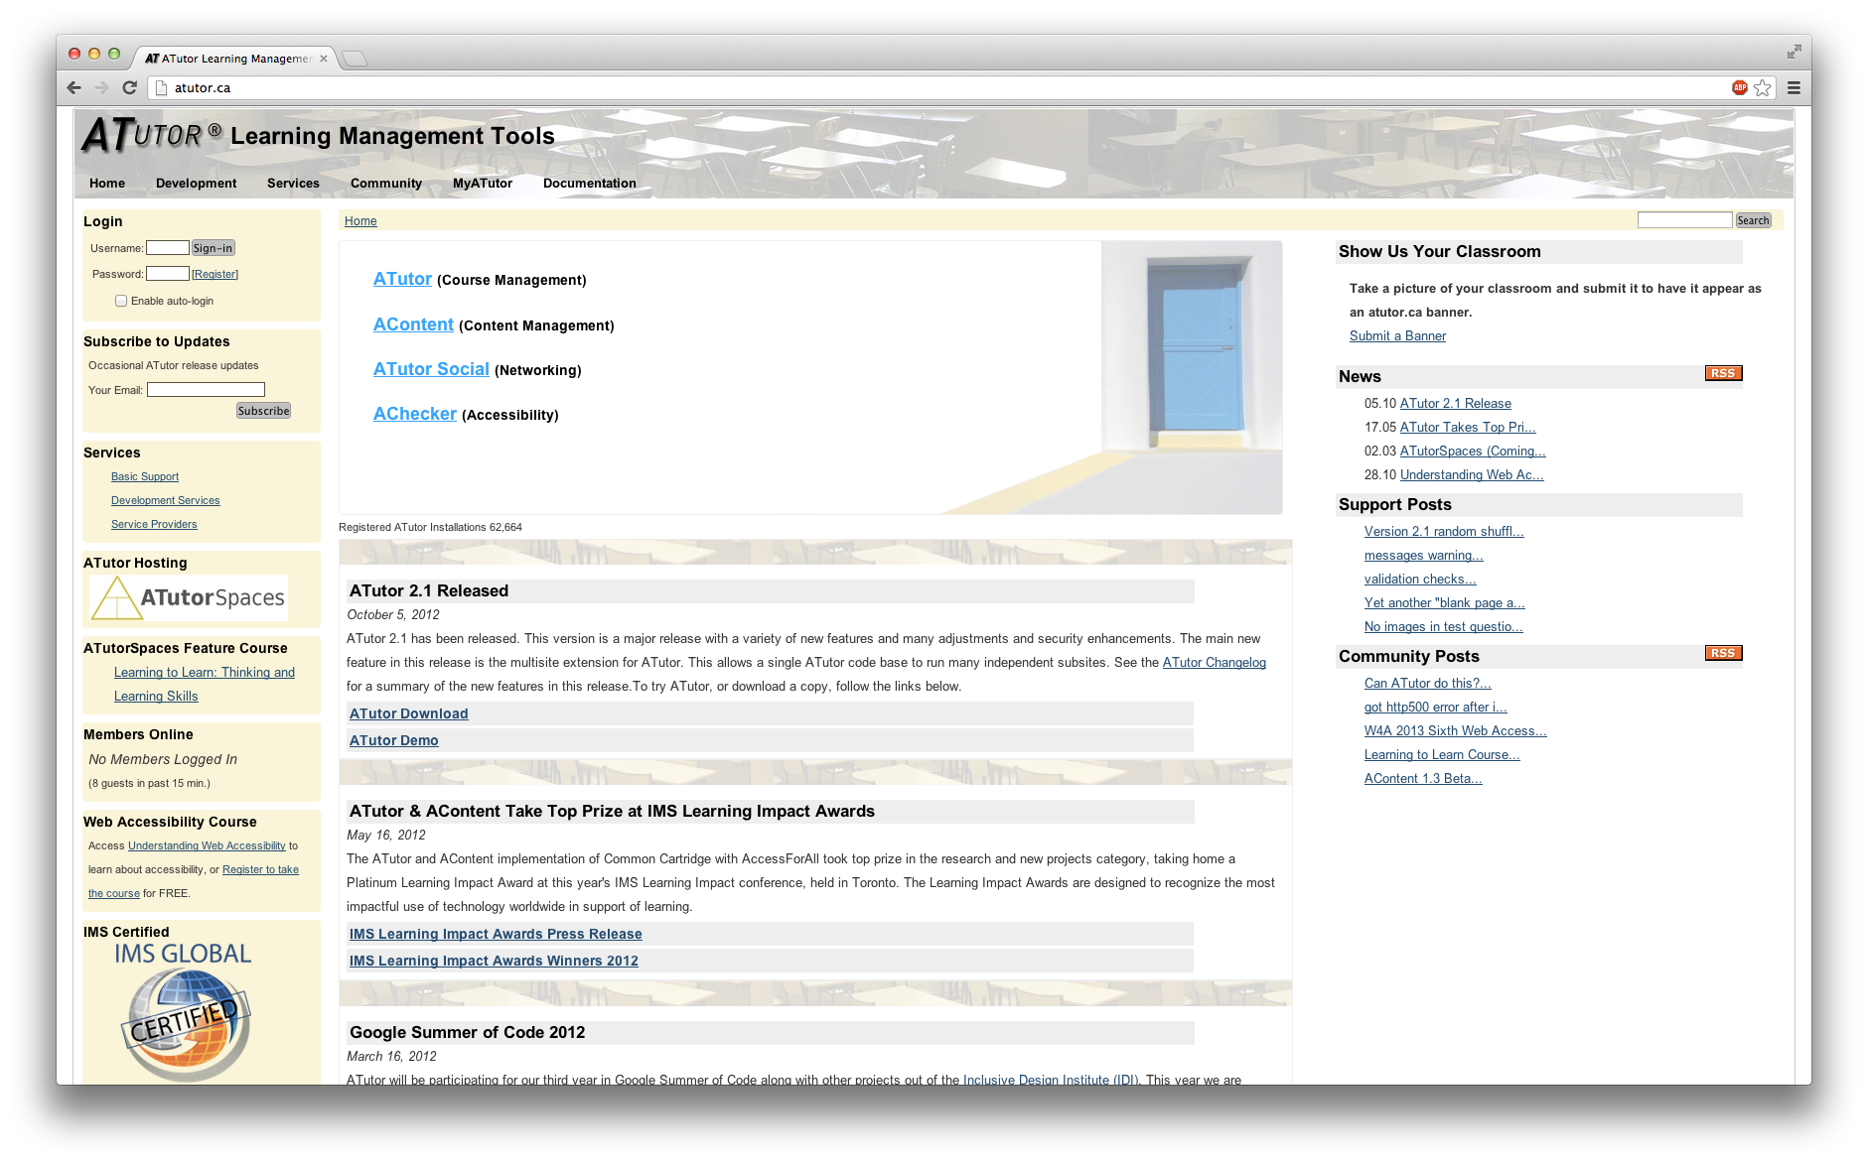
IDRC Examples (PHP)
Did you know ?
ATutor

Slide 13
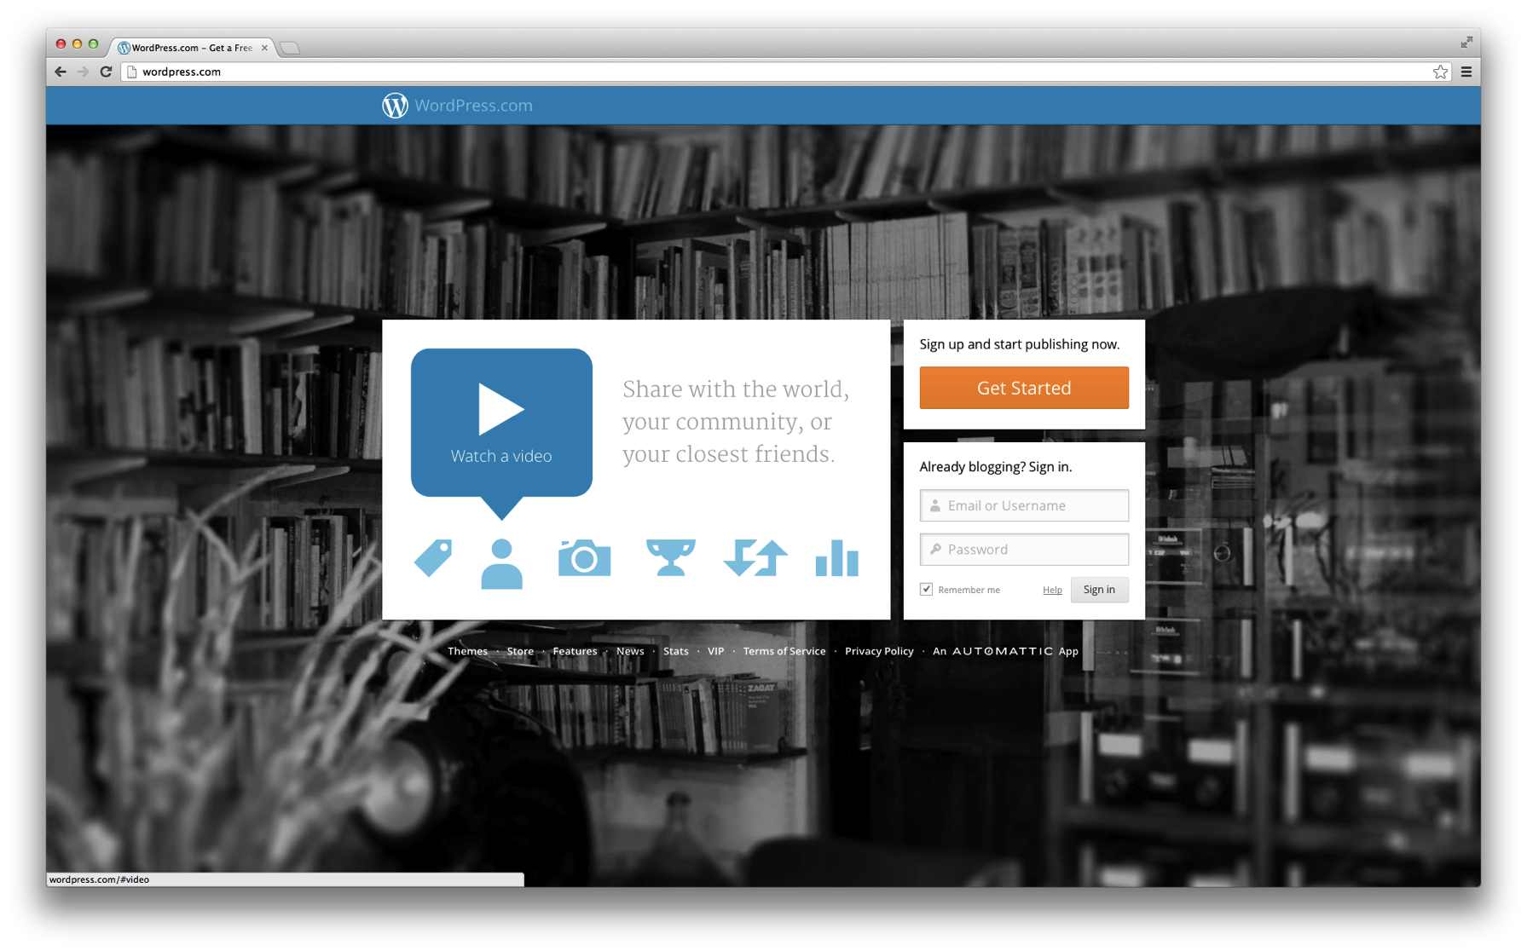
IDRC Examples (PHP)
Did you know ?
ATutor
WordPress

Slide 14
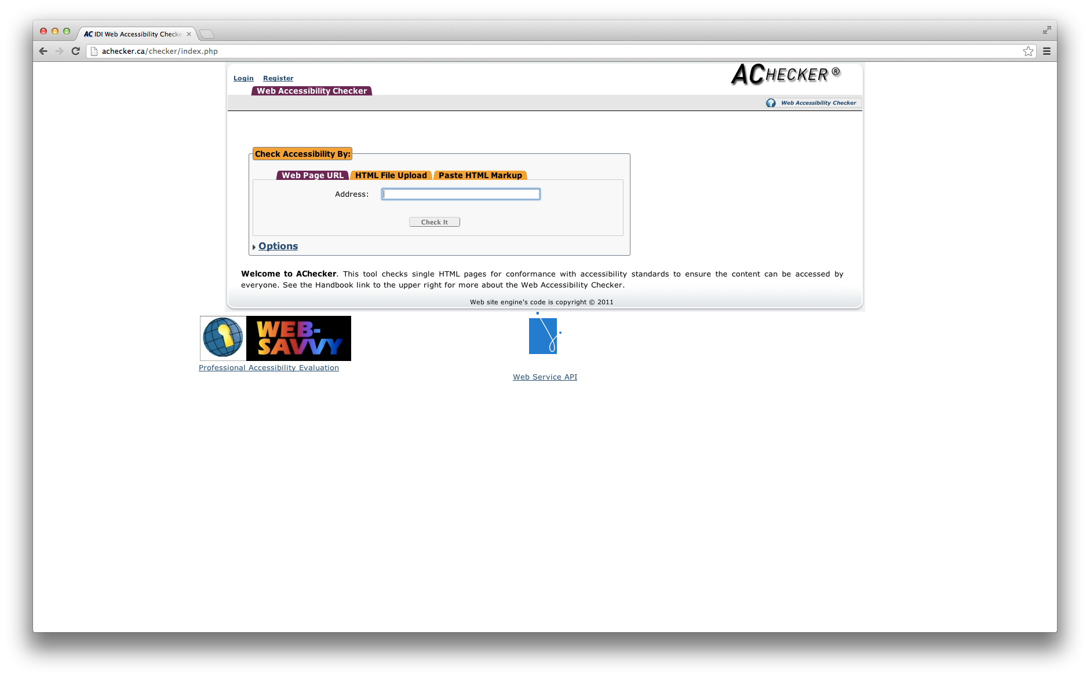
IDRC Examples (PHP)
Did you know ?
ATutor
WordPress
AChecker

Slide 15
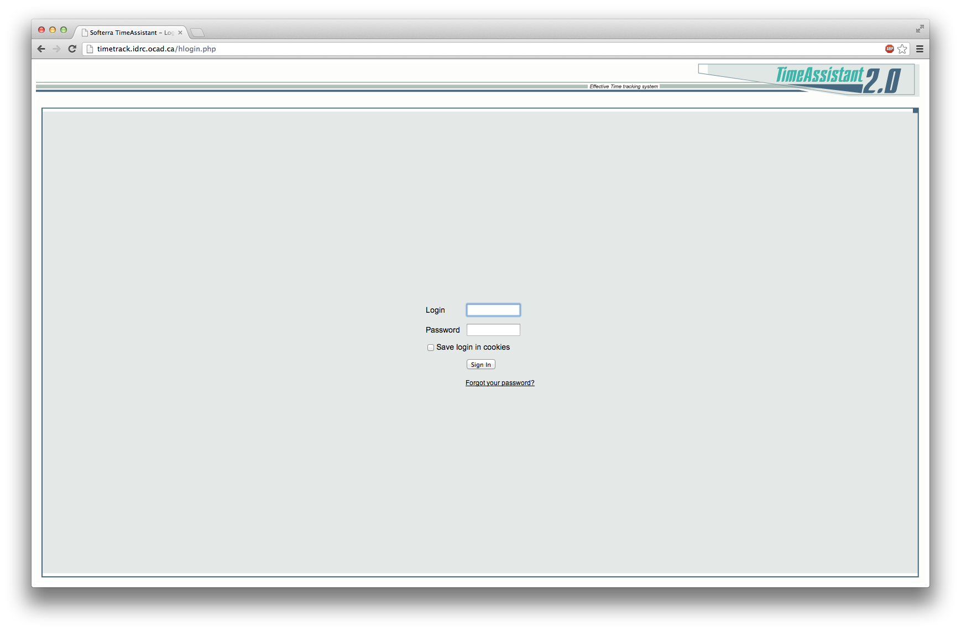
IDRC Examples (PHP)
Did you know ?
ATutor
WordPress
AChecker
TimeTrack

Slide 16
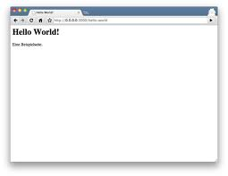
Workflow of PHP pages
Requests “index.php”
Sends PHP requests
PHP Processor
Sends “index.php”
Returns page or data
Access any additional resources such as MySQL database
MySQL

Slide 17
Compare PHP and Javascript

Slide 18
Loosely typed language
var a = “fine”;
$a = “fine”;

Slide 19
Function defaults
Function junction (a, b) {
b = b || 2;
return a * b;
}
Function junction ($a, $b = 2) {
return $a * $b;
}

Slide 20
Closures
var junction = function (a, b) {
return a * b;
};
junction(3, 4); // 12
$junction = function ($a, $b) {
return $a * $b;
};
$junction(3, 4); // 12

Slide 21
Function scope
$a = function () {
$c = 3;
$b = function ($a, $b) {
return $c * $a * $b;
};
return $b;
};
$b = $a();
$b(1, 2); // 0 in PHP, 6 in JS

Slide 22
Object
var fido = {};
fido.name = “Fido”;
$fido = new stdClass();
$fido->name = “Fido”;

Slide 23
I’m so excited now! How do I install?
MAMP (MAC OS)
WAMP (Windows)
XAMP (Linux)
SAMP?
More AMPs are better ☺
Apache + MySQL + PHP + MAC OS/Windows/Linux/Solaris

Slide 24
Let’s dig in!
Demo time!

Slide 25
This is it, Folks!
Now go and write more PHP code.
Any questions?
https://github.com/anvk/php_overview
https://github.com/cindyli/php_overview
If you have any extra questions after the presentation, please ask Cindy or Alex

