Slide 1
Visions for DEEP 2020 What would you like DEEP to be?
___________________________________________________________________________
Inclusive Design Research Centre
OCAD University
Notes:
Meeting recording: for use by the DEEP Organizing Committee. This video recording will not be released. Is anyone not okay with this session being recorded?
Thank you and welcome.
Introduce myself: joined the DEEP Team last year to assist with logistics.
DEEP Committee Vera Roberts and David Pereyra
Acknowledge those who have not attended a DEEP conference before.
We are planning for DEEP to be an online event.

Slide 2
Agenda
Meeting guidelines: Participation
Overview of DEEP
DEEP Format: Thoughts and Questions (30 mins)
DEEP Theme and Topics (40 mins)
Wrap Up and Next Steps (10 mins)
Notes:
2. 2019 General Overview and 2020 possibilities
3. 2019 General Overview and examine DEEP Theme and Topics

Slide 3
Guidelines
Slides
Participation:
1. Live Google Doc (https://bit.ly/2X3UDDH)
2. Trace Online Hand Raising Utility (TOHRU)
Zoom Chat and Hand Raising function
Notes:
Share links to the Google Doc and TOHRU
Slides are only to guide us through the agenda. We want to talk and take note for our preparations.
Zoom Chat will be monitored, however due to the size of this group, we recommend using TOHRU to help us manage our discussions.

Slide 4
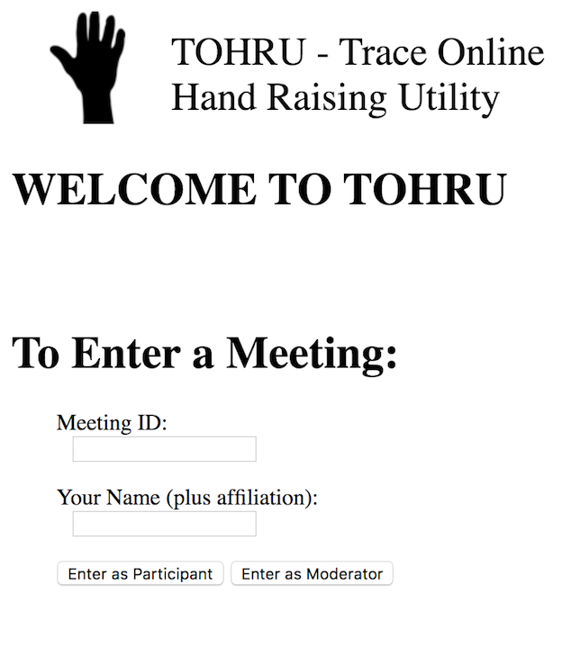
Hand Raising Utility tohru.raisingthefloor.org
Where it asks for Meeting ID put: DEEP2020
Type in your name
Enter as Participant
1
2
3
Notes:
We’ll be using this to manage the discussions.
Vera and David will be assisting with managing turn taking.
Optional reminder/hint

Slide 5
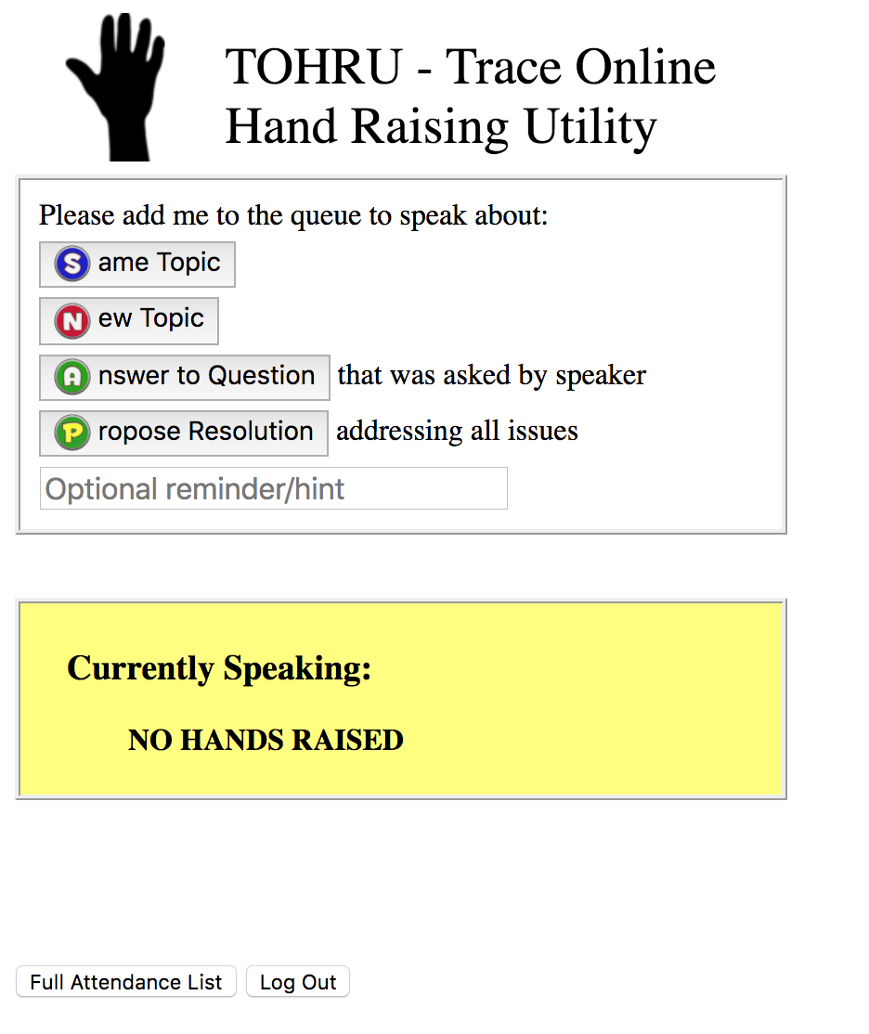
Hand Raising Utility
Meeting ID: DEEP2020
The Tohru tool will allow you to raise and lower your hand or indicate if you would like to comment on the current topic or start a new one.
Notes:
We’ll be using this to manage the discussions.
Vera and David will be assisting with managing turn taking.
Optional reminder/hint

Slide 6
DEEP Conference Overview
Goals and Objectives:
To engage in a meaningful debate
Access multiple perspectives
Be collaborative and interactive
Promote the goal of inclusive participation
Have a diverse audience and panel
Address challenges
Share information and innovative strategies
Notes:
DEEP began in 2012 and we are now moving into preparations for our 9th annual international event.
DEEP welcomes the insights of participants who may be left out but profoundly affected by decisions.
Collaboration across sectors, for example, technology, education, government, science and research.

Slide 7
DEEP 2020 Vision Meeting
Goals:
Identify a theme
Learn topics of interest to you
Anticipate and plan for challenges
Discover opportunities
Reminder: you can share on our Google doc as well
https://bit.ly/2X3UDDH
Notes:
We want to talk with you and get your ideas.
We expect that deep will be an online event and we have never done a fully online event before.
Your contributions today will help us plan what DEEP will be like.
We have a Google Doc

Slide 8
DEEP 2019 Format
General Overview
New Venue: Cooper Koo Family YMCA
One full day in one room
Roundtables with panel members
No breakout sessions
Notes:
Before the pandemic we had planned to carry out a meeting like this, to find out if we should proceed with booking this venue again and how we could make it better.
As mentioned at the start, this year, we expect DEEP to be an online event.
Roundtables were set up for participants to chat with panel members during the reception.
4. Breakout sessions did take place in prior years.

Slide 9
DEEP 2020 Format
Possibilities (Pros, Cons, Ideas)
One day versus multiple day event?
Networking and social aspect?
Breakout sessions?
Notes:
In order to get a sense of what could be a positive and useful format for DEEP, what have been some of your experiences?
Roundtables were scheduled during the reception to provide an opportunity for attendees to chat with panelists in smaller groups.
Would having smaller concurrent sessions be of interest to you?

Slide 10
DEEP Theme & Topics
2019 – Conversations about The State of Inclusion
Some topics included:
Informed Consent in the age of data science
The Future of Work, the GIG Economy and the Digital Skills Gap
Open Education and Inclusive Life-long Learning
We Count: a project to create an inclusive data ecosystem
Notes:
Challenges with Artificial Intelligence and announcement of We Count: a project funded by the Accessible Technology Program- to help find solutions that help Canadians with disabilities overcome barriers that come in the way of their full participation in the workplace.

Slide 11
Questions to Consider
What do we want to focus on for DEEP 2020?
What activities can we engage in to further our discussions and work?
What can work well in the online format?
Notes:
Does anyone have an idea they’d like to share now?
For those of you who shared ideas on the survey, we put that in the google doc and you’re welcome to talk about them here as well.

Slide 12
Survey: Comments & Topic Interests
Virtual social events and inclusiveness of various conferencing portals.
A11Y approaches for a post-pandemic world: Contactless interfaces and hurdles for low vision or no-vision amongst other groups in public spaces.
More indigenous involvement.
Way finding, protection of privacy and role of privacy commission offices in keeping on top of AI enabled global services that cross multiple jurisdictions.
How do things look in this pandemic for people with hidden and/or non- disclosed disabilities?
Notes:
Here are some suggestions that have already been made. Does anyone have ideas about how we can explore them further?

Slide 13
Survey: Panelists and Activities
Data ethics: invite guest speakers such as Luciano Floridi
Exploring:
Remote On-Line Learning in the public school system (JK-12)
Remote On-Line Learning for colleges and Universities
A focus on human rights legislation and accessibility. The requirement to provide equal access sometimes has greater implications than simply meeting existing accessibility standards.
Workshop/panel/discussion forum about virtual identity options…A new range of disabilities and abilities reveal themselves as more social interaction happens online and inclusive design initiatives will need to adapt to a post COVID-19 world.
Notes:
Here are some suggestions that have already been made. Does anyone have ideas about how we can explore them further?

Slide 14
Next Steps
Email to follow with summary
Digging DEEPer and We Count Learning Zone Events
wecount.inclusivedesign.ca
Contact us:
idrc@ocadu.ca
Gloria Bernal: gbernalgomez@ocadu.ca
Thank you!

