Slide 1
Sustainable Inclusive Branding
Feriyal H.Arani

Slide 2
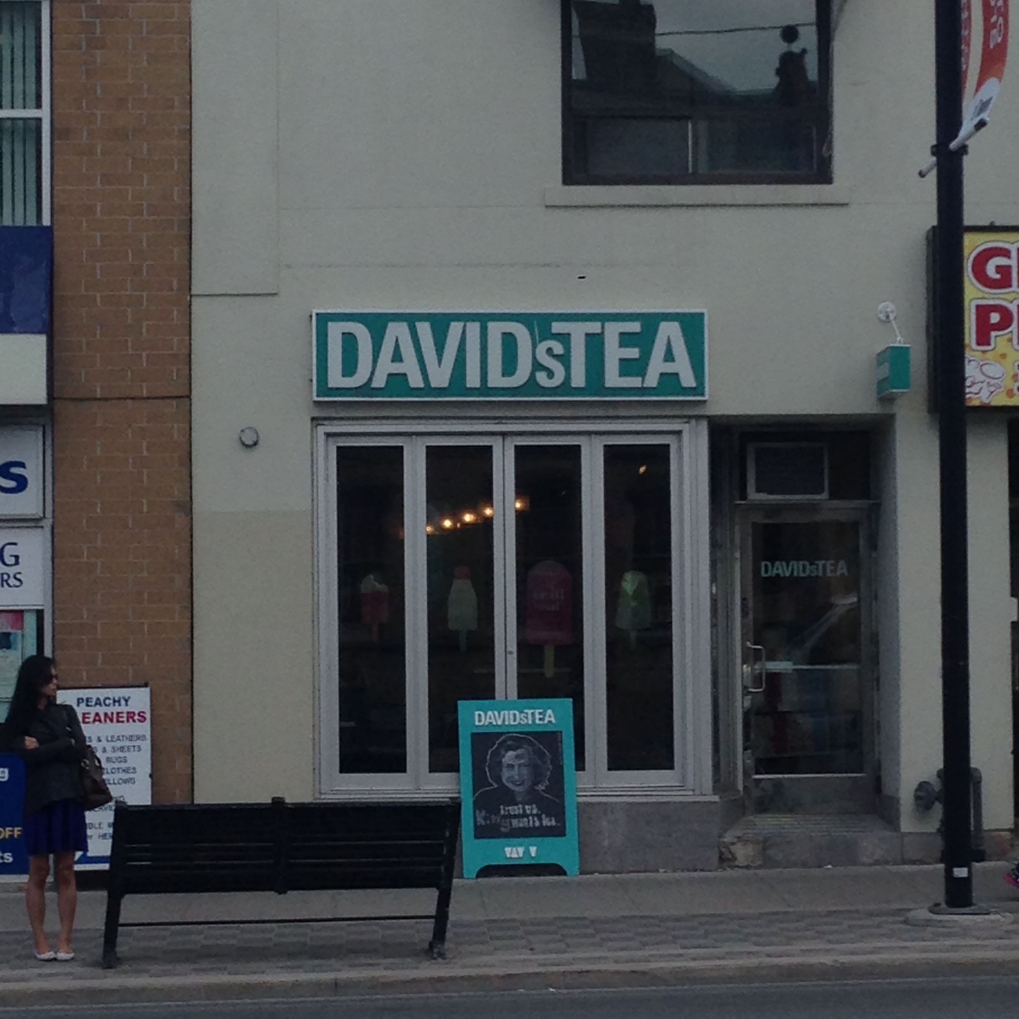
David’s Tea
Yonge & Eglinton

Slide 3
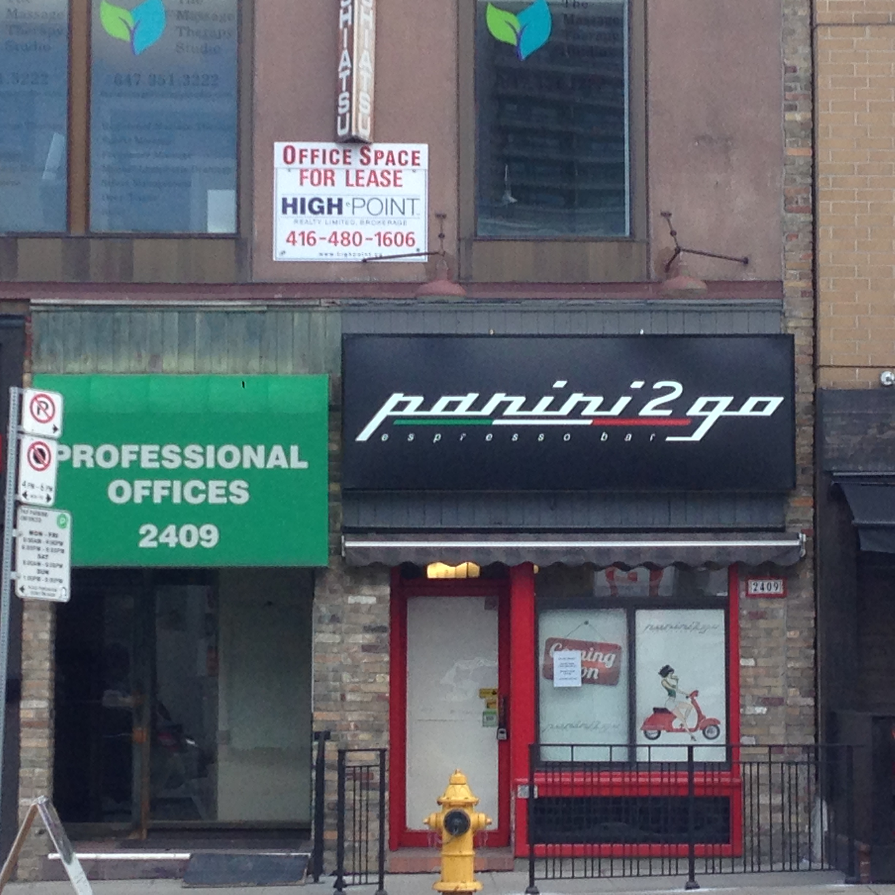
Panini to go!
Yonge & Eglinton

Slide 4
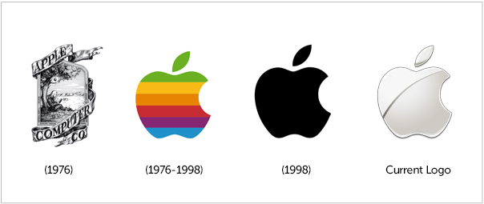

Slide 6
Three Main Questions:
Why is Branding important in terms of accessibility?
Who is responsible to make a brand accessible?
How we can make a brand 80% accessible?

Slide 7
Why is Branding important in terms of accessibility?

Slide 8
Web Accessibility guidelines and Graphic Design
All public sector organizations, businesses and non-profit organizations with 50 or more employees* in Ontario have to meet web accessibility standards.
The internationally accepted standard – World Wide Web Consortium’s Web Content Accessibility Guidelines (WCAG) 2.0 –
has three levels of accessibility: A, AA and AAA.
New websites or significant site refreshes, as well as any content published after January 1, 2012, must conform to the WCAG 2.0 Level A.
the Association of Registered Graphic Designers (RGD) has partnered with the Government of Ontario to help graphic designers and their clients meet the legal requirements of the Accessibility for Ontarians with Disabilities Act (AODA), which aims to make Ontario accessible to people with disabilities in all areas of daily living by 2025.

Slide 9
According to David Aaker on Branding:
The three most important assets to most organization are people, information and brands.
In an increasingly crowded marketplace, fools will be competing on price. Winners will find a way to create lasting value in the customer’s mind.
So The fact is:
The more you care about your customers, the more profit you can get from your business, and who doesn’t want that?

Slide 10
Who is responsible to make a brand accessible?

Slide 11
Organizations and companies
People with disabilities
Designers

Slide 12
How to get to an accessible branding?

Slide 13
Main Focus:
According to David Aaker:
Brand management is mostly about managing the image, creating an advertising campaign, managing a distribution strategy, developing sales promotion, supporting the sales force, getting packaging right and other such tasks.
But my main focus is on LOGO design:
Shape, Space around and Positioning
Text, Text size, Legibility
Color, Contrast
Size
Cultural Differences
And…

Slide 14
Some Examples:
The key to ensuring readability for users with low vision is contrast, which is determined by text size and how easily letterforms can be distinguished in a particular font.
Colour is also an important factor in accessibility. Many people find that black text on a tan background offers the best readability; others favour off-white text reversed out of black.
Some users with colour blindness have difficulty distinguishing between red and green, others between yellow and blue – and some cannot see colours at all.

Slide 15
Process:
For this, first a set of fundamental branding principles will be selected from books such as “Designing brand identity: an essential guide for the whole branding team” by Aalina Wheeler and “Aaker on branding: 20 principles that drive success” by David Aaker.
Then, established accessibility guidelines such as WCAG 2.0 and various ISO accessibility standards would be applied on them to arrive at a set of inclusive branding guidelines.
Views of experts and practitioners in business and advertising fields could be obtained on the above to refine them into a set of sustainable, inclusive branding guidelines.
The target group for this would comprise brand designers and companies who are starting to establish their new brand, or companies looking to rebrand their image.
Further steps could be to use the guidelines in a case study and conduct a usability study thereafter.

Slide 16
“Frames are mental structures that shape the way we see the world. If a strongly held frame doesn’t fit the facts, the facts will be ignored and the frame will be kept.”
George Lakeoff, Professor of Linguistics, UC Berkeley.

