Slide 1
Captivating places:
The impact of inclusive design on inclusive place attachment
Jutta Treviranus &
Doreen Balabanoff
Parinaz Mizban
November /15/2017

Slide 2
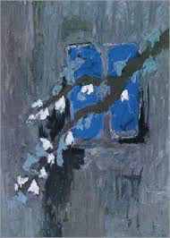
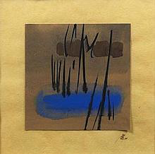
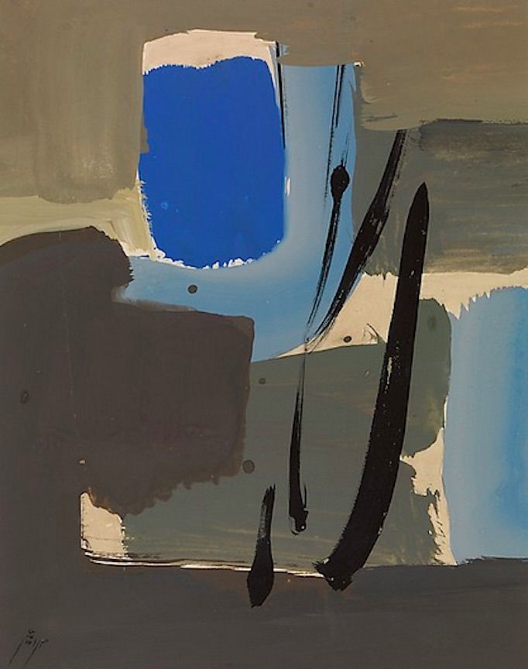
^{Streams of Personal Experience}
Where does the journey take me?
Where will the footprints remain unfinished?
And the string of my shoes will open
By the soft fingers of leisure
Where is my destination to spread a carpet
To sit carefree
And listen
To the sound of the washing of a dish under the neighboring water tap¹?
^{Sohrab sepehri}

Slide 3
^{Streams of Personal Experience}
Place
Non-physical
physical
Environmental psychology
Shumaker 1983
Hummon 1992
Low-Altman 1992
Stedman 1992
Rubinstein 1992
Meaning place
Sense of places
Ahrentzen 1992
Happiness
Pride
love
Twigger- 1996
Klatenborn -1997
Memory
Knowledge Schemas meaning
Kyle،Graefe 2003
considers the full range of human diversity
Hernandez 2007
Religion
historical
Scannel –Gifford 2010

Slide 4
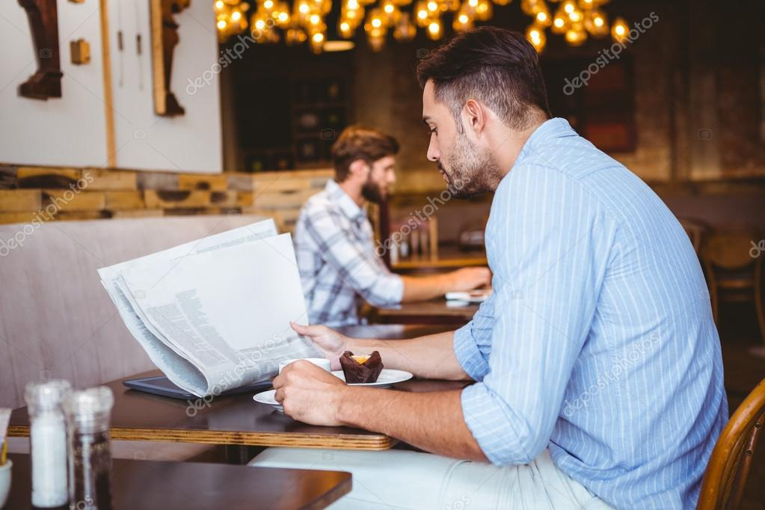
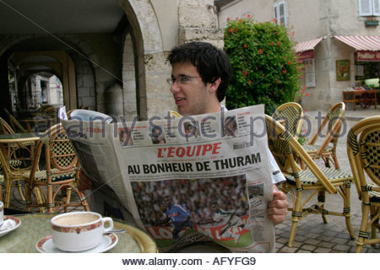
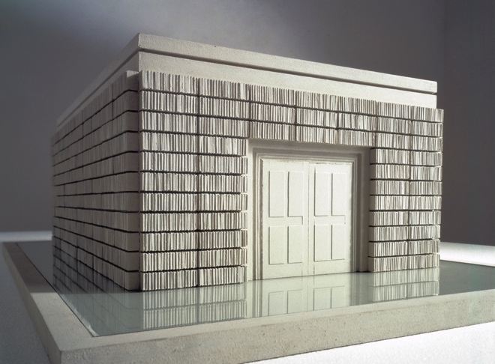
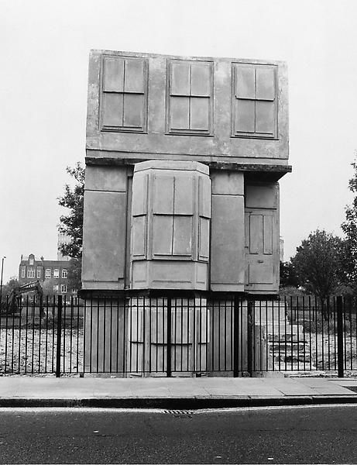
Phenomenological Approach
Imagine( home. stain of wine sign )…Rachel Whitereadca
Topophilia(space happiness-human space- memorial space -nostology)
Micro-Macro(details of home-cosmologic)
vacuum- Fullness(voice –silence ..detailed )
Gaston Bachelard
Poetics of space
vacuum- Fullness
Identity(city and person)
Feeling space
The moment
Rhythm(focus-micro)
Pierre Sansot

Slide 5
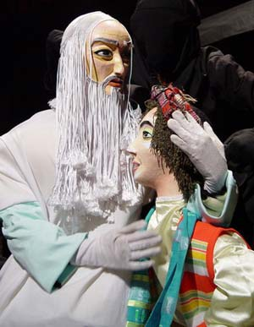
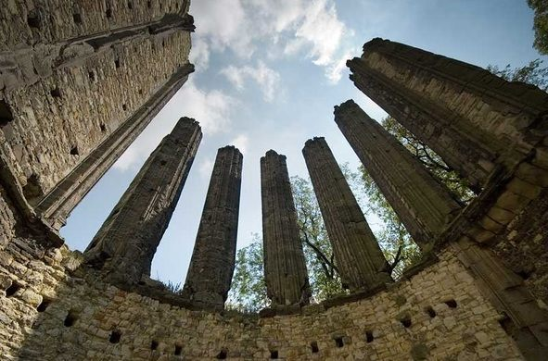
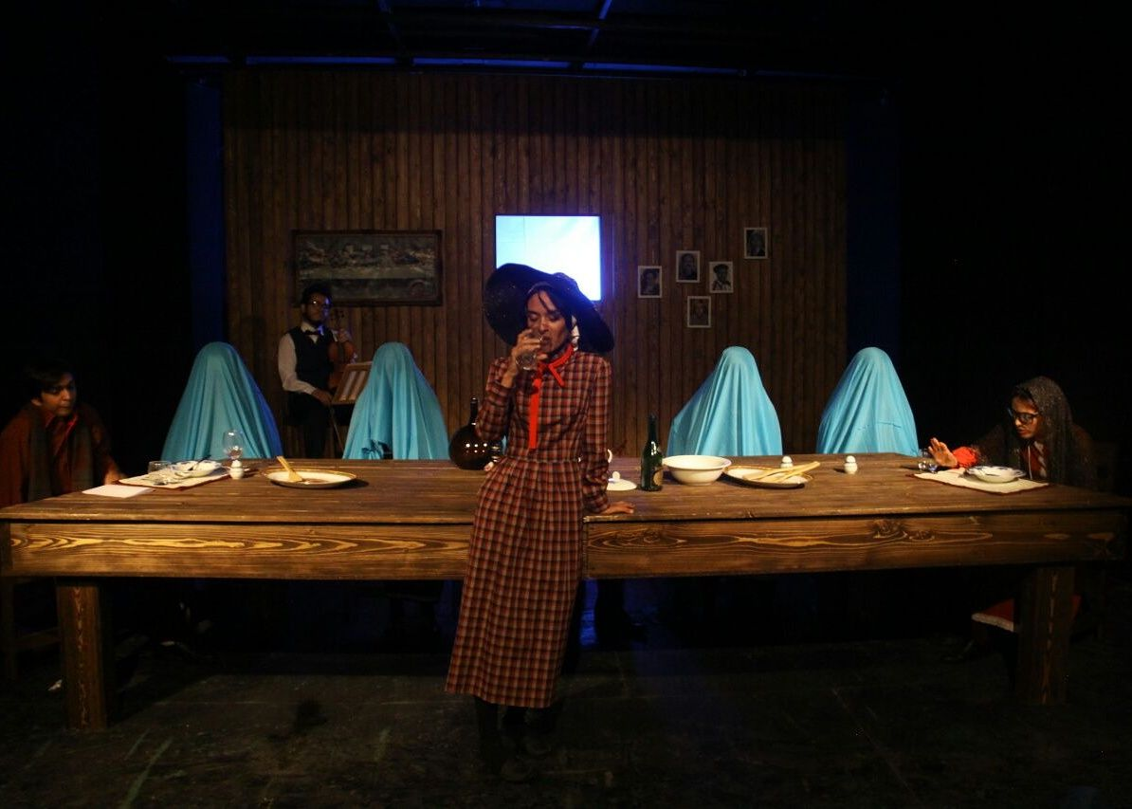
Phenomenological Approach
Emic- Etic(
Semiotics
Bunraku theater- hidden)
(it Is the people that make city or city make the people? Inner-
Roland Barthes
Myth)
Pallasmaa
Sensory relationship
Auditory: Space Dimensions-The train beeps-church bell-Silence-Gothic church)
Tactile ways:(Home-Sense of intimacy-
Discursively:
Visual :
Olfaction:(Abandoned house- Bakery shop-old narrow street)
The Eyes of the Skin

Slide 6
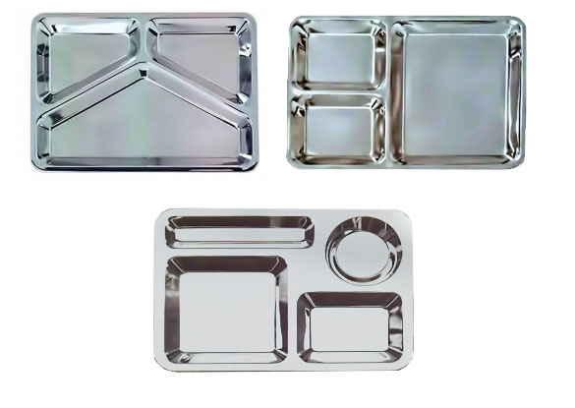
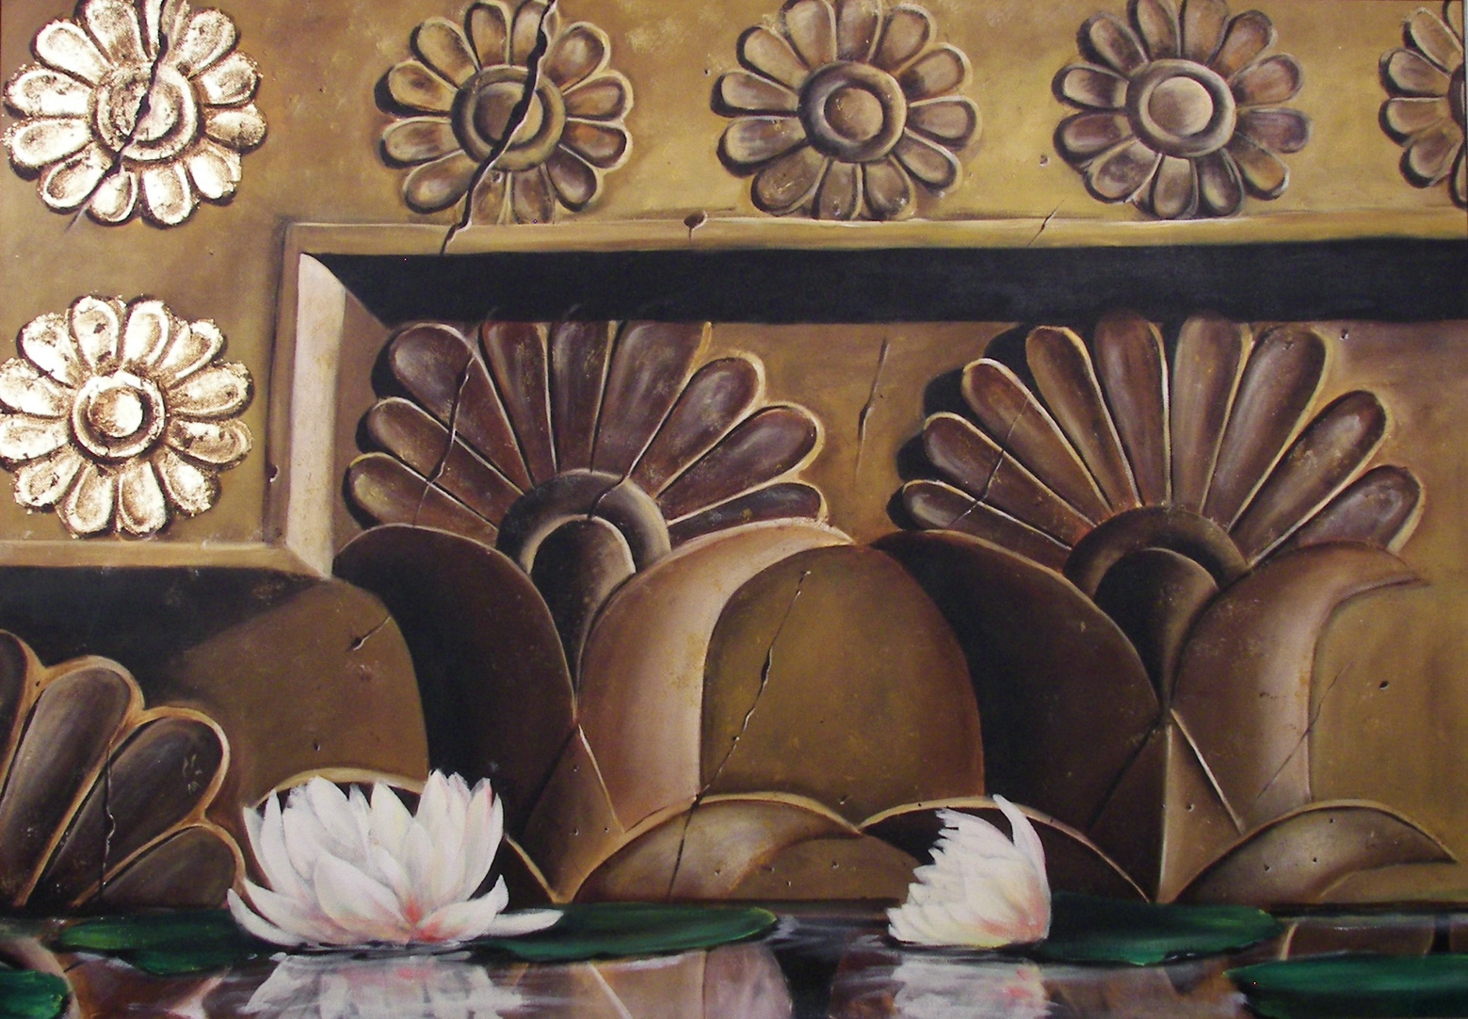
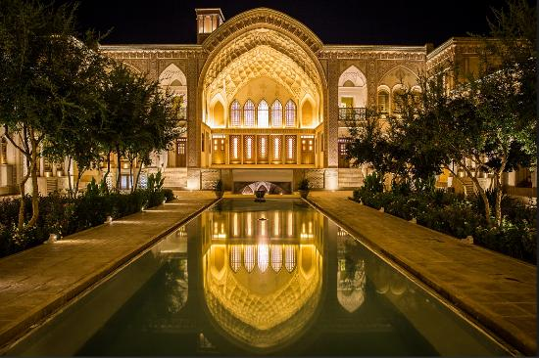
Phenomenological Approach
Pitter Zomtor
Sensory relationship
Common sense
Archetype(Collective memories Egyptian pyramids)
Depth
Speed(integration of people)
soft-hard(material)
Having unity-unique diversity(modern life )
Maurice Merleau-Ponty

