Slide 1
Inclusive Tourism Design: Toolkit for Managers
Universal Design and Inclusive Design
Sustainability
Application to Tourism
Application to Tourism businesses

Slide 2
Agenda:
Background
My research idea
Group-based discussions

Slide 3
Introduction
My Background

Slide 4
Wildcat Adventure Race
https://www.youtube.com/watch?v=0Rrb9_GPZtQ
An opportunity in sport to break down barriers between people with disabilities and able bodied people

Slide 5
Research Question
How might universal and inclusive design be used together to develop design principles for training resources for managers that can result in accessible and adventurous tourism experiences?

Slide 6
Objectives
Identify whether these design principles are feasbile
Benefits and Barriers from on the ground experience
Recommendations for the future

Slide 7
Why inclusive tourism? Why Asia?
Human right to participate in tourism and sport on an equal basis (Disability Rights Promotion International, 2015)
Tourism for all: Promoting Universal Accessibility (United Nations Tourism Organization, 2016)
One of the fastest growing tourism industries
New accessible adventures outside of the west
Contextual situation in Nepal and Thailand
Thailand: (Chang Mai)
https://www.youtube.com/watch?v=ZaGk-NMWa58

Slide 8
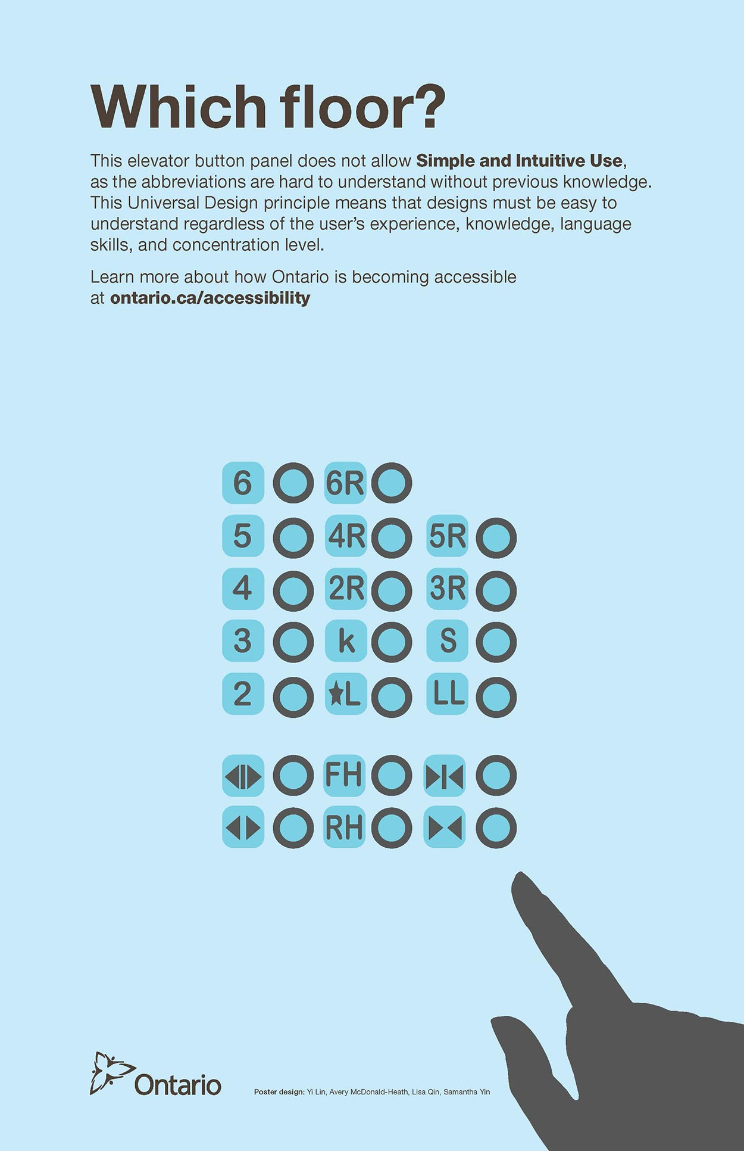
Universal Design
An environment usable to all people to the greatest extent possible (Mace, 1997)
Greater safety
Increased Comfort
OCAD, 2016

Slide 9
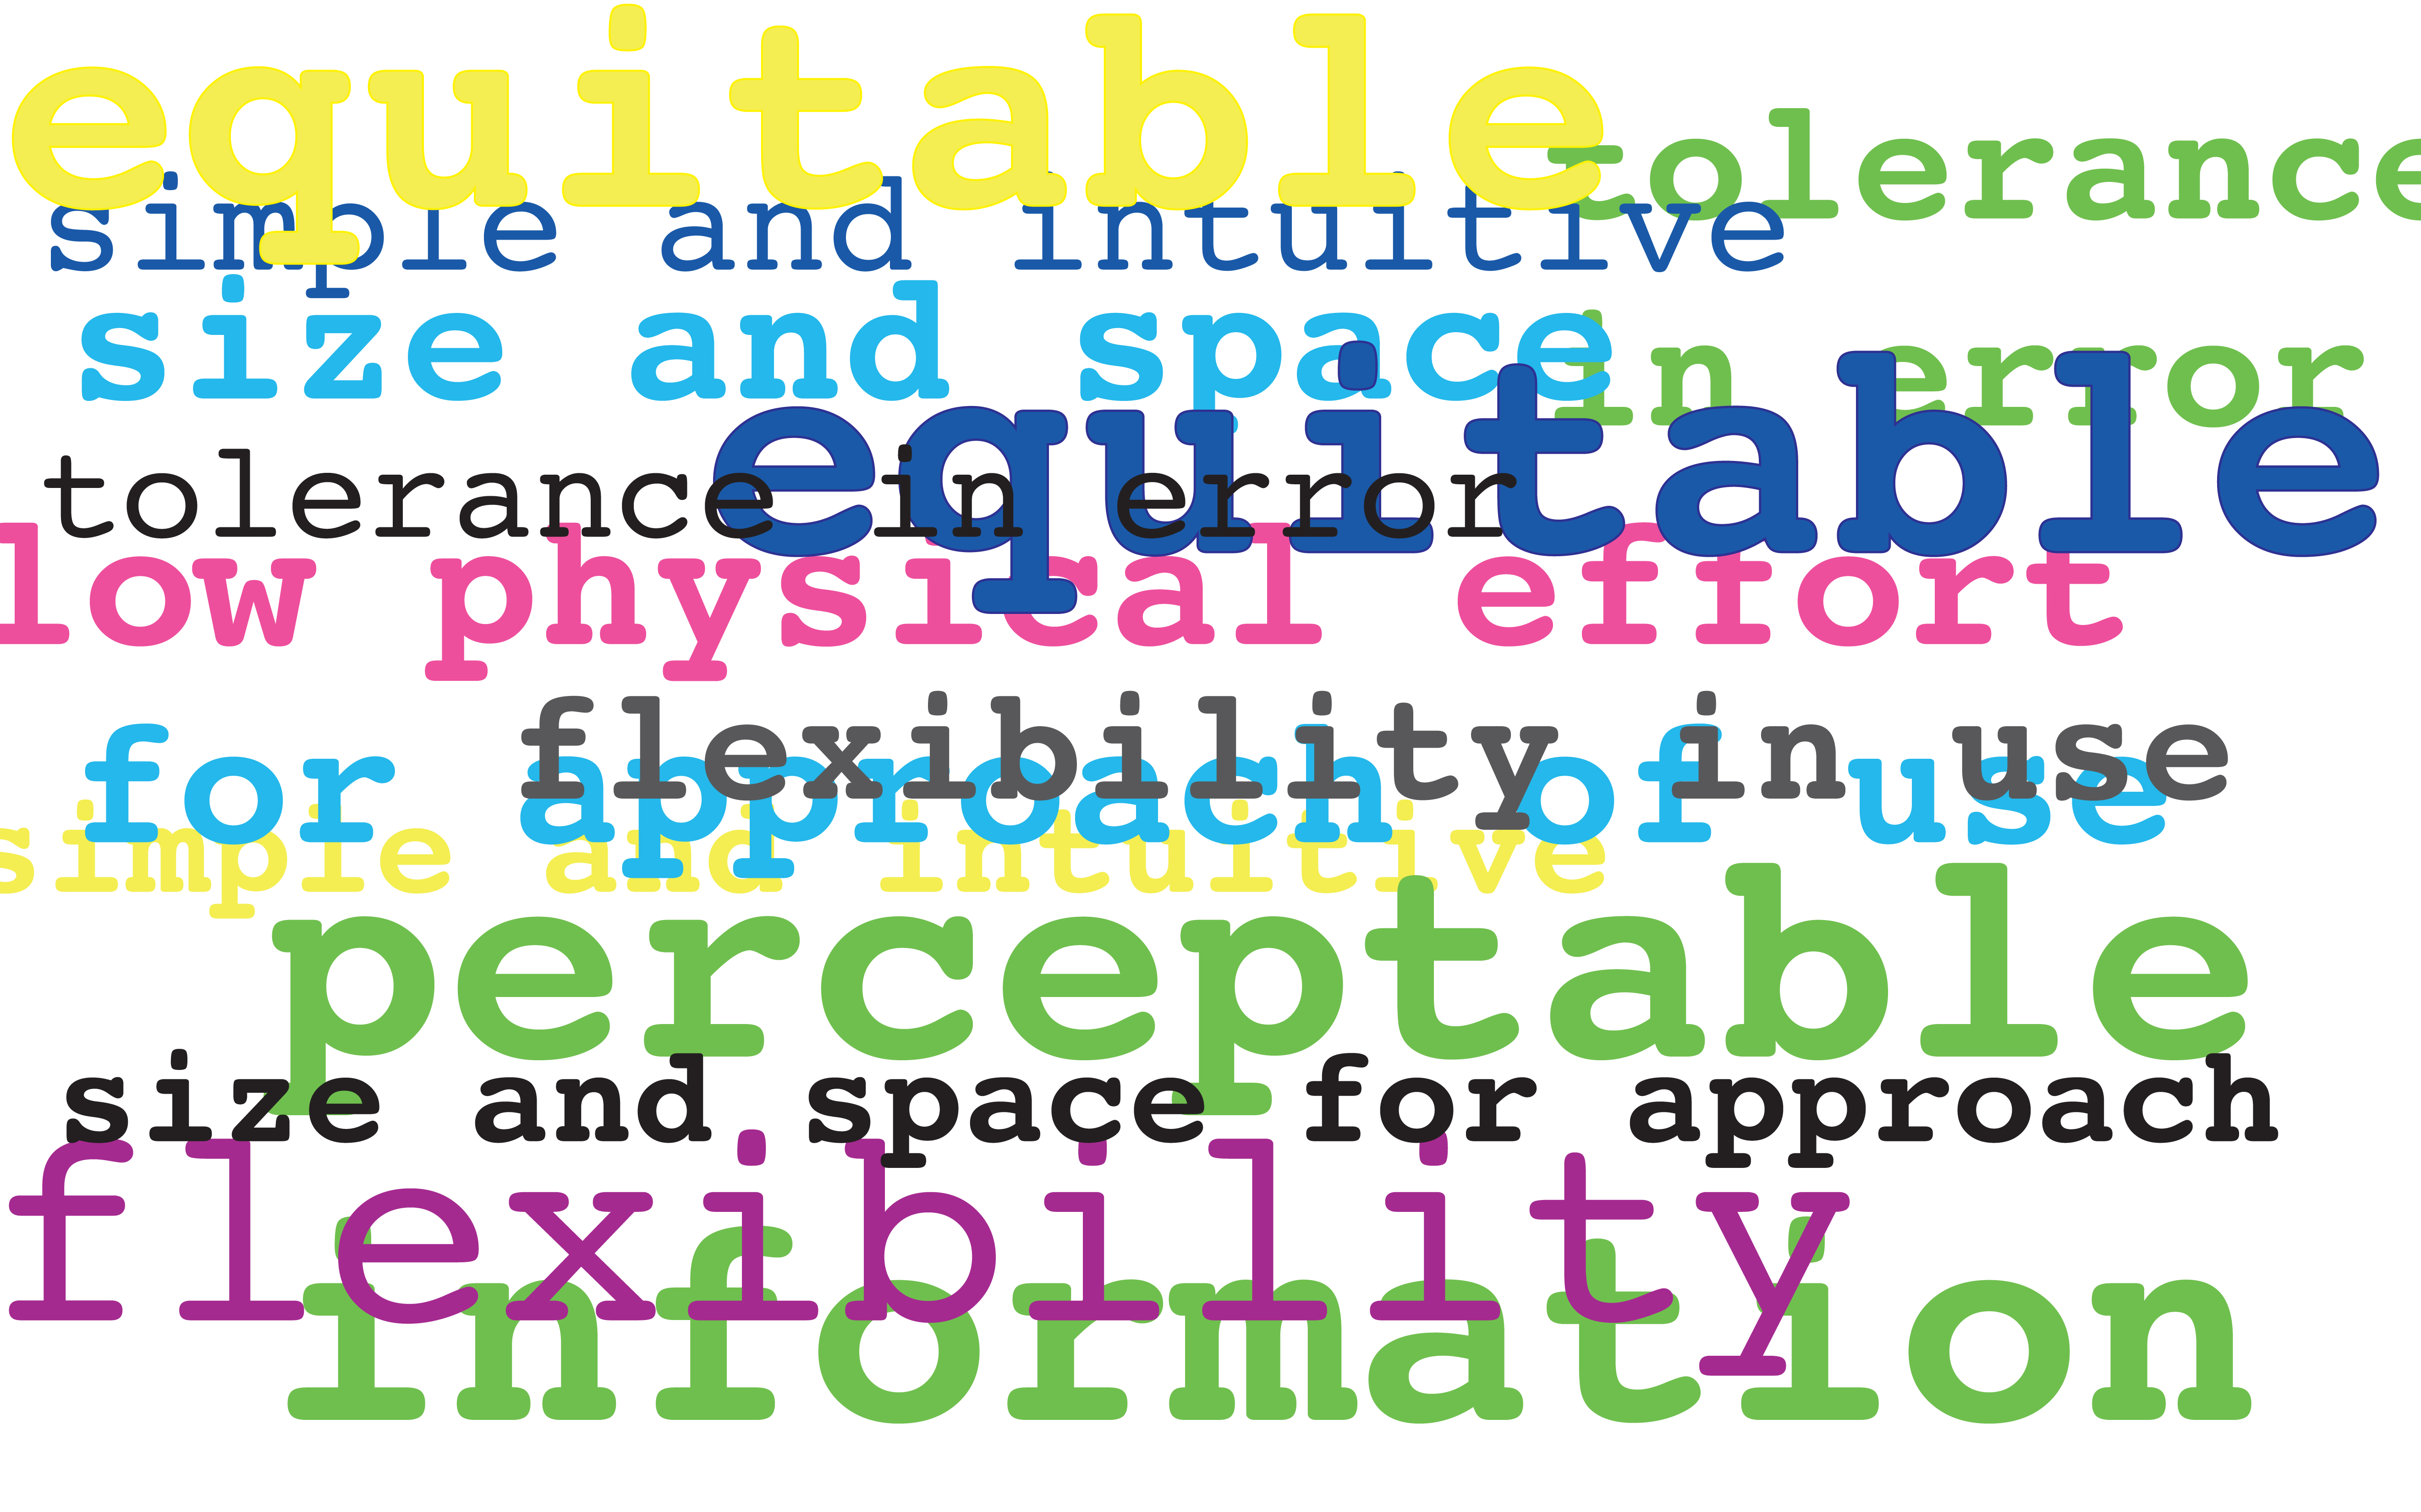
7 Principles to Universal Design
1. Equitable Use
2. Flexibility in Design
3. Simple and Intuitive Use
4. Perceptible Information
5. Tolerance for Error
6. Low Physical Effort
7. Size and Space for Approach and Use

Slide 10
Equitable Use
1. Equitable Use
Marketable to people with diverse abilities
Marketable to people with diverse athletic interests
Marketable packages for 'soft' and 'hard' tourism options (Beard, Swarbrooke, Leckie and Pomfret, 2012)
Inclusion of people with disabilities in niche markets, and not their niche market being disabled tourism

Slide 11
Flexibility in Design
2. Flexibility in Design
Tours are adapted to different paces to never make a client feel rushed (flexibility in optimal tour timing)
Contingency plans in place to make last minute adjustments in tours when necessary
Options for custom made packages for customers
Accommodates a wide range of individual preferences in design

Slide 12
Simple and Intuitive Use
3. Simple and Intuitive Use
Design is easy to understand regardless of user experience
Training instructions and visuals availabe in different languages
Hands-on activities and practice rounds in addition to visual, verbal and tactile language
Have a signer who can be arranged to work on a contractual basis when needed

Slide 13
Perceptible Information
4. Perceptible Information
Design communicates necessary information
Communication can be through both verbal and non-verbal communication
Performance needs to be shown and told to ensure safety
Specialized equipment is demonstrated by people with extensive and/or lived experience

Slide 14
Zero Tolerance for Error at the Fault of the Company
5. Tolerance for Error will be adapted to Zero Tolerance for error at the fault of the company
Minimize hazards and provide warnings
Waiver is in plain text language and provides warnings of what can happen that is outside of the control of the company such as environmental hazards
Waiver is also verbally, visually or tactically communicated to ensure it is understood
Zero tolerance rule for guides who forget or rush a safety check of equipment. Safety checks such as breathalizers will also be done on the guide

Slide 15
Varying Physical Activity
6. Low Physical Effort adapted to Varying Physical Activity
Design can be used efficiently and comfortably with minimum fatigue
Sufficient resources to ensure availability at all times (Rice, 2014)
Different tours available such as nature based, mild activities to extreme adventure activities
Adaptability: options to change lengths of walks, exit routes, provide assistance if asked for

Slide 16
Size and Maintenance of the Space
7. Size and Space for Approach adapated to Size and Maintenance of the Space
Appropriate size and space is provide for apporach, reach, manipulation, and use regardless of the user's body size, posture or mobility
Equipment available or that is adaptable to all shapes and sizes
Guides are thoroughly trained on making size adjustments that are double checked by another guide and re-checked continuously on tour
Activity spaces such as the water or trails need to be physically and visually checked by guides every morning for obstacles and safe conditions for use

Slide 17
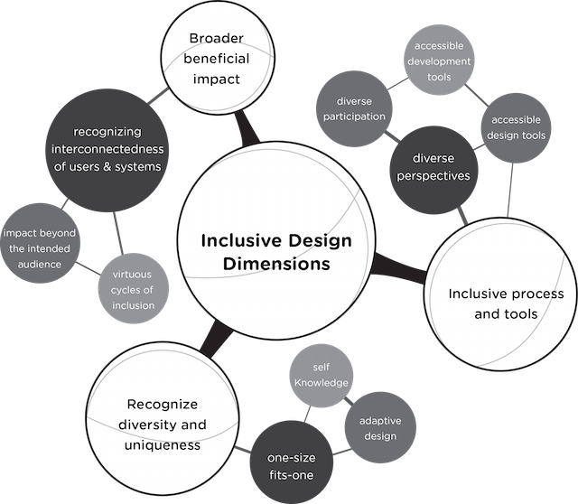
Inclusive Design in Tourism
Inclusive Design Research Centre 2016:
-one size fits one
-tailored and customized tours
-digital realm
-impact beyond intended audience
-diverse perspectives
Insights!

Slide 18
Tintagel Castle (example of sustainability challenges)
Do you think the tourist with a disability can supplement this experience through going to the visitor centre?

Slide 19
Universal Design: Application to Sustainable Tourism
Conservation vs. Social Inclusion
Degradation of traditional aesthetics before disability legislation
Different entry access points eliminated
Physical, Sensory and Communication access
Sensitive installation of accessible amenities
Provisions to make buildings accessible and usable

Slide 20
Information Communication Technology Systems:
How do you think they can play a positive role in the tourism industry in all stages of the process?
Pre trip
Safety/Waiver Experience
Actual Experience
Post Trip

Slide 21
Sustainability Lens

Slide 22
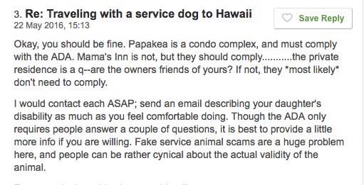
Social and Equitalble
“It is too organized as a team and you are immmeditately identifed as a blind person. We may as well have put a sign up”

Slide 23
Online Booking Issues

Slide 24
Enhancing the Tourist Experience
Staff training for everybody
Experience with specialized equipment prior
Meetings about any safety or satisfaction issues that arise
If you don’t know, ask

Slide 25
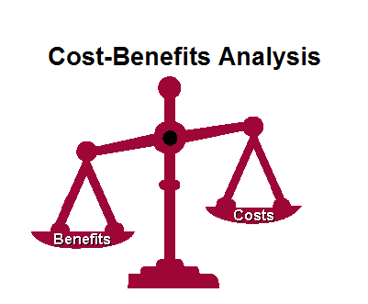
Economic Costs
Start-up costs
Less tours in a day
Support staff required
If a discount is offered for people with a disability, if people start to take advantage

Slide 26
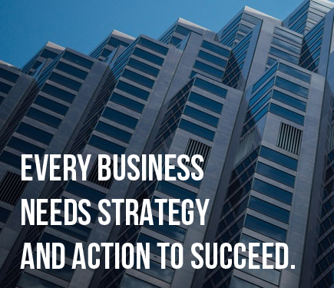
Economic Benefits
Viable
Strong business strategy
Competitive advantage
Baby-boomer market
Long-term economic gain can outweigh start-up costs

Slide 27
Environmental critique
Emergency and safety plans for people with disabilities
Accessibility in old towns, neo-colonial cities, heritage sites
Transportation services to a destination
Entire destination experiences

Slide 28
Best Practice in Environmental design in Tourism
Not just the final service but the entire experience: airport transfers, hotel rooms, accessible vehicles, restaurants, adapted toilets and professional staff
Coordination and partnerships between leaders in the industry
Bearable (carrying capacity)

Slide 29
At your own Risk
https://www.youtube.com/watch?v=vseXEMoOMBc

Slide 30
Risk
Personal Choice
Tendency to overprotect
The ‘what if’ mentality
Don’t judge a book by it’s cover or it’s title

Slide 31
HealthCare in Other countries
Emergency Scenarios
Helicopter access
Insurance policies

Slide 32
Question
Can you provide the group with an example of a time you witnessed an accessibility issue in tourism or at a destination?

Slide 33
Management Toolkit: Graphic Design
How do you think tourism businesses can promote accessibility using graphic and communication design?
Website
Travel retail and wholesale sites
https://www.go-nepal.com/destination/nepal.html

Slide 34
Management Toolkit: Whole Destination Experience
Building partnerships and a community
Building international partnerships
Japan:
https://www.youtube.com/watch?v=xycecbwpIzE
Education

Slide 35
Management Toolkit: Barriers
How do you tackle equity in countries where there is still a stigma surrounding disability?

Slide 36
Limitations
Reliance on secondary sources vs. first hand experience with a mobility device
Some of the experiences mentioned are for people who have the disposable income to participate
New topic area
Part of the adventure, is that it isn’t always 100% predictable

Slide 37
Recommendations for the future
1. Half to Full day Sensitivity Training Workshop by people with disabilities
2. Discount if part of tour/service is disabling
3. Support worker can join for free
4. Service from start to finish (+ receiving feedback)
5. People with disabilities in all stages of planning and in the workplace
6. Complaint resolution- freebie and notify all staff to avoid future problems

Slide 38
Conclusion
Tourism processes are complex!
To better understand the intricate interaction between conservation and inclusion as well as sustainability
To better understand tourist, company and all stakeholder needs within the tourism industry
Attitudinal shift is needed to dismantle stereotypes
Shift towards universal design and inclusive design

Slide 39
References
Ed Roberts Campus. (2016). Building Independence from the Ground Up. Retrieved from http://www.edrobertscampus.org
Eichhorn, V., & Buhalis, D. (2011). Accessibility: A key objective for the tourism industry. Accessible tourism: Concepts and issues, 46-61.
Mace, R. (1997). Universal Design A review of Universal Design conducted by John Paul Harris, coordinator for Wyoming AIM Clearinghouse, Wyoming Institute for Disabilities (WIND) (Review) (p. 5). North Carolina: Wyoming Institute for Disabilities.
OCAD University. (2016). Universal design | OCAD UNIVERSITY. Retrieved November 2, 2016, from http://www2.ocadu.ca/feature/12517/universal-design
Ostroff, E. (2011). Universal design: an evolving paradigm. McGraw-Hill.
Pearn, M., Buhalis, D., & Darcy, S. (2011). Accessible Tourism: Concepts and Issues. Channel View Publications. Retrieved from https://books-google-ca.ezproxy.library.yorku.ca/books/about/Accessible_Tourism_Concepts_and_Issues.html?id=B-SeyjdevpwC
Ray, N. M., & Ryder, M. E. (2003). “Ebilities” tourism: an exploratory discussion of the travel needs and motivations of the mobility-disabled1. Tourism Management, 24(1), 57–72. https://doi.org/10.1016/S0261-5177(02)00037-7
Song Ee Kim, & Xinran Y. Lehto. (2012). The voice of tourists with mobility disabilities: insights from online customer complaint websites. International Journal of Contemporary Hospitality Management, 24(3), 451–476. https://doi.org/10.1108/09596111211217905

Slide 40
Group Feedback
If you have any suggestions or constructive criticism for my research, I am open to it ☺
Future participation opportunity

