Slide 1
Inclusive Statistics
Dr. Kevin Stolarick

Slide 2
Agenda
Statistics Overview
How & Why Statistics Fail
  On Being “Normal”
  Definitions/Models of Disability
Alternatives?
  User States and Contexts
  The Impossibility of Universality
  Accessibility vs. Inclusion
  Tails & The Tails of the Tails
  Sample of One
  “Small” Data

Slide 3
Statistics Overview

Slide 4
Statistics
Key Ideas
Data Types
Data Sources
Describing Data

Slide 5
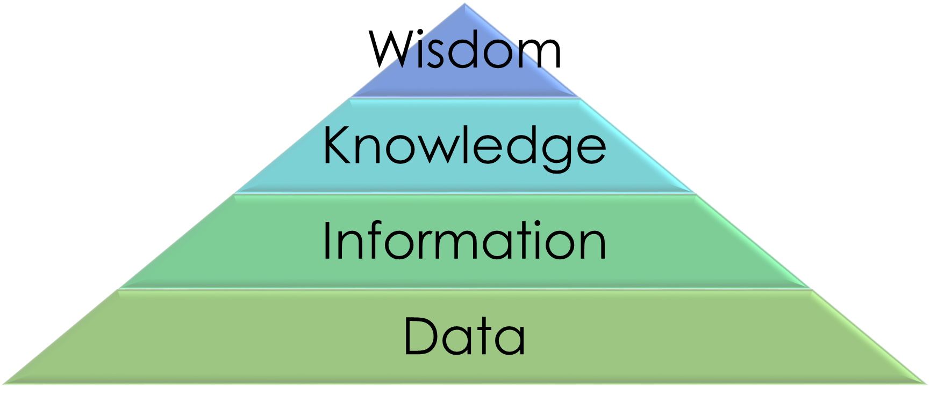
Statistics
“The study of how to collect, organize, analyze, and interpret numerical information from data.”
Information Hierarchy
  Data → Information → Knowledge → Wisdom

Slide 6
Example: The S.A.T.
For 200 college Freshmen, have
  S.A.T. scores
  1st Year college GPA
  Public/Private High School
  Gender
Use statistics to learn about …

Slide 7
Types of Statistics
Descriptive
  Use numbers and graphs to look for patterns and summarize information in the data
    How many of 200 went to private schools?
Inferential
  Use data to make estimates, decisions, predictions, or generalizations about a larger set of data
    How many HS students go to private schools?

Slide 8
Important Concepts
Unit of Analysis/Experimental Unit
  Observation (person, object, event) for which data is collected
  Sample
    HS students, took SAT, finished 1 yr college
Population
  Complete set of units of interest
  Census
    All HS students who go on to college
    Everyone who took the SAT in a given year

Slide 9
Important Concepts
Variable
  Characteristic, attribute or property about an observation (need not be numeric)
    SAT verbal score, gender, GPA
Statistical Inference
  Estimate or prediction about a population based on a sample
    25% attended private high school
Reliability (Measure of)
  Degree of uncertainty associated with a statistical inference
    +/- 5%

Slide 10
Important Concepts
Sample
  Subset of the population
  Any subset is a sample
    200 HS students in my data set
  Not all samples are equally good

Slide 11
Important Concepts
Representative Sample
  Any sample whose characteristics are “typical” of the population
Random Sample (of n observations)
  Every possible sample of size n has an equal chance of being selected from the population
  Every member of the population has an equal chance of being included
  Only as good as ability to identify and list the population

Slide 12
Sampling Methods
Random – generated or tables
Stratified – random within classifications
Systematic – ordered population, every k^{th} observation
Cluster – divide population into sections, census (all) random sections
Convenience – easy to get; “man on the street”; person on the Internet

Slide 13
Sampling and Inclusion
You should all be sufficiently uncomfortable by now
Any sampling, by its very nature, tends to exclude:
  Those on the “edges”
  The non-typical
  Those not identified as part of the original population
  Often, those with disabilities
If included, the result is:
  A “token” person
  A single person’s disabilities used to represent all those with disabilities

Slide 14
Data Types - Variables
Qualitative
  Classification information; not meaningful numbers
Quantitative
  Numeric information

Slide 15
Measurement Levels
Nominal – Name only
  Gender, public/private high school
Ordinal – Order only
  HS Rank, good/better/best, Likert (1-5)
Interval – Order and differences; not ratios
  Year in college, temperatures, calendar time
Ratio – Order, differences, and ratios
  Age, SAT score, measurements, clock time

Slide 16
Data Collection
Secondary – someone else collected
  Published data, known source
Primary – you collect
  Experiment
  Survey
  Observation

Slide 17
Using Statistics Wisely
Asking the right (kind of) questions
Allowing for problems/issues
  Measure of reliability
  Nonrandom samples
  Selection bias – incorrect population
  Non-response bias – unanswered question
  Measurement error – variables are “off”

Slide 18
Describing Data
Qualitative Data
  Class – classification category
  Counts
Quantitative Data
  Value – dealing with unique numbers

Slide 19
Qualitative Data
Class Frequency
  Count of observations in each class
Class Relative Frequency
  Observations in each class divided by total number of observations
Class Percentage
  Class Relative Frequency times 100

Slide 20
Qualitative Data
Text/Table
Bar Chart
Pie Chart
Pareto Diagram
  Bar Chart (%) – show highest values first

Slide 21
Lies, Damn Lies & Statistics
Impact of data/variable choice
  Total number vs. percentage
Impact of presentation
  Scale, color, size
Impact of text/description

Slide 22
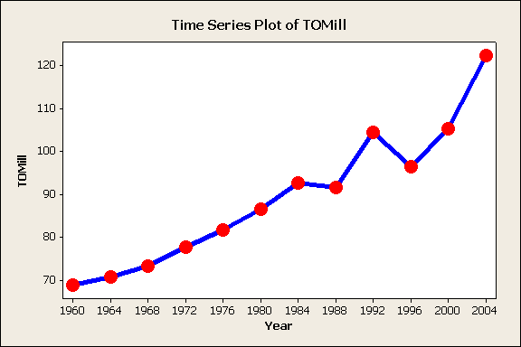
Time Series Plot – Voter Turnout

Slide 23
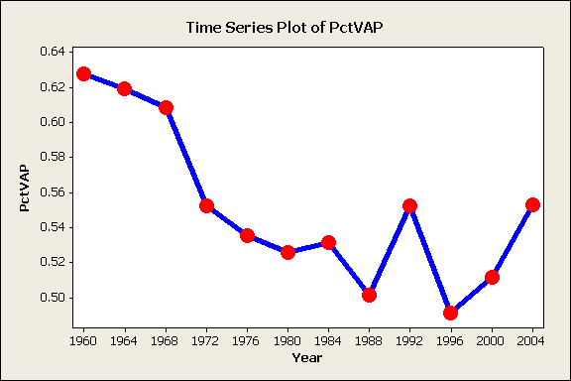
Time Series Plot – Voter Turnout

Slide 24
Impact of Description
“For the third presidential election in a row, voter turn out continued to rise at unprecedented levels.”
versus
“The historic trend of voter apathy continues with turnout for the presidential election well below levels of even 30 years ago.”

Slide 25
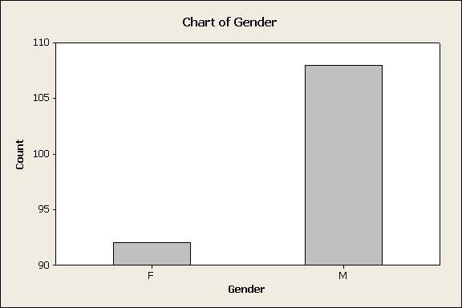
Impact of Scale

Slide 26
Impact of Size, Color
C
h
a
r
t
o
f
G
e
n
d
e
r
1
2
0
1
0
0
8
0
t
n
u
6
0
o
C
4
0
2
0
0
F
M
G
e
n
d
e
r

Slide 27
How and Why Statistics Fail
On Being “Normal”
Definitions/Models of Disability
  Medical
  Functional
  Psychosocialeconomic

Slide 28
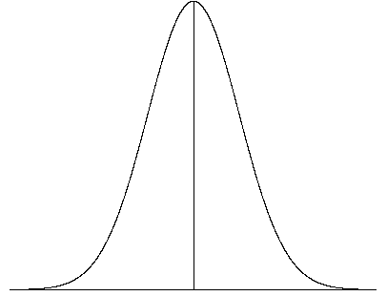
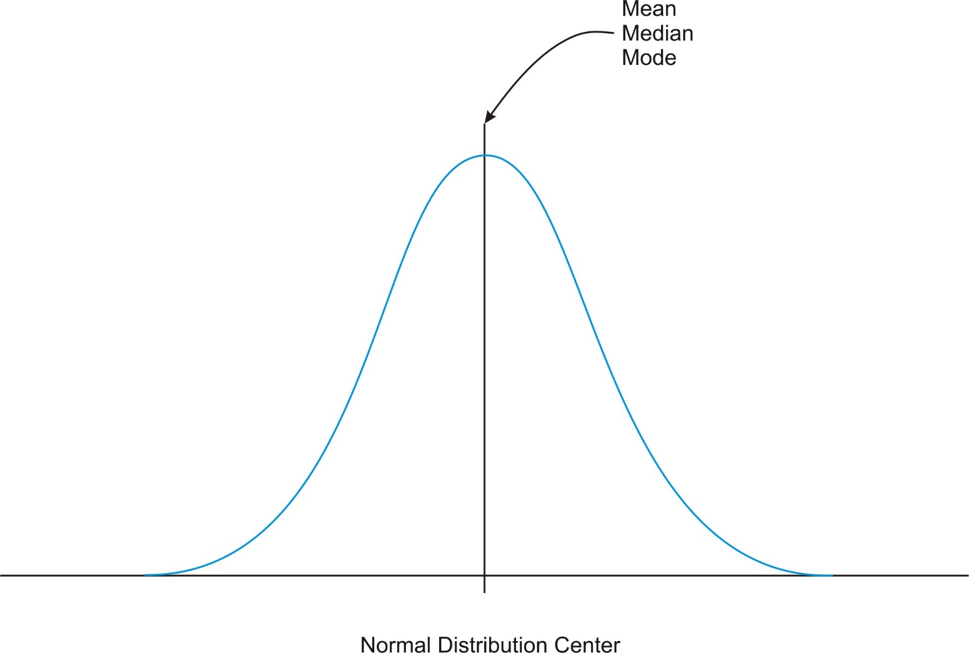
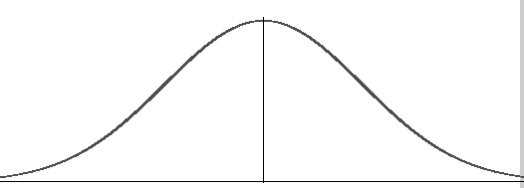
Being “Normal”

Slide 29
How and Why Statistics Fail
On Being “Normal”
Definitions/Models of Disability
  Medical
  Functional
  Psychosocialeconomic

Slide 30
Alternatives?
User States and Contexts
The Impossibility of Universality
Accessibility vs. Inclusion
Tails & The Tails of the Tails
Sample of One
“Small” Data

Slide 32
Alternatives?
User States and Contexts
The Impossibility of Universality
Accessibility vs. Inclusion
Tails & The Tails of the Tails
Sample of One
“Small” Data

Slide 33
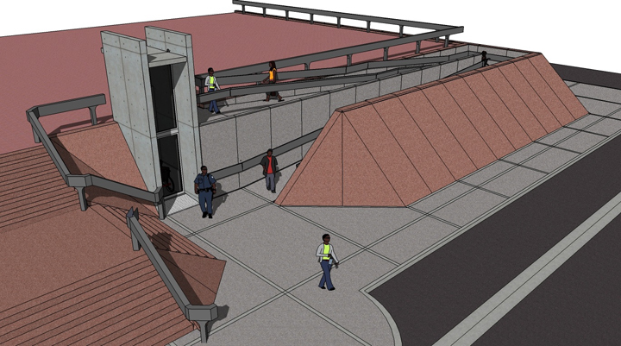
Accessibility

Slide 34

Inclusion (Inclusive Design)

Slide 35
The Difference

Slide 36
Alternatives?
User States and Contexts
The Impossibility of Universality
Accessibility vs. Inclusion
Tails & The Tails of the Tails
Sample of One
“Small” Data

Slide 37
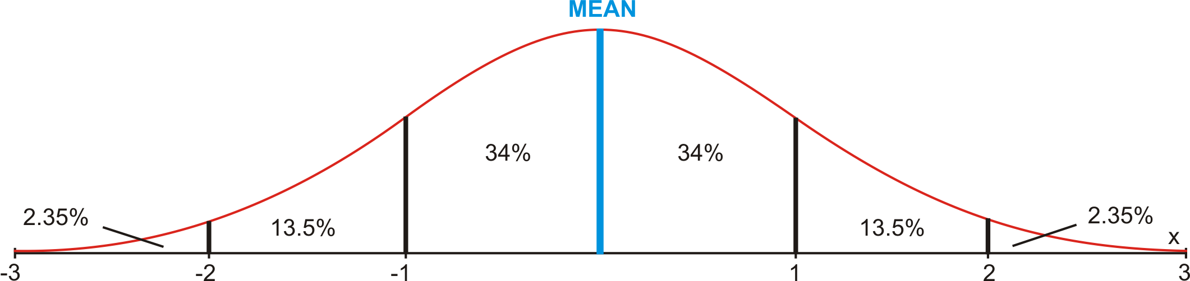
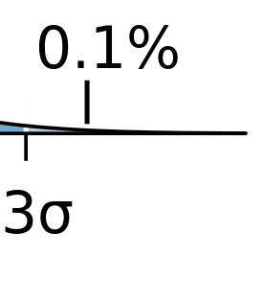
Tails of the Tails

Slide 38
Alternatives?
User States and Contexts
The Impossibility of Universality
Accessibility vs. Inclusion
Tails & The Tails of the Tails
Sample of One
“Small” Data

Slide 39
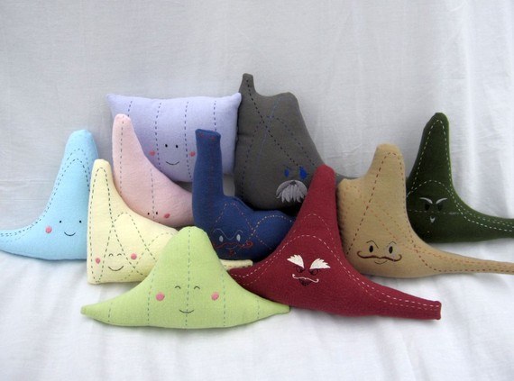

Slide 40
Questions?

Slide 41
Additional Information and Examples

Slide 42
Text/Table
Gender | Count | Percent
F | 92 | 46.00
M | 108 | 54.00
Total | 200 | 100.00

Slide 43
Text/Table
HSType | Count | Percent
N/A | 10 | 5.00
Priv | 30 | 15.00
Pub | 150 | 75.00
Pub/Priv | 10 | 5.00
Total | 200 | 100.00

Slide 44
Text/Table – Better Order
HSType | Count | Percent
Pub | 150 | 75.00
Priv | 30 | 15.00
Pub/Priv | 10 | 5.00
N/A | 10 | 5.00
Total | 200 | 100.00

Slide 45
Cross-Tabulation (Cross-Tab)
Rows: Gender Columns: HSType
N/A Priv Pub Pub/Priv All
F 4 14 69 5 92
4.35 15.22 75.00 5.43 100.00
40.00 46.67 46.00 50.00 46.00
2.00 7.00 34.50 2.50 46.00
M 6 16 81 5 108
5.56 14.81 75.00 4.63 100.00
60.00 53.33 54.00 50.00 54.00
3.00 8.00 40.50 2.50 54.00
All 10 30 150 10 200
5.00 15.00 75.00 5.00 100.00
100.00 100.00 100.00 100.00 100.00
5.00 15.00 75.00 5.00 100.00
Cell Contents: Count % of Row % of Column % of Total

Slide 46
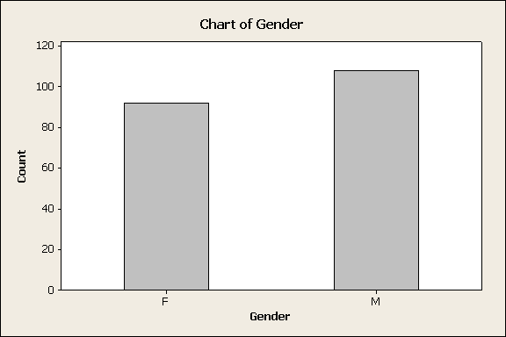
Bar Chart - Gender

Slide 47
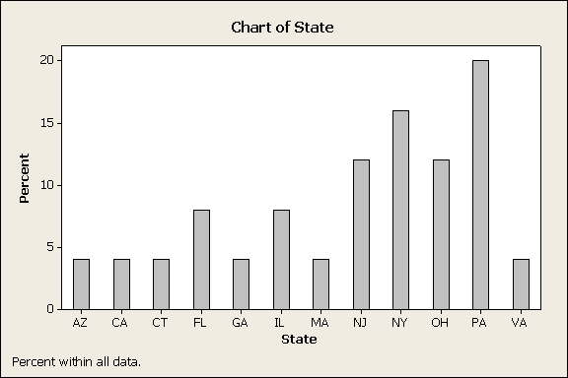
Bar Chart - State

Slide 48
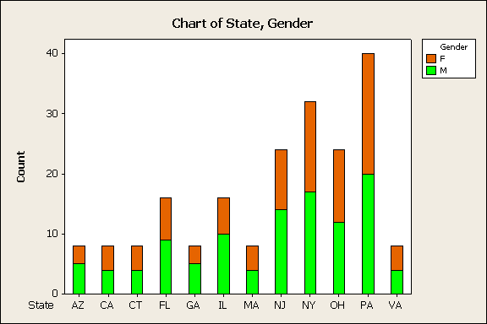
Bar Chart – State & Gender

Slide 49
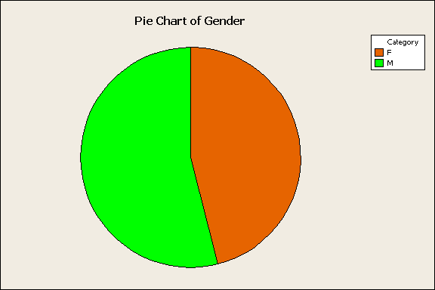
Pie Chart - Gender

Slide 50
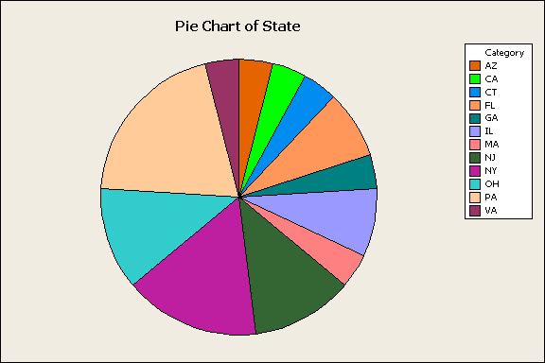
Pie Chart - State

Slide 51
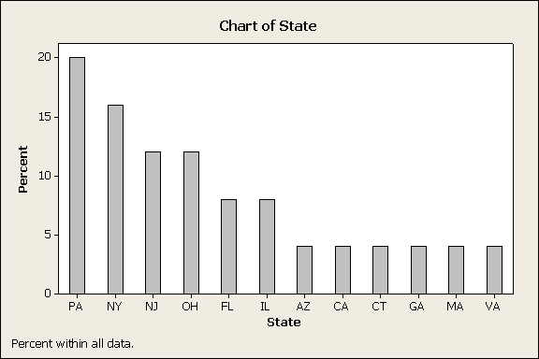
Pareto Diagram

Slide 52
Quantitative Data
Dot Plot
Histogram
  Total
  Relative Frequencies
Stem and Leaf
Ogive (o-jive)
Time Plot

Slide 53
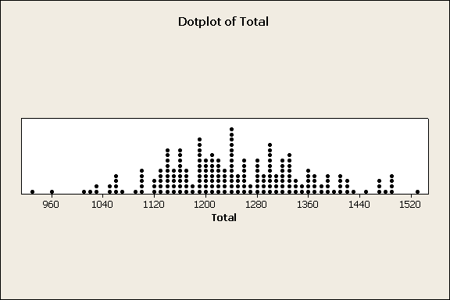
Dot Plot – Total SAT Score

Slide 54
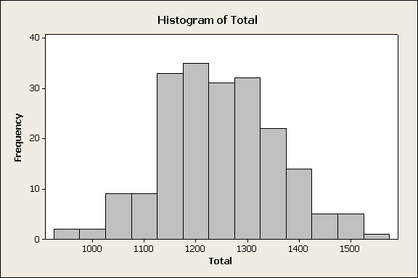
Histogram – Total SAT Score

Slide 55

Histogram – Total SAT Score (%)

Slide 56
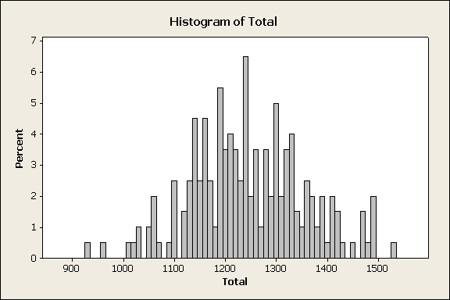
Histogram – Total SAT Score (%)

Slide 57
Histogram – Selecting Bins/Classes
Number of Observations | Number of Bins
Less than 25 | 5-6
25-50 | 7-14
More than 50 | 15-20

Slide 58
Histogram – Bin/Class Width
All bins must have the same width
Bin Width =
Largest – Smallest
# Bins

Slide 59
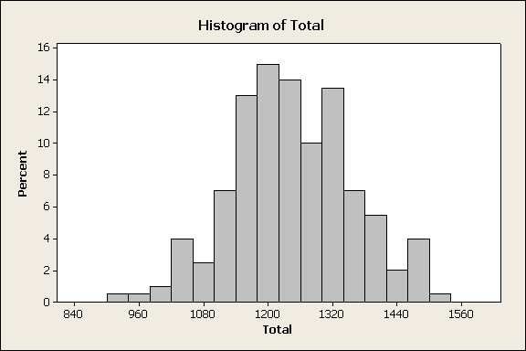
Histogram – Total SAT Score (%)

Slide 60
Stem and Leaf – Total SAT Score
Counts (left) - If the median value for the sample is included in a row, the count for that row is enclosed in parentheses. The values for rows above and below the median are cumulative. The count for a row above the median represents the total count for that row and the rows above it. The value for a row below the median represents the total count for that row and the rows below it.
Stem-and-Leaf Display: Total
Stem-and-leaf of Total N = 200
Leaf Unit = 10
1 9 2
2 9 6
8 10 013344
17 10 555579999
39 11 0011122333333344444444
73 11 5555666666667777778888888999999999
(38) 12 00000111111111222223333333333344444444
89 12 555566667777778888899999
65 13 000000000111222222222333333444
35 13 55556667777888899
18 14 000112224
9 14 67788899
1 15 2

Slide 61
Ogive – Total SAT Score

Slide 62
Measures of Central Tendency
Mean – “average”
Median – middle, if sorted; 50/50
Mode – most frequent

Slide 63
Mean
Sample Mean =
Population Mean = μ (mu)

Slide 64
Median
Sorted; half the values above, half below
If n is odd, the exact middle
if n is even, the mean of the 2 middle numbers

Slide 65
Mode
Most frequently occurring value
If no single value, data set does not have a mode

Slide 66
Mean, Median, Mode
1 1 1 3 6 6 7 10 15 15 (n=10)
Mean = 6.5 = (1+1+1+3+5+6+6+7+10+15+15) / 10
Median = 6 = (6+6)/2
Mode = 1

Slide 67
Skew
Distribution has more observations on one end or the other
  Right skew (more higher numbers)
  Left skew (more lower numbers)

Slide 68
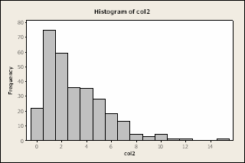
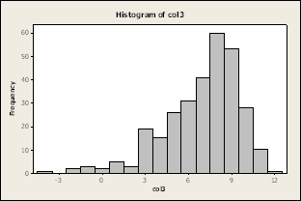
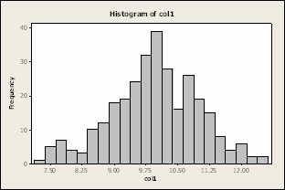
Mean/Median & Skew
Median < Mean – left skew
Median > Mean – right skew
Median = Mean – no skew

Slide 69
Measures of Variability
Range
  largest value – smallest value
Sample Variance (s²)
  Population variance (σ²)
Sample Standard Deviation (s)
  Population standard deviation (σ - sigma)
Coefficient of Variation

Slide 70
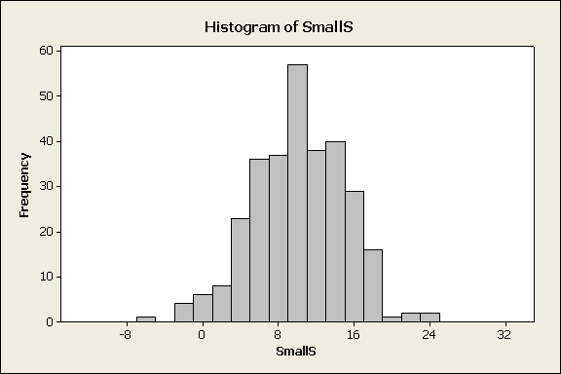
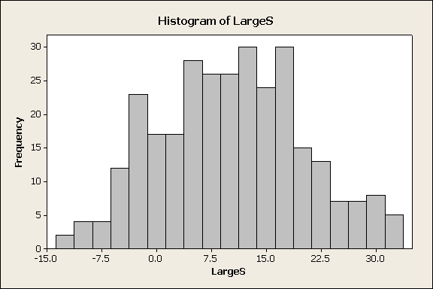
Using Standard Deviation
Standard deviation is measure of the “variability” of the data
  Small s – little variation
  Larger s – greater variation
Both: Mean ~10; Median ~10

Slide 71
Applying Standard Deviation
Chebyshev’s Rule
  any distribution
Empirical Rule
  standard, mound-shaped, symmetric only
  “normal” or normal-like

Slide 72
Chebyshev’s Rule
no useful information
at least 75% of data (3/4)
at least 89% of data (8/9)
For k>1, 1-1/k² observations
in the range: mean ± ks

Slide 73
Empirical Rule
at least 68% of data
at least 95% of data
at least 99.7% of data

Slide 74
Percentile
The percentile, p, for an observation is such that p% of the observations are at or below and (100-p)% are above
Median is 50th percentile

Slide 75
Quartiles
Split the data into 4 equal (in number) ranges
first quartile
second quartile
third quartile
fourth quartile
lowest value
Q1 25%
median Q2 50%
Q3 75%
highest value
interquartile range

Slide 76
Others Possible
Deciles (10%)
Quintiles (20%)
Percentiles (1%)
Less frequently used

Slide 77
Box-and-Whisker
Summarize data into 5 numbers:
  Lowest value
  Q1 (25%)
  Median (Q2)
  Q3 (75%)
  Highest value

Slide 78
Box-and-Whisker
Highest
Q3
Range of Values
Median (Q2)
Q1
Lowest

Slide 79
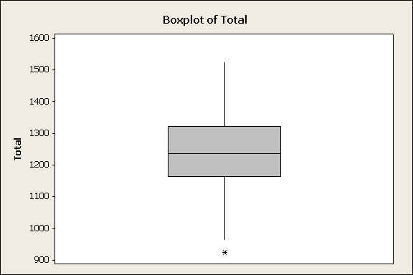
Total SAT Score

Slide 80
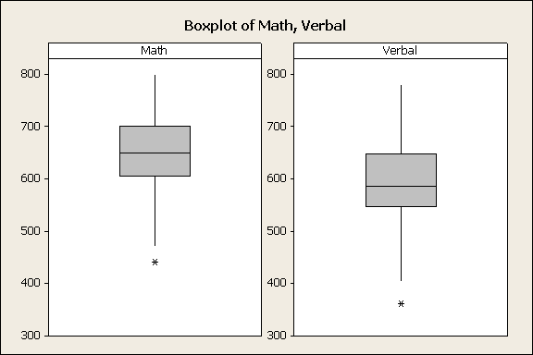
Math & Verbal

Slide 81
Why Box-and-Whisker?
Compare different data sets
Compare data from different categories
Beyond 5 numbers on 1 picture
  Symmetry
  Variance/Standard Deviation
  “Shape” of distribution

Slide 82
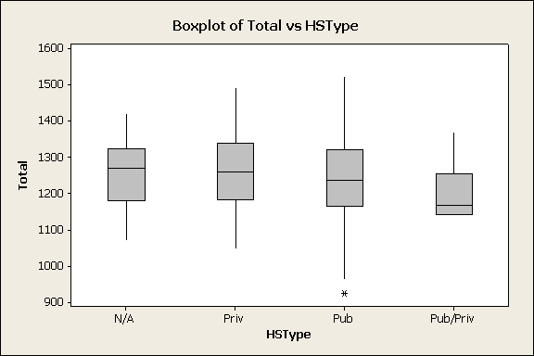
Total by High School
Outlier

Slide 83
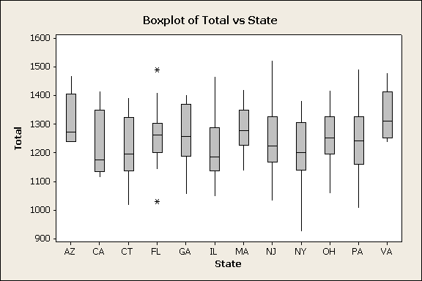
Total by State

