Slide 1
Critical Analysis and the International Symbol for Access
By: Kathryn Benoit, Occupational Therapist Student
Presentation structure and format was inspired by and adapted from Gail Teachman, Yani Hamdani, and Jennifer Johannesen’s lecture Introduction to Critical Analysis: A Focus on Children’s Rehabilitation
Notes:
Disclaimer: Many of the ideas in the script came from discussions generated during the presentation at IDRC, the Gail Teachman, Yani Hamdani, and Jennifer Johannesen’s lecture, and could have been inspired by general discussions with others around disability and health. Comments do not reflect my personal beliefs or the beliefs of the others mentioned, but are meant to generate a discussion and consider multiple view points.

Slide 2
https://www.youtube.com/watch?v=Ux2gvuzkwOw
Notes:
[Ayham Abu Hammad]. (2011, June 6). Look at me not my disability [Video File]. Retrieved
from https://www.youtube.com/watch?v=Ux2gvuzkwOw

Slide 3
Initial Reactions and Observations?
What is the message that this ad is sending?
Who is the target audience?
Do you feel that it this was an effective way express their message and reach the target audience?
Other observations?
Notes:
What message this video is trying to send?
that people with disabilities aren’t different
We should be less focused on the disability, and more focused on the person (underlining belief that abled bodied people are most focused on a person’s disabilities rather than abilities)
Who is the target audience?
Did you feel that this video was effective at getting across this message?

Slide 4
What is Critical Analysis
“The ability to recognize taken-for-granted assumptions and their effects.”
(Nixon et al., 2016)
Why is this so difficult?
Notes:
CA is about recognizing implicit assumptions and their effects
Going beyond the intended purpose of the message
it is not the same as being negative

Slide 5
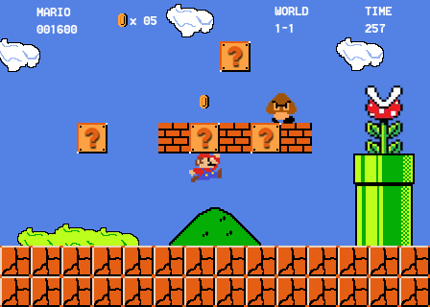
(Ultra Gamer, 2017)
Notes:
Ultra Gamer. (2017). CKPNHIIIOTbI. Retrieved from https://ultragamer.net/catalog/dendy/dendy-mario-60-in-1-8-bit/
Often it is difficult to be critical because our thoughts, opinions, and ideas are shaped by our experiences, other people, our knowledge, and the environment. And so it is only unstill someone questions you, or your experience something that makes you question things that we really begin to critically think.
Analogy: Mario in his Mushroom Kingdom. Where he explores and once in a while comes across a “question” but typically not much changes. This tends to be our default.

Slide 6
Why is this important?
It leads to change
It helps us appreciate others perspectives
Helps to identify taken-for-granted assumptions
(Nixon et al., 2016)
Notes:
AODA: leads to legislation changes
It is important because there are societal barriers in place promoting inequality

Slide 7
7-Step Framework
1. Name the aspect of practice being analyzed
2. Identify the intended purpose of this practice
3. Uncover the assumptions that support these purposes
4. Identify who benefits
5. Identify who is disadvantaged
6. Link specific ideas to societal-level patterns
7. Consider alternatives that mitigate actual or potential harms
(Nixon et al., 2016) & (Teachman, Hamdani, & Johannesen, 2016)
Notes:
-based on critical theory

Slide 8
https://www.youtube.com/watch?v=78mNZeDaMtk
Notes:
[SickKids]. (2016, October 14). SickKids vs: Undeniable [Video File]. Retrieved from https://www.youtube.com/watch?v=78mNZeDaMtk

Slide 9
1. Name the aspect of practice being analyzed
What is the topic of interest being analyzed?
What are the main concepts present?
(Nixon et al., 2016) & (Teachman, Hamdani, & Johannesen, 2016)
Notes:
What are the main concepts or ideas present in this ad?
WHO VS WHAT?
Vs disease/illness
Vs time
Vs worry/missing home (and then emotions people experience)

Slide 10
2. Identify the intended purpose
What is the main goal or purpose?
What messages are being communicated about this purpose?
Does the format that this message is displayed in help provide insight into the purpose? (e.g. ads, symbol/picture, video, and words)
(Nixon et al., 2016) & (Teachman, Hamdani, & Johannesen, 2016)
Notes:
Who is the target audience?
To raise money, developed as a fund raising campaign
Tap into people’s emotions, make them believe that this is a “fight” worth supporting
What is this message sending to children which health conditions and their families?
Telling donors that because of their donation, a child is able to continue in their fight
Emphasis on the illness and its effects rather then the person
Focused on the big fights (life/death); not the smaller challenges people face daily
Illness/health conditions need to be cured
Healing can only happen if western medical technology is involved
Biomedical model on health

Slide 11
3. Uncover the assumptions that support these purposes
Think about the intended purposes (step 2) and consider what assumptions support this message?
What norms, values, or beliefs would need to be accepted in order for the message to be clear?
Begin to reflect critically.
(Nixon et al., 2016) & (Teachman, Hamdani, & Johannesen, 2016)
Notes:
What assumptions would people have that would make them more likely to donate to Sick Kids?
Death is an unacceptable in the child population
Illness are bad and needs to be cured. What about autism? Does it need a cure?
Without western medical services these children would not heal and would lose their fight
What assumptions about time did it imply?
We are in a battle against time, all health care is urgent
What other assumptions about disability, health, and illness were implied?
Communicates that the abled body is normal (girl when her cast bursts off her arm)
Assumes that we shouldn’t need assistive devices and that you cant live a happy healthy life with them
What assumptions were made around what it means to be a fighter
Need courage and bravery
Fighting is desirable
A “winner” should not need medical care
What about the parent role?
Parents are passive when it comes care and support of their sick children, it is really just the health care professionals (only really showed parents crying outside the room)
Parents are there only to love their child

Slide 12
4. Identify who benefits
What groups or practices are represented and supported?
Does the message empower the people it is supporting?
What are the expected benefits?
(Nixon et al., 2016) & (Teachman, Hamdani, & Johannesen, 2016)
Notes:
Fundamentally the hospital (through donations) and by extension the health care workers and patients
Who is empowered or supported by this ad?
Those individuals and families who identify and see themselves in a fight against time/and their illness
The children in the ad during the making process
Those individuals who made the ad
Donors who feel that they have done their part through donating

Slide 13
5. Identify who is disadvantaged
What groups are not supported, portrayed negatively, or excluded?
What messages are being communicated about these groups?
Who or what is disadvantaged?
(Nixon et al., 2016) & (Teachman, Hamdani, & Johannesen, 2016)
Notes:
-think about what groups are made impossible: ex: living happily with a health illness
What about people who cannot overcome their diagnosis? Autism
Children and families who don’t see themselves in a fight against their health condition
Those who see themselves are learning to live with their disability rather than trying to overcome or cure it
Tells children that if they don’t feel like they are in a battle then something is wrong (for kids who never even considered that their illness is something that they should be trying to overcome, maybe they never had that thought or perspective before)
What about children who are not healing despite medical treatment?
Tells children that if they aren’t improving then they are not successful
If you are not getting better then you are weak; need to fight harder
What groups of children were not represented here?
Children who are living happily with their health conditions

Slide 14
6. Link specific ideas to societal-level patterns
What inequities are unintentionally present or communicated through this message?
Think broadly on a societal level.
(Nixon et al., 2016) & (Teachman, Hamdani, & Johannesen, 2016)
Notes:
-the focus is not on individuals but on society and the norms that exist
-health care: no age of consent, expect for MAID
What does society typically say about children’s autonomy? How does this ad support that?
Society needs to help children, because they are unable to help themselves (pity)
OR
Children should be admired when they are battling illnesses
What is society’s view on illness present in this ad?
Biomedical model
Disability/illness needs to be overcome (promoting ableism)

Slide 15
7. Consider alternatives that mitigate actual or potential harms
Reflect on other ways this message could be communicated.
What changes can be made to help eliminate the reproduction of inequities
In this step, action is taken.
(Nixon et al., 2016) & (Teachman, Hamdani, & Johannesen, 2016)
Notes:
What are alternative approaches?
Show children who are living a happy life with their disability
Show the family in a more active role
Have the children explain their journey and how they fought/are fighting, so it shows that not everyone has to fight, but that this could be a common shared experience

Slide 16
Sick Kids Response
“The fight metaphor at core is not meant to claim that every kid should be a fighter, but rather that at SickKids we’re fighting for every kid.”
(SickKids, 2016)

Slide 17
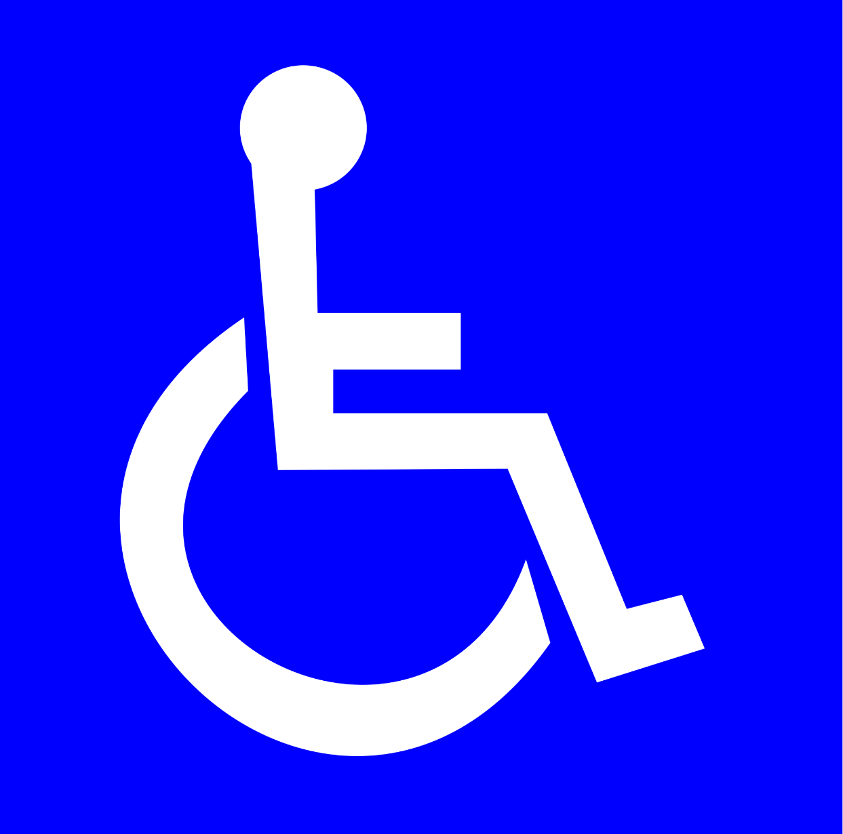
International Symbol of Access
(Jacklau96, 2015)
Notes:
Where do we commonly see this symbol:
Restaurant tables
Washrooms
Movie theaters
Parking lots
Subway, and other forms of transit
Elevators
Entrance ways
And more…

Slide 18
Evolution of the International Symbol of Access
Created out of the need for consistency
Chosen by the International Commission on Technology and Accessibility
Simple, without words, and could be seen from a distance
(Leotta, 2017)

Slide 19
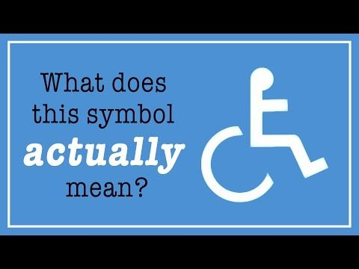
https://www.youtube.com/watch?v=ppNYZq-hYTw
(Treharne, 2017)
Notes:
Treharne, A. [TED-Ed]. (2017, January 5). What does this symbol actually mean? [Video File]. Retrieved from https://www.youtube.com/watch?v=ppNYZq-hYTw

Slide 20
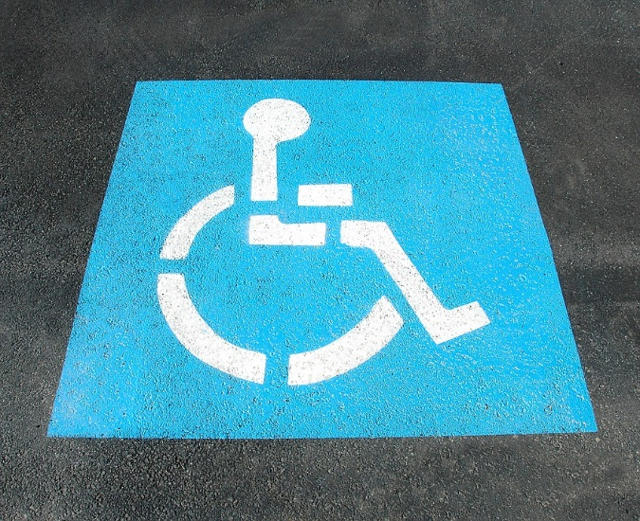
1. Name the aspect of practice being analyzed
What is the topic of interest being analyzed?
What are the main concepts present?
(Free Great Picture, 2016)
(Nixon et al., 2016) & (Teachman, Hamdani, & Johannesen, 2016)
Notes:
International Symbol of Access

Slide 21
2. Identify the intended purpose
What is the main goal or purpose?
What messages are being communicated about this purpose?
Does the format that this message is displayed in help provide insight into the purpose? (e.g. ads, symbol/picture, video, and words)
(Nixon et al., 2016) & (Teachman, Hamdani, & Johannesen, 2016)
Notes:
Who is this intended to help?
People with physical and/or mobility impairments + anyone with a disability
It’s a symbol: can be identified by people of all ages, cultural, literacy levels (universal)
How does it help?
Helps people locate accessible facilities and makes these more visible
Context clues help people determine what services are accessible (e.g. washrooms vs parking lot)
The position of the figure should actually indicate the direction of the accessible facility, (Left or Right)

Slide 22
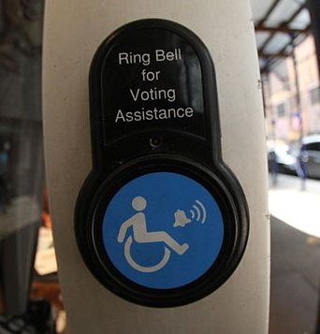
3. Uncover the assumptions that support these purposes
Think about the intended purposes (step 2) and consider what assumptions support this message?
What norms, values, or beliefs would need to be accepted in order for the message to be clear?
Begin to reflect critically.
(Javier Robles, 2013)
(Nixon et al., 2016) & (Teachman, Hamdani, & Johannesen, 2016)
Notes:
To understand how to use this symbol, what assumptions do we need to make? Or generally are made?
Takes for granted that the abled body is normal, and that accessibility is “other”
People who need accommodations have physical disabilities only, and are most likely to be in
That you can’t have a wheelchair and be able to walk stairs or sit in a normal booth at a restaurant (That people with w/c’s are confined to them)

Slide 23
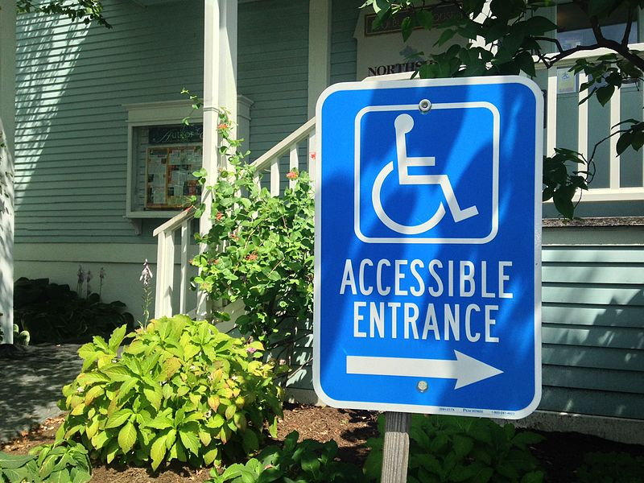
4. Identify who benefits
What groups or practices are represented and supported?
Does the message empower the people it is supporting?
What are the expected benefits?
(Nixon et al., 2016) & (Teachman, Hamdani, & Johannesen, 2016)
(MarkBuckawicki, 2015)
Notes:
What groups are represented or supported?
Those in w/c’s, their caregivers, and family members
Anyone with a physical impairment, and often those with other impairments as well
People with strollers, carts, luggage, carrying heavy items, or large bulky items
How does this symbol work to eliminate stigma?
Acknowledges the importance of universal access

Slide 24
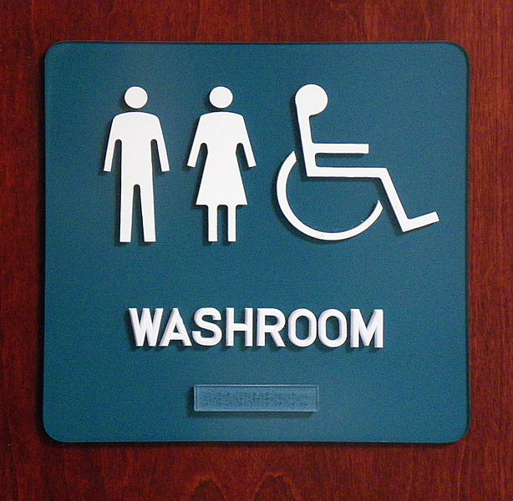
5. Identify who is disadvantaged
What groups are not supported, portrayed negatively, or excluded?
What messages are being communicated about these groups?
Who or what is disadvantaged?
(Gloggera, 2008)
(Nixon et al., 2016) & (Teachman, Hamdani, & Johannesen, 2016)
Notes:
What are the potential unintended consequences?
Those with invisible disabilities may feel more stigma and discrimination
They may question if they can use accessible features if they don’t have a physical disability or visible disability (chronic pain, fatigue, parents with strollers)

Slide 25
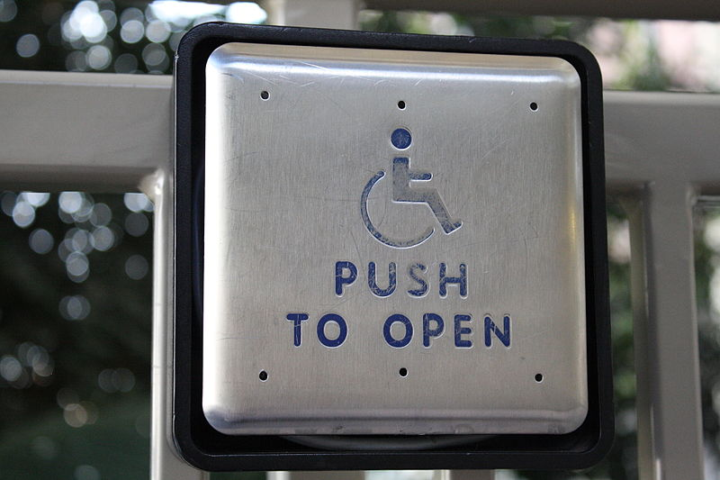
6. Link specific ideas to societal-level patterns
What inequities are unintentionally present or communicated through this message?
Think broadly on a societal level.
(Wheeler Cowperthwaite, 2011)
(Nixon et al., 2016) & (Teachman, Hamdani, & Johannesen, 2016)
Notes:
How is the biomedical model represented in this symbol?
The focus is on biological processes: the person’s body is what is preventing them from accessing services; not the environment creating barriers
Reinforces ableism: society is built for people without physical or other impairments
What about the idea of disability on a whole?
disability is something that can be seen

Slide 26
7. Consider alternatives that mitigate actual or potential harms
Reflect on other ways this message could be communicated.
What changes can be made to help eliminate the reproduction of inequities?
In this step, action is taken.
(Nixon et al., 2016) & (Teachman, Hamdani, & Johannesen, 2016)
Notes:
What are alternative designs could we have to represent accessibility?
OR what should this symbol include?
Do we need multiple signs to represent accessibility in different places? (pros and cons)
Social model of disability: Structures in society create barriers and decrease independence
New symbol: focus more on the environment, and not on the person
Ex: a symbol of a pillar “a pillar could represent the idea of support, meaning that there are supportive/accessible services available”

Slide 27
Application to Research and Technology/ Take Home Messages
It is important to be aware of the implicit messages that we are communicating
When creating and designing services, ensure to consider everyone who benefits
Keep the focus on the service and what it offers, rather on the person and their limitations
Notes:
Be cognisant of the images and ways things are portrayed, think about unintended messages it might be communicating to different populations

Slide 28
Thank you!

Slide 29
Resources
Aimi, H. (2016) Universal design and the problem of “post-disability” ideology, design and culture, 8(3), 285-309. doi: 10.1080/17547075.2016.1218714
[Ayham Abu Hammad]. (2011, June 6). Look at me not my disability [Video File]. Retrieved from https://www.youtube.com/watch?v=Ux2gvuzkwOw
Domínguez, T., Alén, E. & Fraiz, J. (2012). International accessibility: A proposal for a system of symbols for people with disabilities. International Journal on Disability and Human Development, 12(3), 235-243. doi:10.1515/ijdhd-2012-0102
Free Great Picture. (2016). Painted Disable Sign Street Handicap Parking. Retrieved from http://maxpixel.freegreatpicture.com/Painted-Disable-Sign-Street-Handicap-Parking-2328893
Glogger. (2008). File:Washroom pictogram sign with braille.jpg. Retrieved from https://commons.wikimedia.org/wiki/File:Washroom_pictogram_sign_with_braille.jpg
Jacklau96. (2015). File: International symbol of access.svg. Retrieved from https://commons.wikimedia.org/wiki/File:International_Symbol_of_Access.svg
Javier Robles. (2013). File:Wheelchair Accessible Sign.JPG. Retrieved from https://commons.wikimedia.org/wiki/File:Wheelchair_Accessible_Sign.JPG
Leotta, J. (2017). Accessibility in motion. Retrieved from http://disability-marketing.com/2013/12/01/accessibility-in-motion/
MarkBuckawicki. (2015). File:Wheelchair ramp sign.jpg. Retrieved from https://commons.wikimedia.org/wiki/File:Wheelchair_ramp_sign_.jpg
Nixon, S. A., Yeung, E., Shaw, J. A., Kuper, A., & Gibson, B. E. (2016). Seven-step framework for critical analysis and its application in the field of physical therapy. Physical Therapy. doi: 10.2522/ptj.20160149
SickKids. (2016). SickKids VS campaign: A lot of buzz, thoughtful feedback and important discussion. Retrieved from http://www.sickkids.ca/AboutSickKids/Newsroom/Past-News/2016/SickKids-VS-campaign.html
[SickKids]. (2016, October 14). SickKids vs: Undeniable [Video File]. Retrieved from https://www.youtube.com/watch?v=78mNZeDaMtk
Teachman, G., Hamdani, Y., & Johannesen, J. (2016, January 10). Introduction to critical analysis: A focus on children’s rehabilitation. Lecture presented at University of Toronto, Toronto.
Treharne, A. [TED-Ed]. (2017, January 5). What does this symbol actually mean? [Video File]. Retrieved from https://www.youtube.com/watch?v=ppNYZq-hYTw
Ultra Gamer. (2017). CKPNHIIIOTbI. Retrieved from https://ultragamer.net/catalog/dendy/dendy-mario-60-in-1-8-bit/
Wheeler Cowperthwaite. (2011). File:Pushbutton door opener.jpg. Retrieved from https://commons.wikimedia.org/wiki/File:Pushbutton_door_opener.jpg

