Slide 1
Accessible Standardized Testing
Community Meeting. Feb 18, 2015

Slide 2
Devices for delivering tests
Laptops
Desktop computers
Touch screen tablets/surfaces
Abilities that impact the test outcome
Sound
Vision
Dexterity
Ability to spell correctly
Speedy response time (time management)

Slide 3
Standardized Testing Types
High Stake Tests (Including Summative Tests)
Low Stake Tests (Including Formative Tests)
Self Assessments

Slide 4
High Stake Tests
Evaluation of student’s learning by comparing it against some standard or benchmark e.g. University Entrance Exams.
Test Environment
Accessibility Issues
Class rooms, auditoriums
Public venues like libraries and examination centers
Controlled individual kiosks
Group auditions
Individual’s own setting
Time requirements (Automation issue)
Cognitive load and required efforts
Fatigue
Grouping arrangements
Use of earphones or headphones
Use of individual setting if response method distracts others
Glare from windows or overhead lights
Adaptive furniture
Test security

Slide 5
Low Stake Tests
Monitoring student learning to provide ongoing feedback e.g. class discussions.
Test Environment
Accessibility Issues
In classrooms
In groups
Tutoring sessions
Informal learning sessions
Providing equivalent content modalities and access mechanisms to enable students to participate in these feedback loops

Slide 6
Self Assessments
Evaluation of oneself or one's actions and attitudes, in particular, of one's performance at a job or learning task considered in relation to an objective standard.
Test Environment
Accessibility Issues
Individual’s own setting
At workplace
Flexible and adapted testing tools to match user's needs
Time requirements
Cognitive load

Slide 7
Challenges
Non-text test or exercise presented in text
Time extensions when the time limit is essential to the test
Detecting errors and auto suggestions when correct spelling is essential to the test
Multi-page text or enlarged text require great mental efforts and certain skills for navigation
Inability to see the entire problem on the screen
Use of an online calculator
Scripts for sign language scripts or screen readers sometimes reveal the response
Auto-updating information can be confusing
Familiarizing students with the test format before the exam deadline

Slide 8
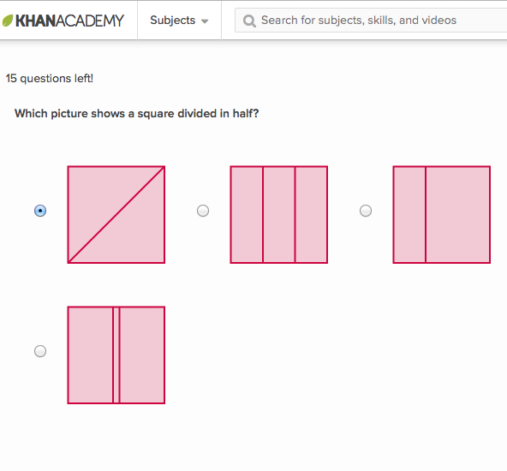
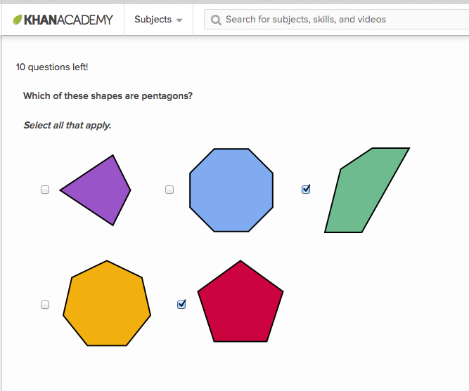
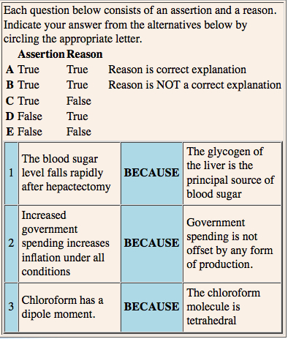
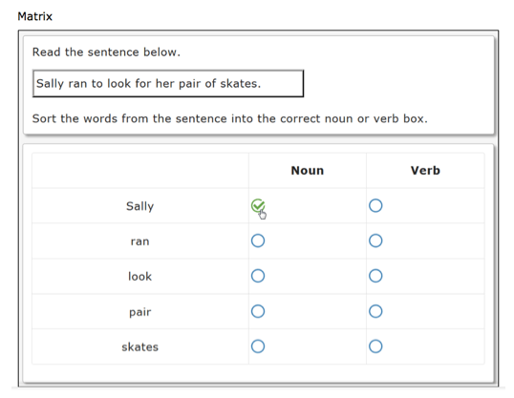
Testing Tools: Multiple Choice
Single Select
Multiple Select
True-False

Slide 9
Accessibility Issues
For students relying on text to speech:
Remembering a variety of spoken information can require considerable mental effort
Require longer time to acquire and digest information and recognize the subtle distinctions between choices.
Questions that address higher-order understanding rather than surface learning are very complex and can require numerous re-readings.
Use of visual elements makes it inaccessible visually impaired users
A dyslexic student may be unable to identify such subtle distinctions at all.
Progressing between options using the tab key (for students who cannot use a mouse) can take up a great deal of additional time.

Slide 10
Alternative Methods
Provide a printed version or a braille transcription (if applicable)
Provide text-to-speech screen readers depending on the content
Provide different methods for selecting a response, such as mouse click, keyboard, touch screen, speech recognition, assistive devices to access the keyboard and select (e.g., mouth stick, head wand, one-and two-switch systems)
Provide an option for paper/pencil in addition to computer (e.g., scratch paper for solving problems, drafting ideas)
Avoid overly-complex answers, especially long lists with distinctions that can only be made by careful re-readings.
If using graphics, ensure that high-quality recorded descriptions are available for each graphic used or that a narrative is included with video clips to describe any action taking place.

Slide 11
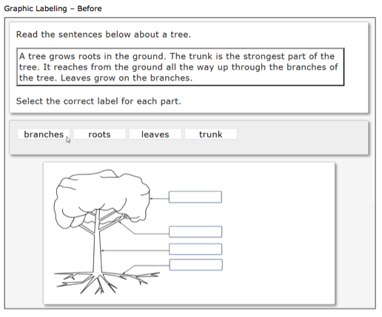
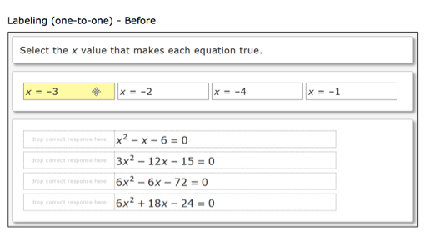
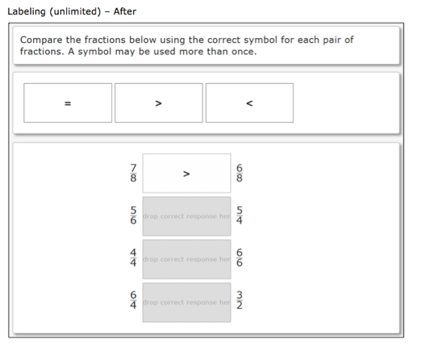
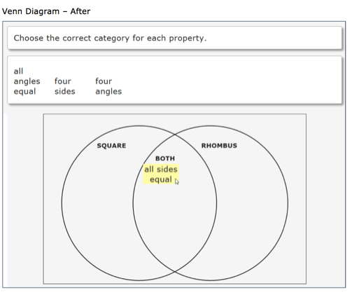
Testing Tools: Labeling
Graphic
One to One
Unlimited

Slide 12
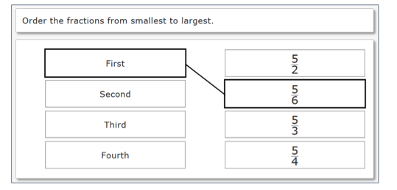
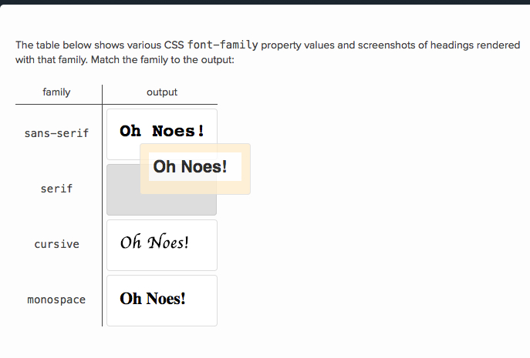
Testing Tools: Grouping/Ordering
Matching
Categorization
Ordering/Ranking

Slide 13
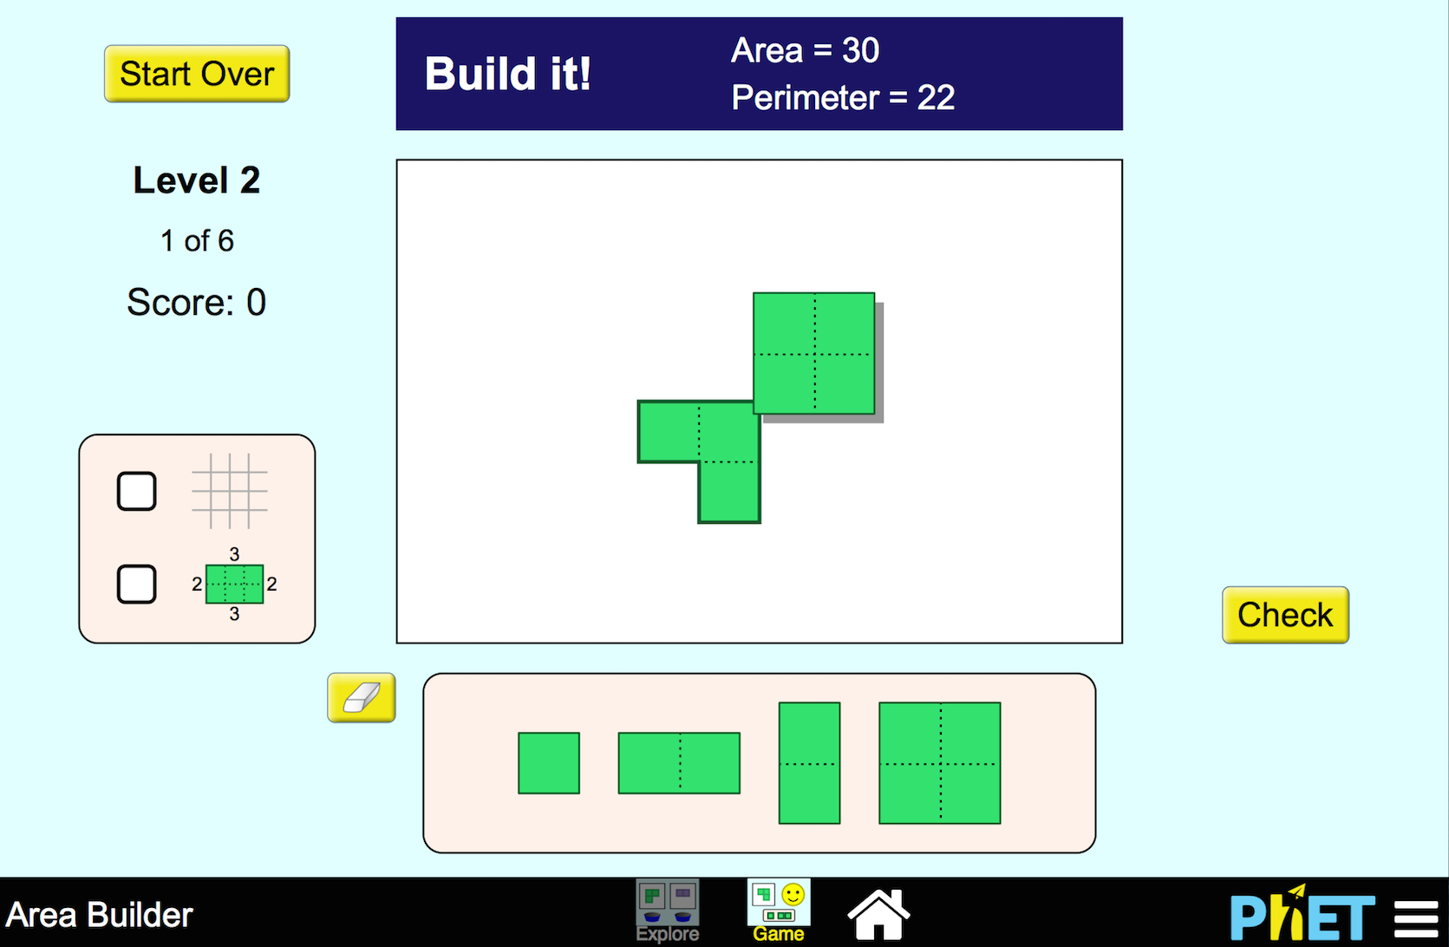
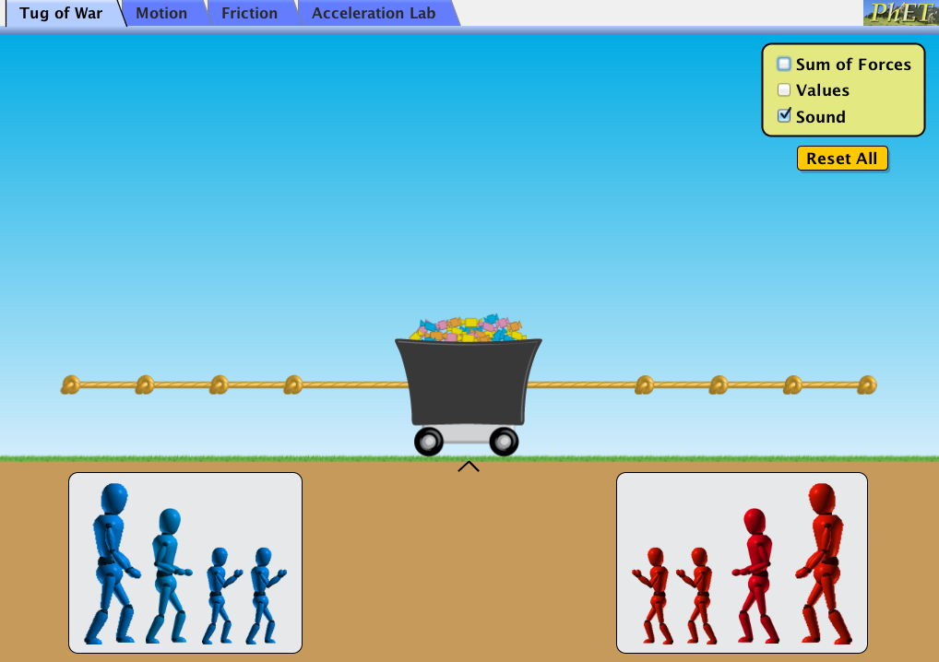
Testing Tools: Interactive
Interactive Items
Field Simulations

Slide 14
Accessibility Issues
Actions like dragging and dropping elements onscreen are inaccessible
Inaccessible to students who cannot see the screen or navigate with a mouse or touchscreen
Difficult to transcribe into braille or print
Difficult for text-to-speech screen readers
Inaccessible to switches

Slide 15
Alternative Methods
Replace those actions with radio buttons, matrix, or click to select interactions
Use of drop downs that is compatible with keyboards and switches
Include high-quality recorded descriptions for each graphic without disclosing the responses.

Slide 16
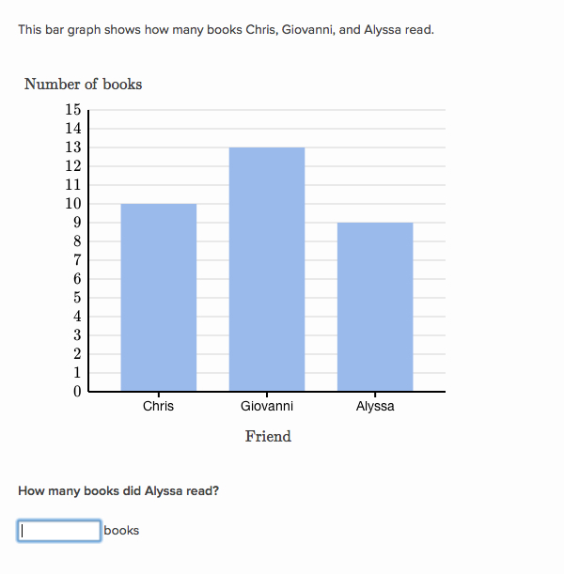
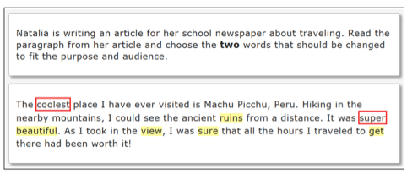
Testing Tools: Text Based
Constructed Response
Select Text
Essay Questions

Slide 17
Accessibility Issues
Implications of using the spell check when achievement in spelling is being measured as part of the writing process
Implications of using a screen reader when the construct being measured is reading
Difficult for students who do not use keyboard
Difficult for students who use speech recognition
For Essays, requires multiple re-readings to proofread and edit

