Slide 1
A11y assessment
Lisa Liskovoi

Slide 2
WCAG
POUR some accessibility sugar on me
Perceivable – Can I see it? Hear it? Feel it?
Operable – Can I scroll it? Fill it? Move it?
Understandable – Can I read it? Get it? Predict how it will behave?
Robust – Is it standard enough that it will it work with all my tools?

Slide 3
Perceivable
Key points:
Alternatives to non-text content
Captions
Info and Relationships

Slide 4
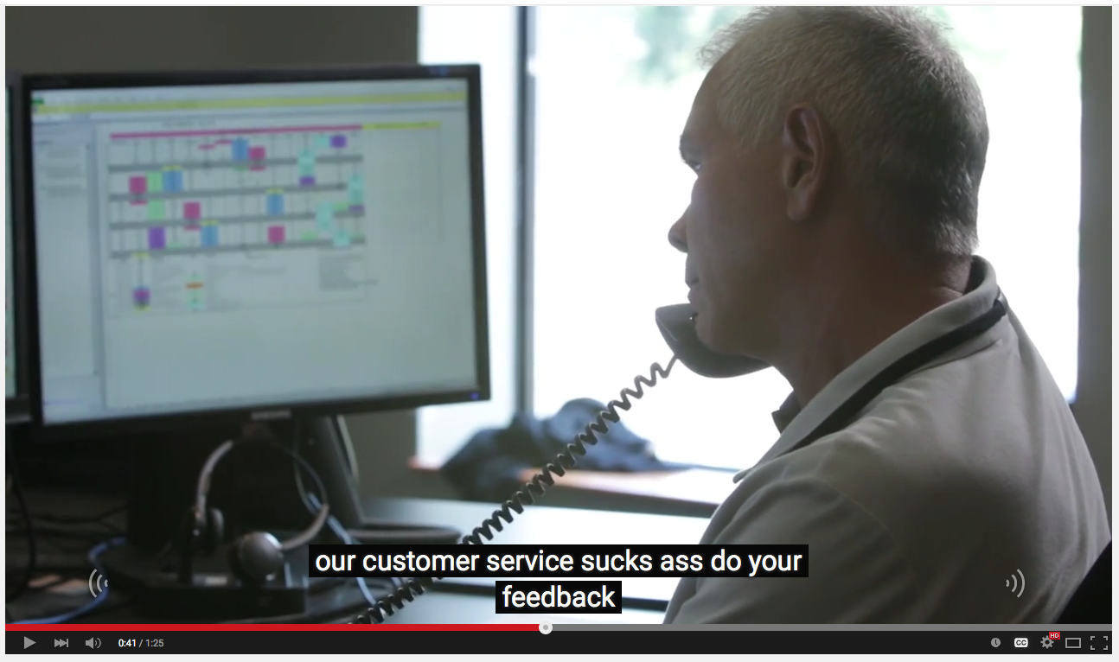

Slide 5
Info and Relationships
Headings
Tables
Form inputs
Navigation (dynamic content, show/hide toggles)
Modal dialog windows
Disabled/hidden content

Slide 6
Operable
Key points:
Keyboard navigation
Bypassing blocks of content
Focus – visibility, order
Link purpose
Multiple ways of finding content

Slide 7
Understnadable
Key points:
Consistent navigation/identification
Clear labels
Error identification/suggestion

Slide 8
Robust
Key points:
Validation check
Roles

Slide 9
A11y Assessment Process

Slide 10
A11y Assessment Process
General Assessment
Automated checks
Manual checks
Screen reader
Validation check
Notes:
General assessment: take note of potential issues and select content to review
Automated checks: identify issues that can be checked automatically
Manual checks: Interact with the site, especially areas of specific concern
Screen Reader: Go over areas with a screen reader.
Validation check: Run sample page through a validation check.

Slide 11
1. General Assessment
Contrast - light text on light backgrounds or dark text on dark backgrounds
Images – informative, decorative, icons, images of text, galleries
Text – areas that are hard to read, descriptive headings and labels, reading order, text presented as images
Forms – searches, contact and login forms
Dynamic content - sliders, drop-down navigations, show/hide content toggles
Tables – are they data tables (rows and columns all have meaning) or only used for on-screen layout.
Audio or video content – the players, media alternatives
Interactive features that may be difficult to use with a keyboard such as calendars or flash elements
Linked files - such as PDF or Word documents
Notes:
Go through the site and take note of content.
Sample pages that represent the full range of content.

Slide 12
2. Automated checks
Achecker
HTML CodeSniffer
WebAIM WAVE Add-In
Notes:
Achecker: A web based HTML accessibility checking service.
HTML Code Sniffer: browser extension that will report accessibility issues in a small pop-up window.

Slide 13
3. Manual Tools
Headings Map
TPG Colour Contrast Analyzer
Zoom Text
Firebug/Web Inspector
Keyboard

Slide 14
4. Screen Reader
VoiceOver (free)
NVDA (free)
Chromevox
JAWS
Notes:
More expensive screen readers will often be more forgiving, for example, JAWS will often make up for a site’s shortcomings. so free screen readers tend to be better for testing

Slide 15
5. Validation check
W3C Nu HTML Checker

